Slide 1
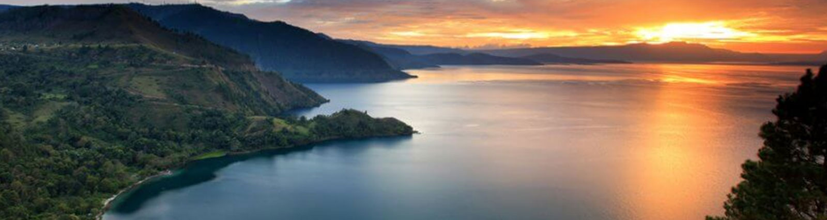

The Relative Strength of Water Tenure Security for Oil Palm and Hydropower: A Preliminary Study
ASEAN International Conference on Energy and Environment
Phnom Penh, Cambodia
14-15 September 2022
Mohamad Mova AlAfghani (Presenting)
Budi Susetyo
Universitas Ibn Khaldun Bogor

Slide 2
Conceptual Frameworks
Water Tenure: “…the relationship, whether legally or customarily defined, between people, as individuals or groups, with respect to water resources” (Hodgson, 2016);
Tenure Security (proposed definition): Defeasibility and defensibility of a particular tenure, both sociologically (de facto) and legally (de jure)

Slide 3
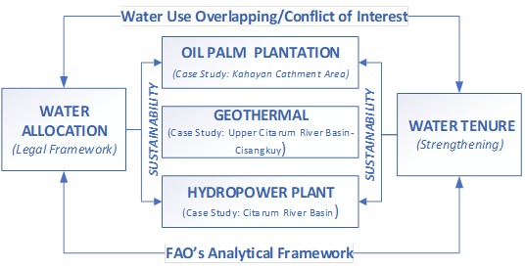
Methodology
FAO’s Analytical Framework (Adjusted)
Water Tenure fiches
Mapping Tenure Against Uses
Legal Analysis of the Allocation Framework Against Tenure
Analysis of Tenure Security

Slide 4

Findings

Slide 5
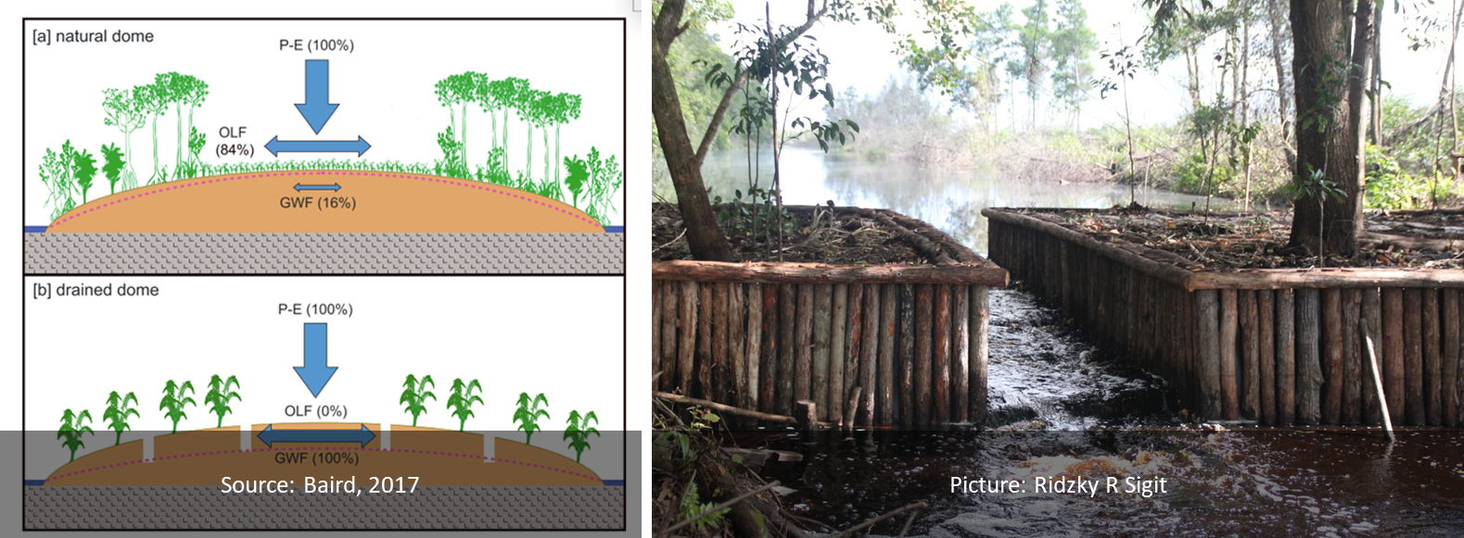
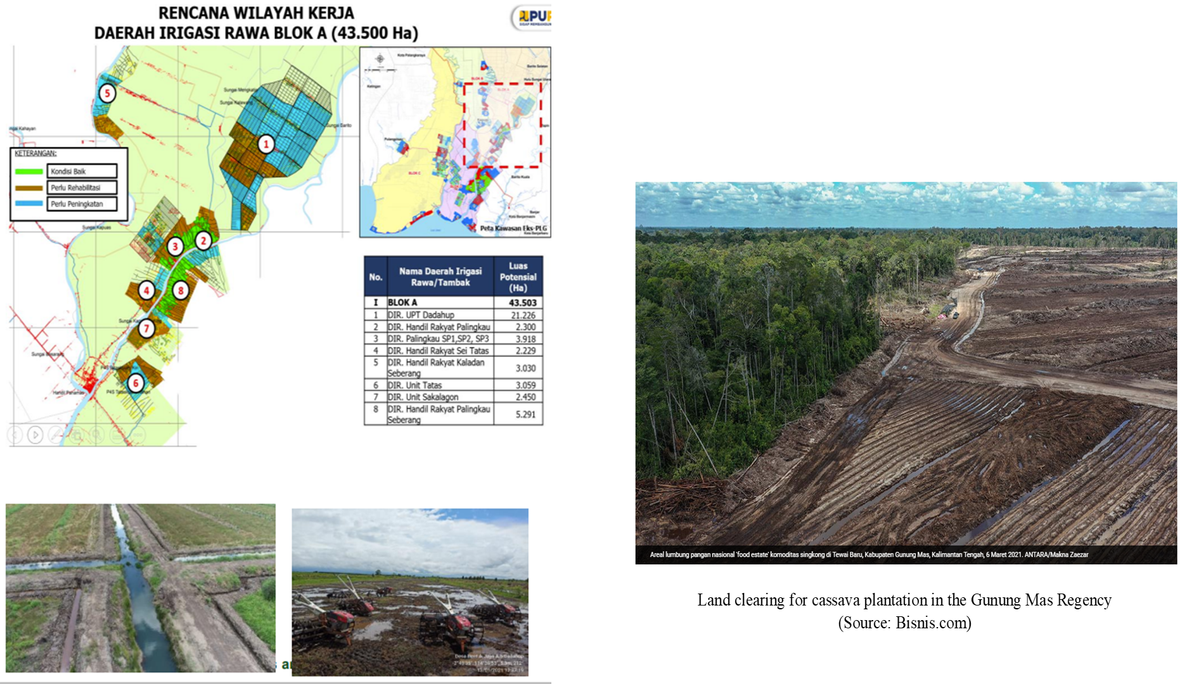
Kahayan Catchment 1: Food Estate and Conservation
Presentation by Coordinating Minister for Maritime and Investment on Integrated Food, May 24, 2022
Damaged peatland has to be restored (per regulation). Definition of “Damaged”: Conservation peatland : artificial drainage has been constructed Cultivation peatland: water table depth > 40 cm --> Produce Competition

Slide 6
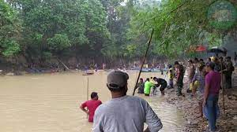
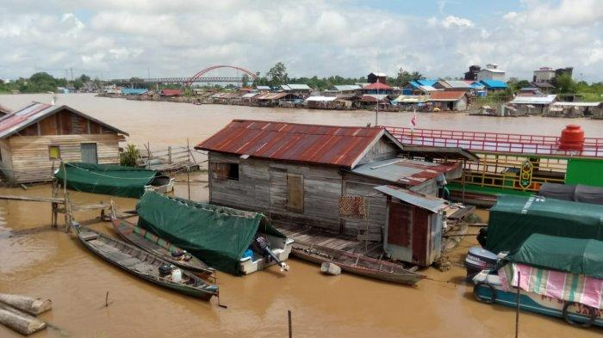
Customary Water Use
Kahayan Catchment 2: Customary Water Use
(Source: Lubis, et.al; Satia et.al; Subahani; Octora, et.al)
Lexicon | Explanation
Handil | According to Lubis, it is used to denote three things : “a) a manmade navigable canal connecting a river to farmland; b) fields around the canal under collective management; c) the system of collective management of the fields and canals”.
Tatas | manmade channels (approximately 1 × 1 m), dug to give access to forest resources (Lubis, et.al). Anyone can build a new tatas, extending on existing ones. Owners of the tatas are entitled to levy some percentage of the value of the forest product that is carried through their tatas. tatas are controlled by either individuals or families. Owners of the tatas and their family is allowed to extract resources around the tatas, usually up to 500 meters on both sides of the tatas.
Beje | Manmade small pond in the swamp area. Beje, 25-250 meter square artificial pond were often dug by farmers oftentimes inside the peatland; fish will naturally seek for location with plenty of water during dry season, and thus they gather in Beje, which is then harvested by Farmers.
Tabat | Overflow dam, usually made of clay or wood
Baruh | Small pond in Peatland which is filled with water all year long, usually formed due to large trees which are uprooted. Fishing in the Baruh (Ngebaruhi) is also considered a free access.
Saka | Third order tributaries, usually a short and narrow creek. Satia et.al. notes that the owner of saka and Sungei can manage and supervise anyone conducting activities in their area. Other people can fish in the sungai only when they are connected by marriage to the owner of the sungai/saka.
Pukung Pahewan | Protected area, could be on land or peatland or water bodies. According to Satia,et.al, the area is considered to be controlled by mythological creatures which guards the area from destruction. According to custom, not only the forest or the trees are protected, but also all animals, plants and other being within the protected zone.
Menuba
Lanting House

Slide 7
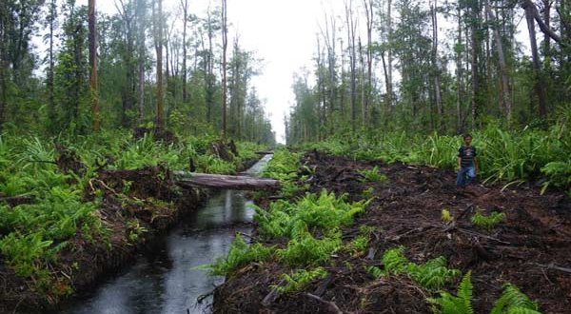
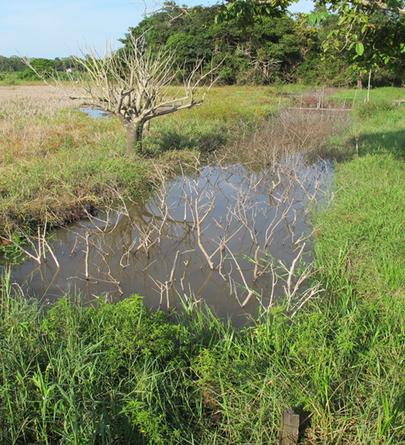
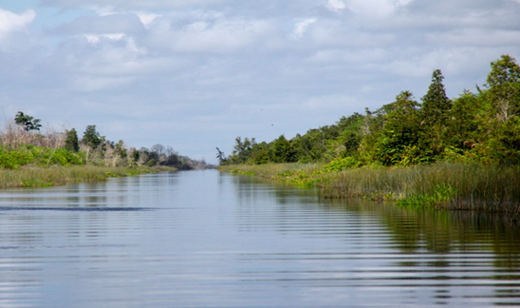
Kahayan Catchment 3 Customary Water Use
Beje
Handil
ERMP Kanal

Slide 8
Kahayan Catchment 4: Water Tenure and Water Use
 |  | A. Water supply |  |  | B. Agriculture |  |  |  |  |  | C. Industry | D. Power generation |  | E. Environment |  | F. Navigation | G. Livelihoods |  | H. Recreation /landscape
 |  | 1. Urban water supply | 2. Rural water supply (infrastructure) | 3. Unimproved sources | 1. Estate irrigation | 2. Public irrigation scheme | 3. Small-scale non-public irrigation | 4. River bank garden/flood recession | 5. Livestock watering | 6. Aquaculture | Commerce/industry | 1. Thermal | 2. Hydropower | 2. Diversion | 1. Stream flow & Retention |  | 1. Inland fishing | 2. Wetlands | 1 Instream use | 2 Other
Traditional formal water rights
Modern permit |  | X |  |  | X | X |  |  |  |  | X |  |  | X |  |  |  |  | X
Regulatory license
De minimis/small scale rights |  | X | X | X |  | X |  |  | X | X
Exempt/declared commercial rights
Agency control
Water supply contracts
Commonhold
Investment contracts
Reserves minimum flow |  |  |  |  |  |  |  |  |  |  |  |  |  |  | X
Customary tenure |  |  |  |  |  |  | X | X |  | X |  |  |  |  | X | X | X |  |  | X
Religious law
Informal |  | X | X |  |  |  |  |  |  | X |  |  |  |  |  |  |  |  | X
Assumed |  |  |  |  | X |  |  |  |  |  |  |  |  | X
Impossible
Unrecognized tenure

Slide 9
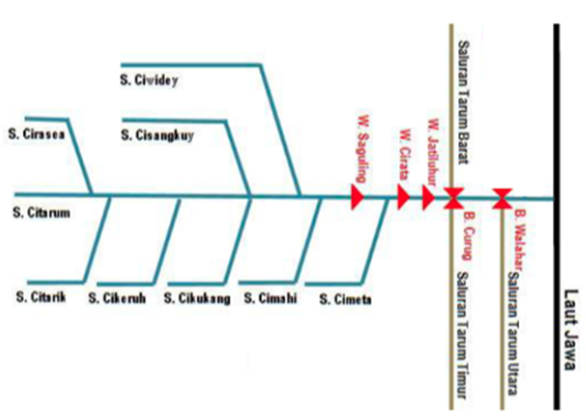
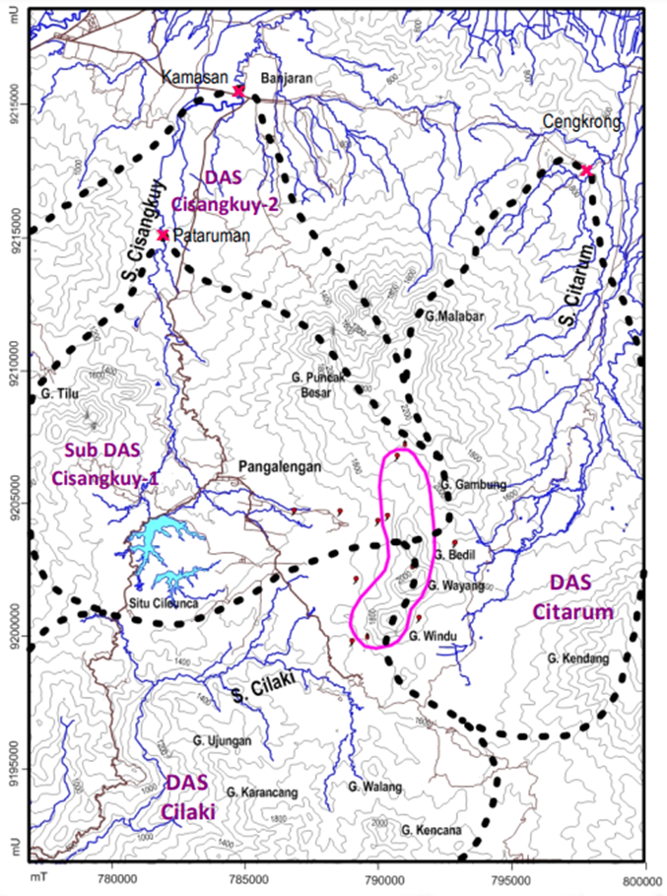
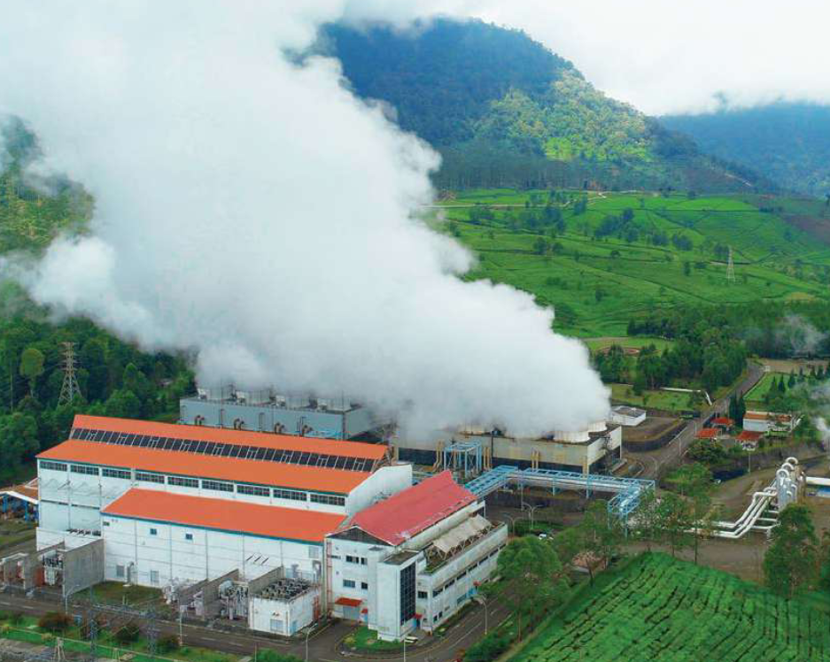
Citarum 1: Geothermal and Hydropower Locations
Source: Hendrasto, 2018
Star Geothermal, 2021
Source: BBWS, 2016

Slide 10
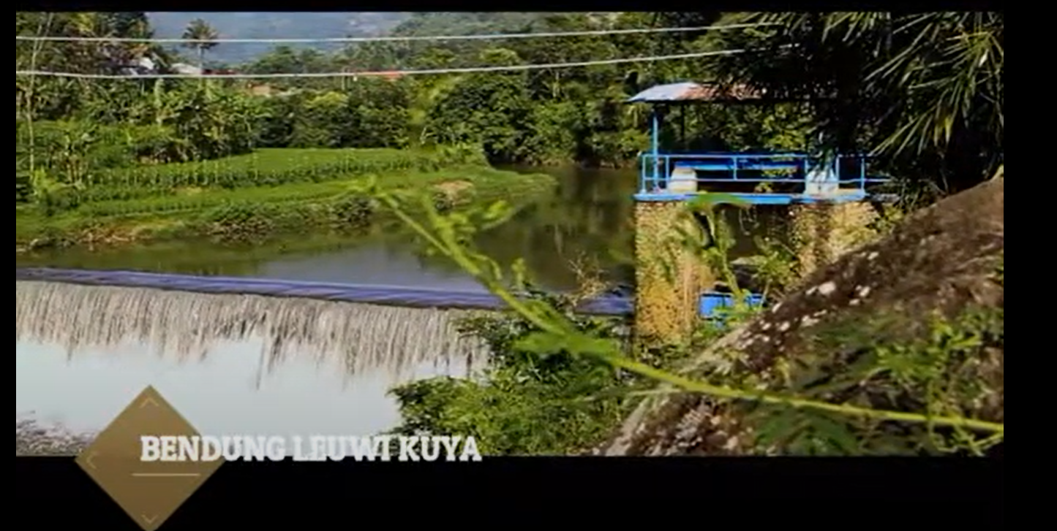
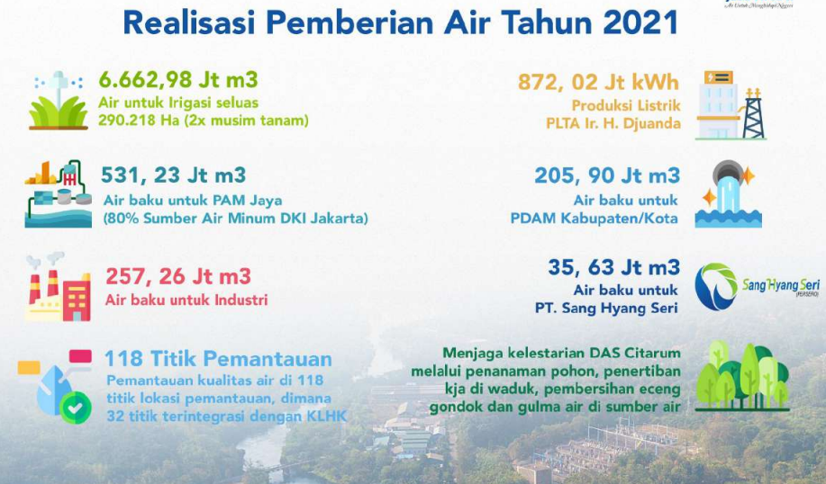
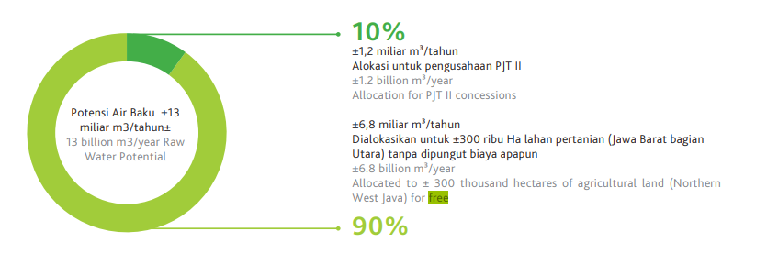
Citarum 2: Upstream Irrigation and PJT 2 Water Use
Significant Upstream Irrigation Area (both under Bandung Province). Leuwi Kuya Irrigation Area = 2357 ha; Cirasea = 2471 ha
PJT II 90% water use = irrigation = free
Annual Report, 2020

Slide 11
Citarum 3: Mapping Water Use
 |  | A. Water supply |  |  | B. Agriculture |  |  |  |  |  | C. Industry | D. Power generation |  | E. Environment |  | F. Navigation | G. Livelihoods |  | H. Recreation /landscape
 |  | 1. Urban water supply | 2. Rural water supply infra | 3. Unimproved sources | 1. Estate irrigation | 2. Public irrigation scheme | 3. Small-scale non-public irrigation | 4. River bank garden/flood recession | 5. Livestock watering | 6. Aquaculture | Commerce/industry | 1. Thermal | 2. Hydropower | 2. Diversion | 1. Stream flow & Retention |  | 1. Inland fishing | 2. Wetlands | 1 Instream use | 2 Other
Traditional formal water rights
Modern permit |  | X |  |  |  |  |  |  |  |  |  |  | X |  |  |  |  |  | X
Regulatory permits |  |  |  |  |  |  |  |  |  |  | X |  |  |  |  |  |  |  | X
De minimis/small scale rights |  |  |  |  |  | X
Exempt/declared commercial rights
Agency control |  |  |  |  |  |  |  |  |  |  |  |  |  | X
Water supply contracts |  | X
Commonhold
Investment contracts |  |  |  |  |  |  |  |  |  |  |  |  | X
Reserves minimum flow
Customary tenure
Religious law
Informal
Assumed |  |  |  |  |  |  |  |  |  |  |  | X |  |  |  |  |  |  | X
Impossible
Unrecognized tenure

Slide 12

Discussion

Slide 13
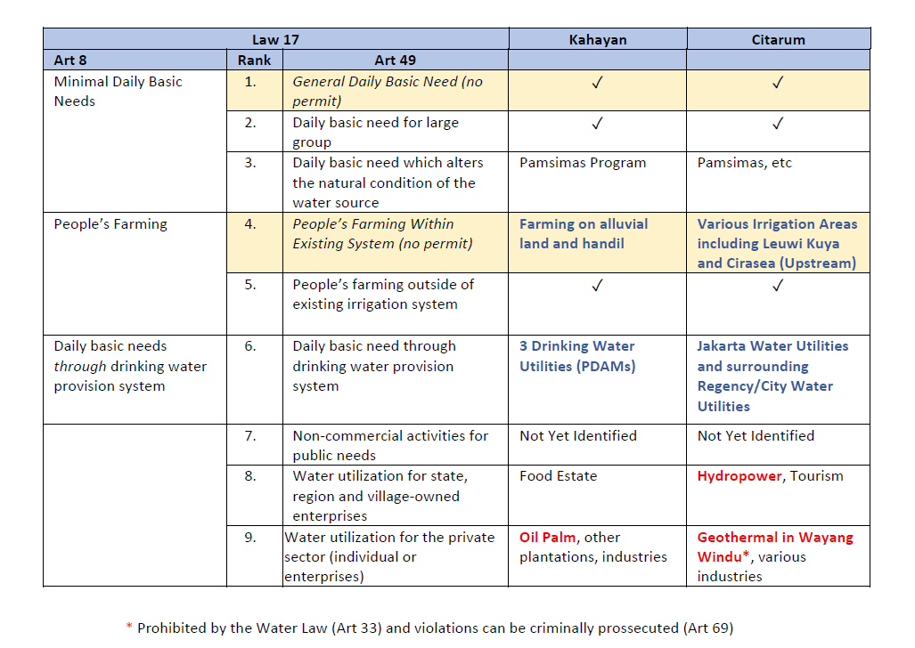
Discussion 1:
Applying Water Law’s Allocation Framework to Tenure
Low priority for allocation

Slide 14
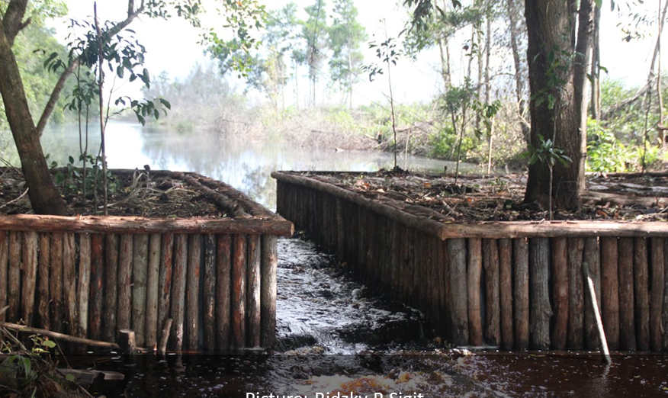
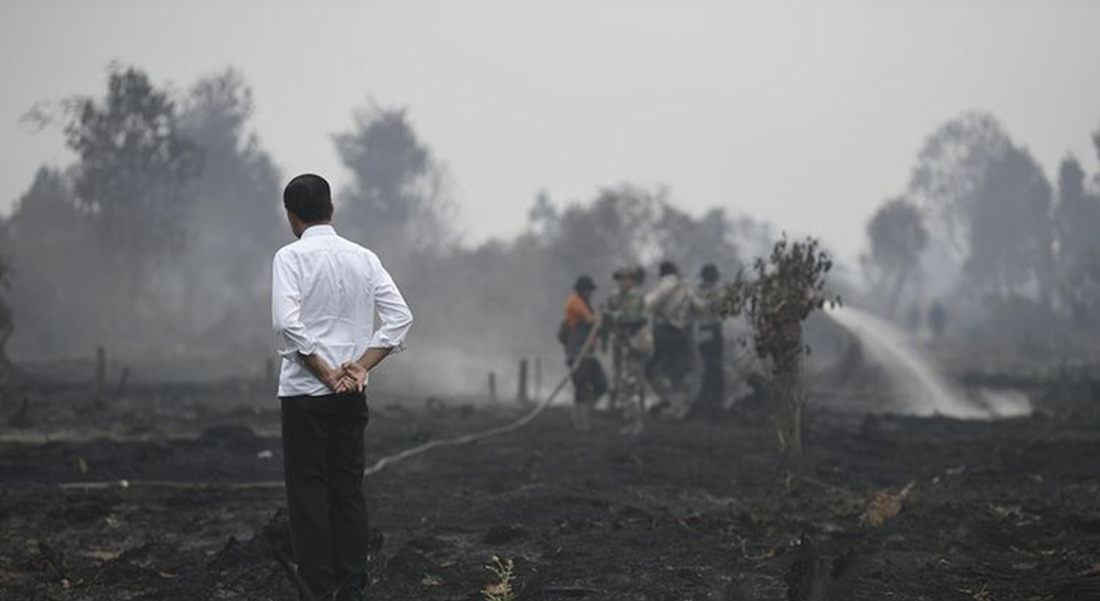
Discussion 2: Oil Palm
Prevention of forest fires through tabat regulation will prevail. The 40 cm regulation have been defended by Court. However, oil palm will only require 0-8% blue water, except for 9-years old oil palm in ultisol which require 25% blue water (Safitri et.al, 2018)

Slide 15

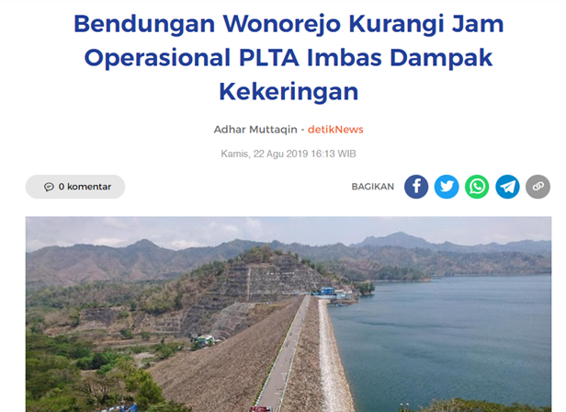


Discussion 3: Hydropower
Upstream irrigation area will have stronger powers both in terms of de jure (higher priority in the allocation framework) and de facto (the ability to control water flow downstream)
Downstream bulkwater supply for Jakarta Drinking Water utility have stronger de jure claims, but this only matters when diversion is required
Downstream irrigation area have strong de jure claims – especially since they are a part of national rice estate. They may require water volume to be release during drought
Source: BBWS, 2016
During drought, one hydropower in Eastern Java reduce operation from 24 hours/day to 8 hours per day

Slide 16
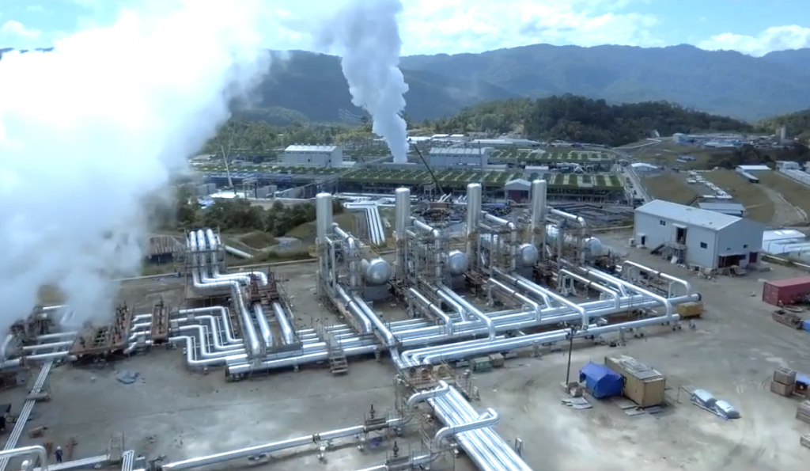
Discussion 4: Geothermal
Incoherent Regulatory Regimes
Illegal | Legal
Utilization of water in Conservation Area is prohibited, except for daily basic needs (Water Law, Article 33) | Still allowed under Forestry Regulation P.18/Menlhk/Setjen/Kum.1/4/2019. However the level of the regulation is low and thus cannot derogate the Water Law’s prohibition
Violators can be sentenced to imprisonment up to 6 years and IDR 10 billion fines

Slide 17
Conclusion: Tenure Strength
Weak
Medium
Strong
Hydropower
Geothermal
Oil Palm

Slide 18



Recommendations
Each hydropower, geothermal and oil palm companies should develop detailed analysis on their water tenure security and identify, adapt and/or mitigate their water risks
The Government of Indonesia should develop reallocation framework from water uses with lower economic productivity to water uses with higher economic productivity while incorporating equity and welfare considerations
Regulation needs to be coherent; either commercial utilization in conservation areas such as geothermal are prohibited or permitted with restrictions. This will require revision of the Water Law (could be done using omnibus method)

Slide 19
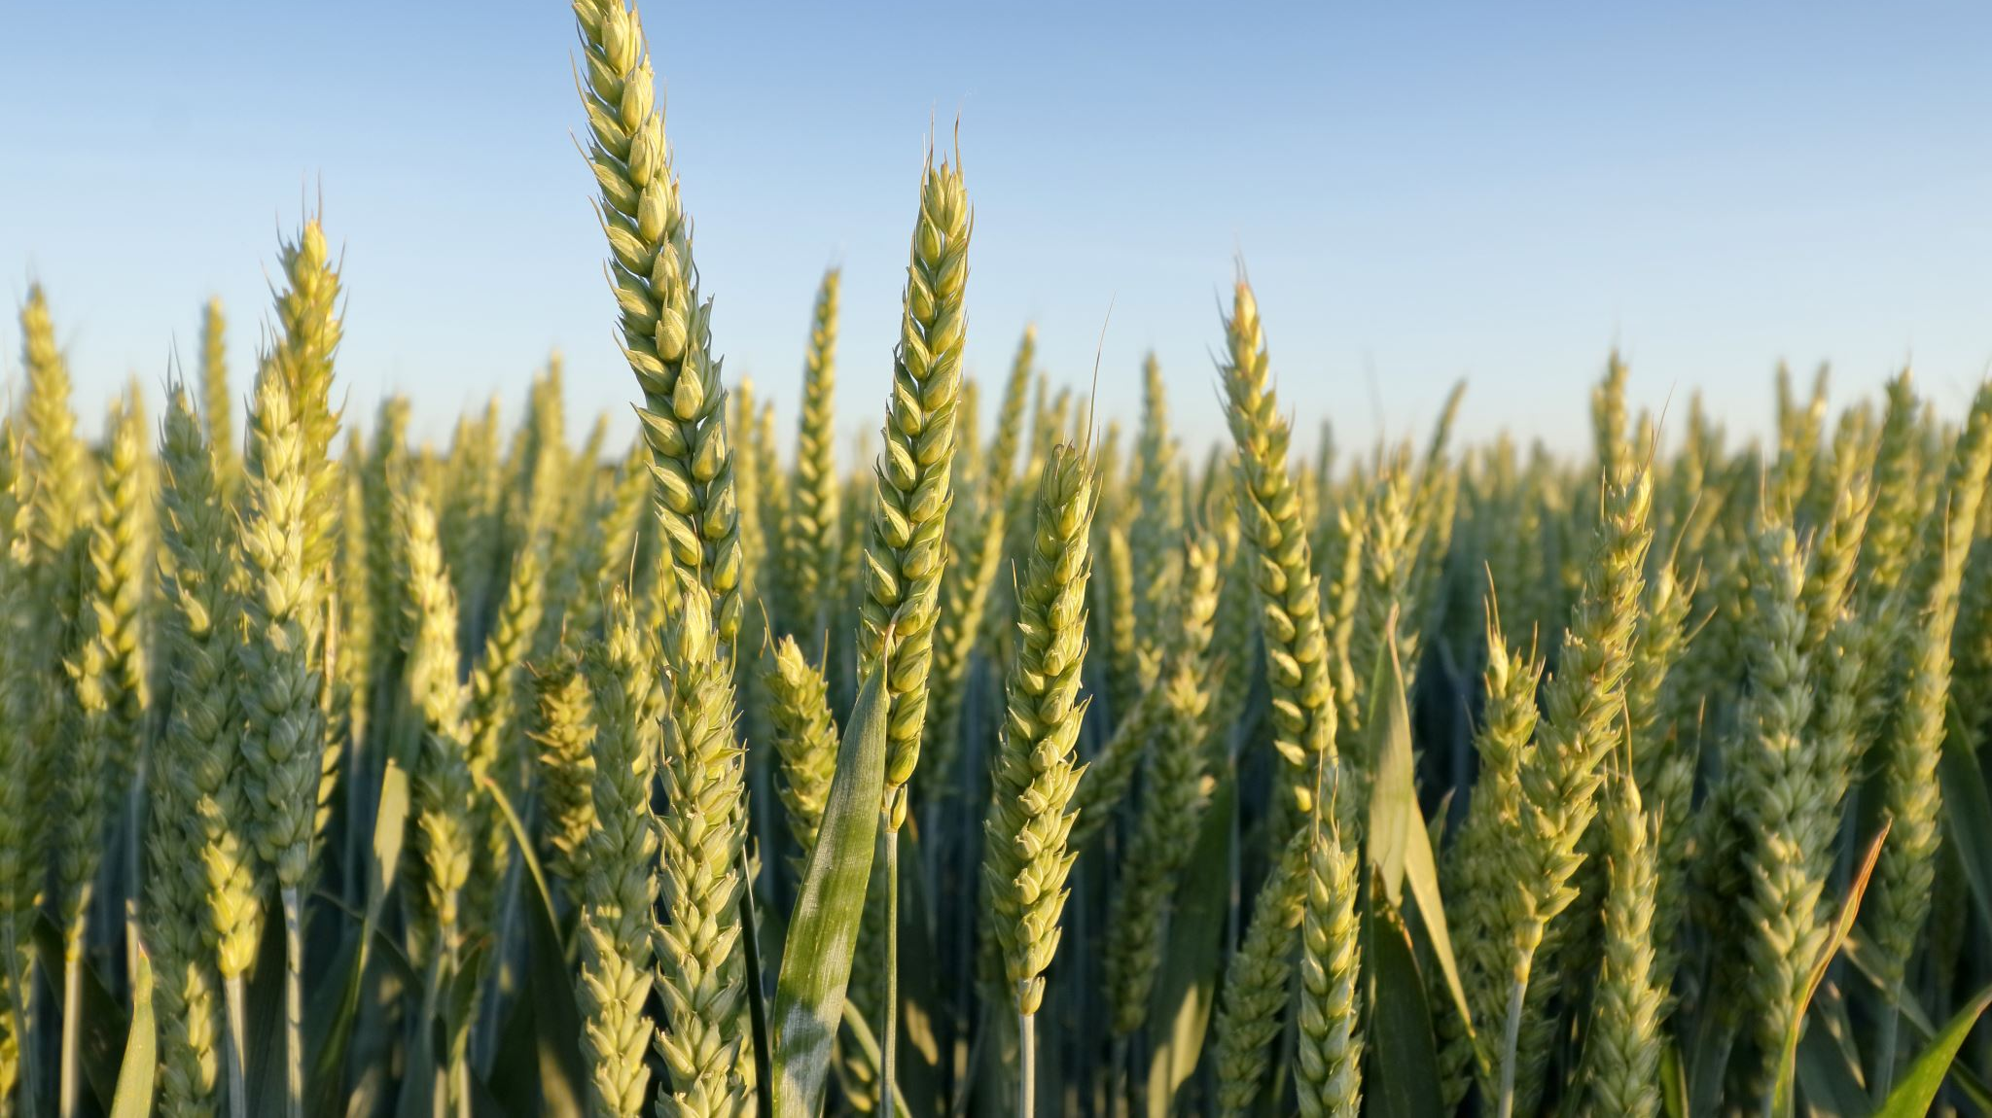
Acknowledgement
Some parts of this research is funded by the Food and Agricultural Organization’s Knowat Program

Slide 20

About the presenter
Dr. Mohamad Mova Al’Afghani’s primary expertise is water law. He earned his PhD in 2013 from the University of Dundee (UNESCO Center for Water Law, Policy and Science) with a thesis titled “The Role of Legal Frameworks in Enabling Transparency in Water Utilities Regulation”. He obtained his master’s degree (LL.M.Eur) from the University of Bremen in 2008 (with distinction) and his Sarjana Hukum (LL.B) from Universitas Indonesia in 2003. Mova had been working as expert consultant with United Nations Industrial Development Organization (UNIDO) on the phasing out of persistent organic pollutants, World Health Organisation (WHO) on drinking water quality and water safety plan, United Nations Development Programme (UNDP) on a project to phase-out mercury, the World Bank for a study on water security in Indonesia, IUWASH-USAID on the provision of drinking water to urban poor population and the Food and Agricultural Organization (FAO) on a study on water tenure. Mova is a lecturer at Universitas Ibn Khaldun Bogor and Director of Center for Regulation, Policy and Governance. He can be reached at mova@alafghani.info and https://www.linkedin.com/in/movanet/

