Slide 1

The Role of Regulatory Frameworks in Ensuring the Sustainability of Community-Based Water and Sanitation in Indonesia
Presentation 1
Mohamad Mova Al’Afghani
Center for Regulation, Policy and Governance (CRPG)
CRPG Workshop, Novotel Resort Hotel, Bogor, February 8th, 2015

Slide 2
Introduction
Problematique
Research question
Clarification of concepts
Methodology
Field Study Justifications
Research Sites
Conclusions

Slide 3
Problematique
Sustainable Development Goals (with 100% access) can never be met by relying only on conventional water supply. 60% will be met by improving CB-watsan (estimate, further confirmation required)
However, regulatory frameworks are “discriminative”. Discriminatory regulation have implications on financing, privileges, rights, monitoring, evaluation (confirmed by legal analysis, FGDs and interviews)
The rise of Local Regulations in Community-Based (CB) Watsan
Sustainability problem with CB Watsan (Litrev, FGD and Interviews)
Lack of clarity as to oversight, monitoring, evaluation of CB Watsan initiatives
“Conflict” between “community” versus “conventional” water provision

Slide 4
The Research Question
How can regulatory frameworks ensure the sustainability of community based water and sanitation?

Slide 5
Clarification of concepts
Regulation is the sustained and focused attempt to alter the behaviour of others according to defined standards or purposes with the intention of producing an identified outcome or outcomes, which may involve mechanism of standard-setting, information gathering and behaviour modification (Black)

Slide 6
Clarification of concepts
Regulatory frameworks
anything that is accepted as “binding” by the community or society and aimed at modifying or shaping certain behaviour
Formal | Public | Private
 | All sorts of legislations and decrees: laws/acts, government regulation, presidential regulation, regional by-law, sectoral rules | MoU, contracts, Articles of Association, agreements, Deeds
Informal | Adat (customary) Law

Slide 7
Clarification of concepts
Sustainability
We choose not to define but utilize general proxies/indicator commonly used in evaluating CB-Watsan: environmental, institutional, technical, financial
But, we have a bit of a problem here. Should we talk about the sustainability of CB Watsan OR the sustainability of water services in general (both CB and non CB watsan)? In other words, should we force CB watsan no matter what?

Slide 8
Methodology

Slide 9
Field Study Justifications (Summary)
Geographical:
Java vs non-java considerations
Western vs eastern Indonesia
Institutional:
“Modernized” communities vs “Traditional” communities

Slide 10
Research Sites
East Nusa Tenggara: Pulau Ende, Maukaro Districts, City of Ende, Kupang
Eastern Java: Lamongan, Kemlagi Lor, Surabaya

Slide 11
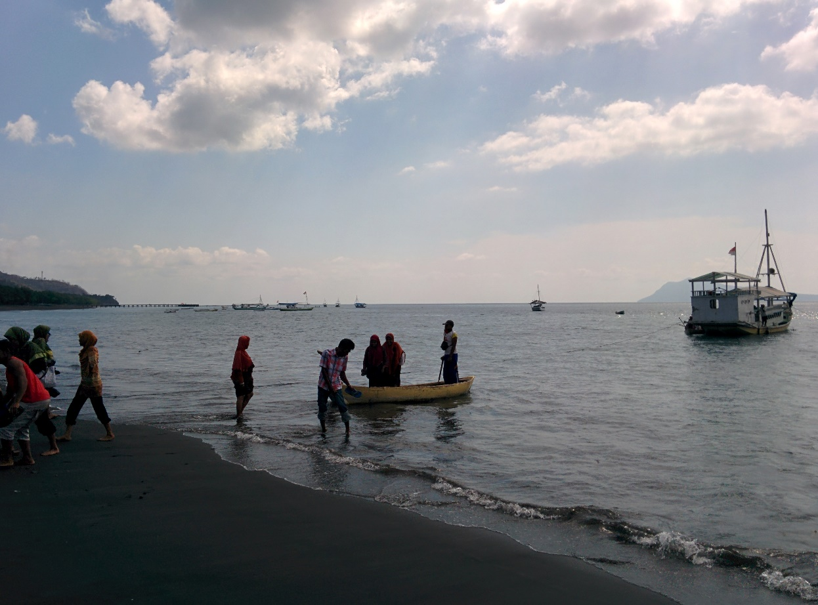
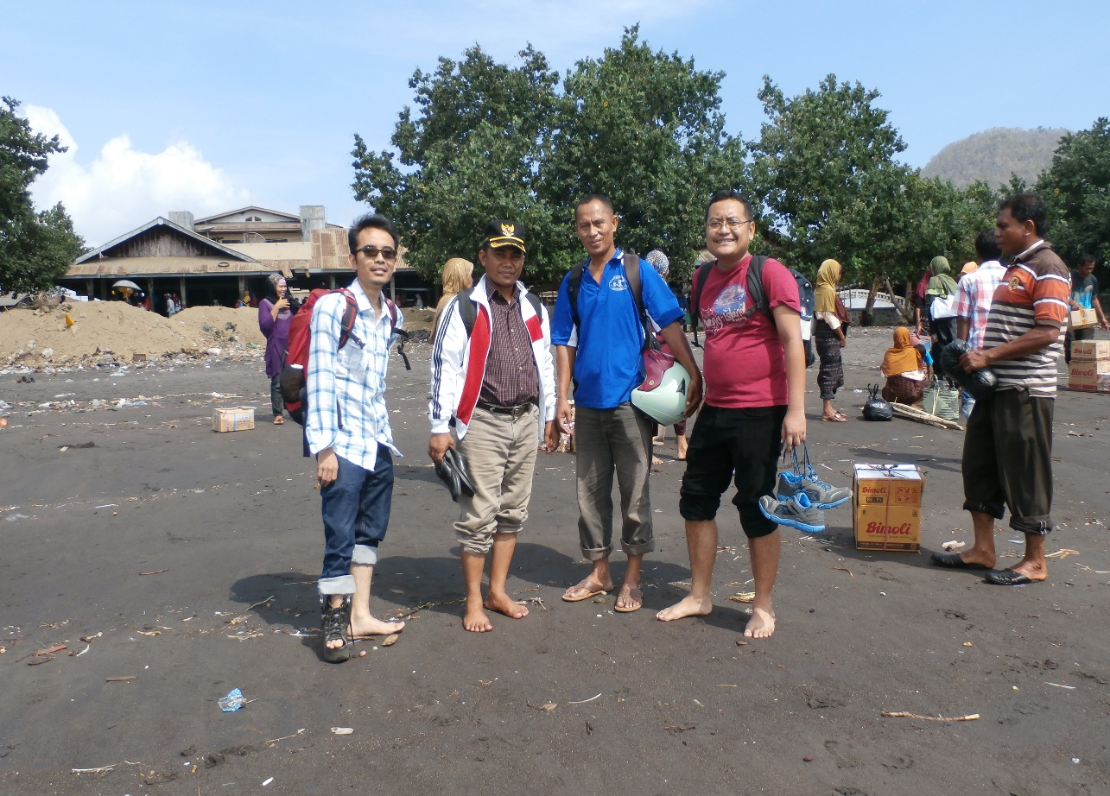
Pulau Ende

Slide 12
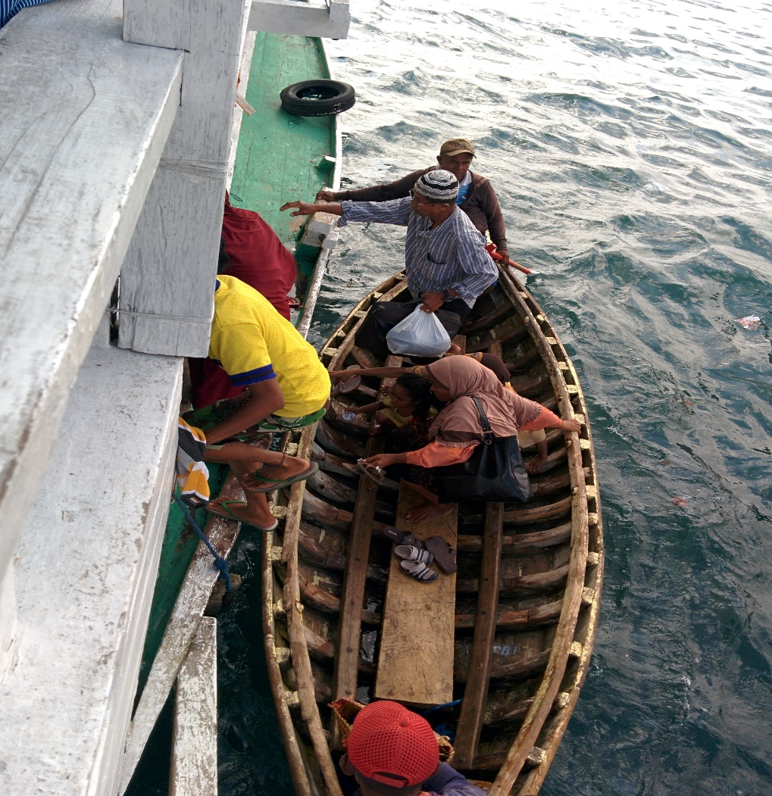
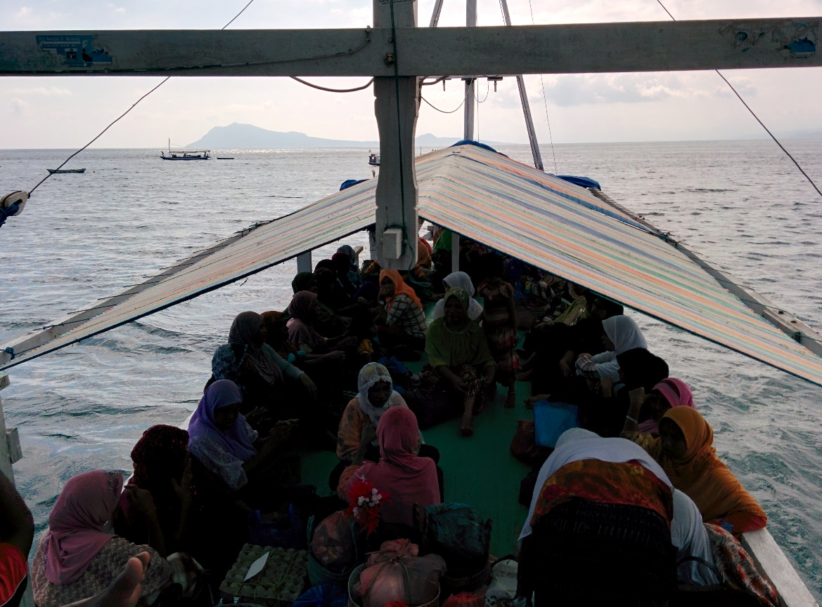
Pulau Ende

Slide 13
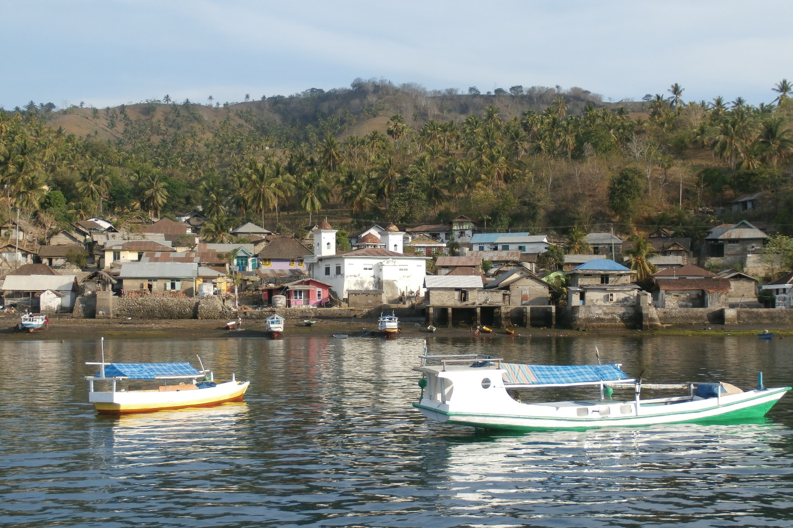
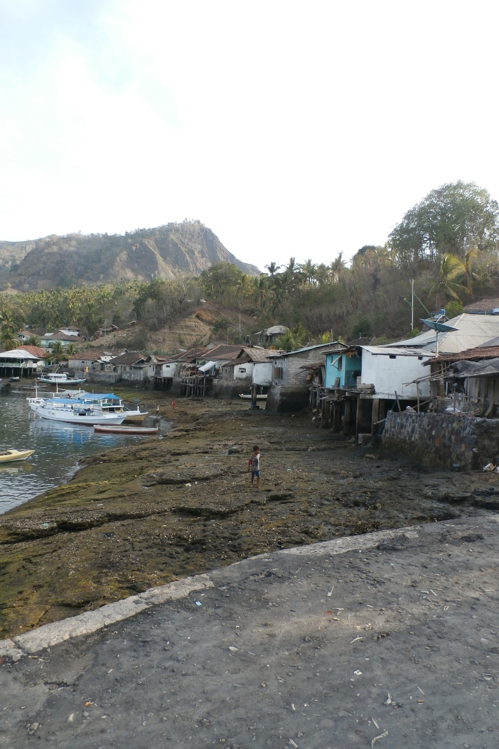
Pulau Ende

Slide 14
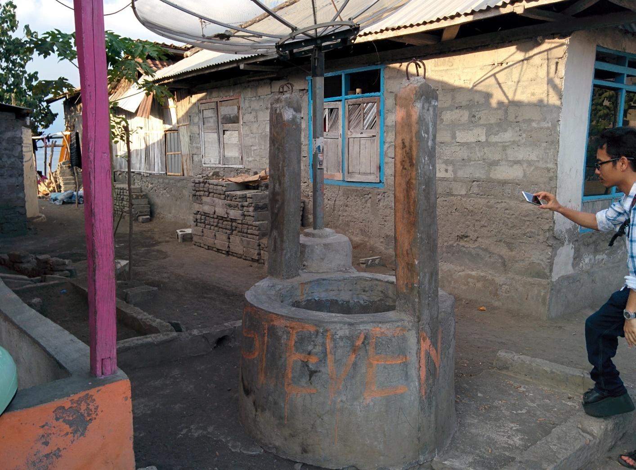
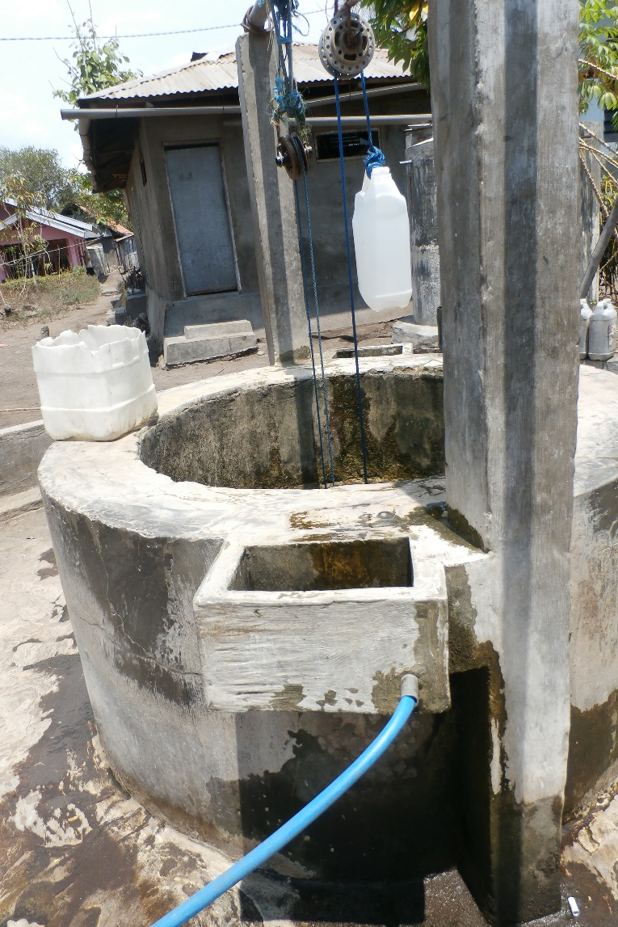
Pulau Ende

Slide 15
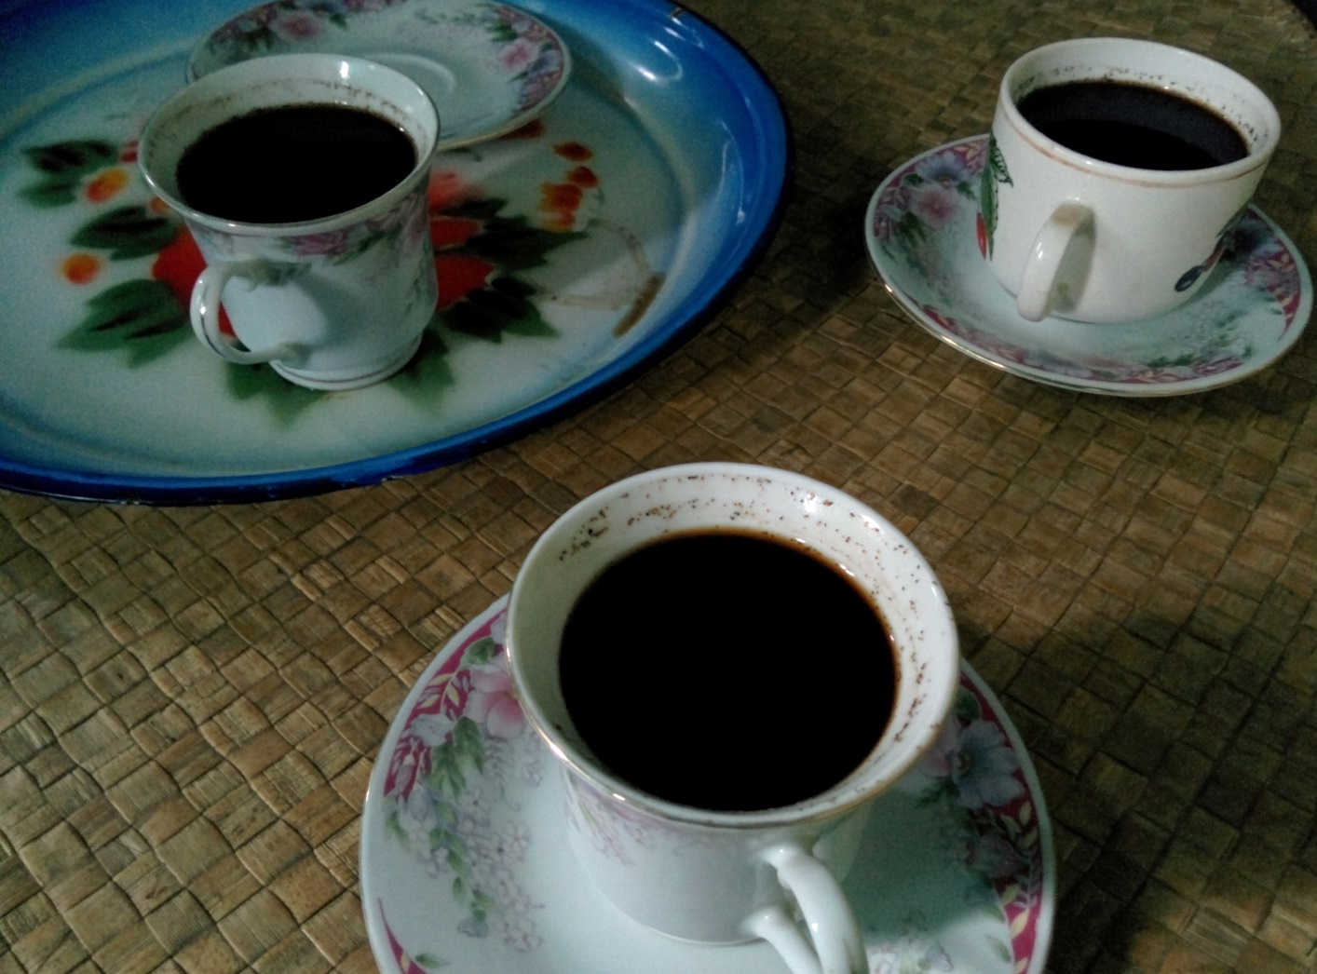
Pulau Ende

Slide 16
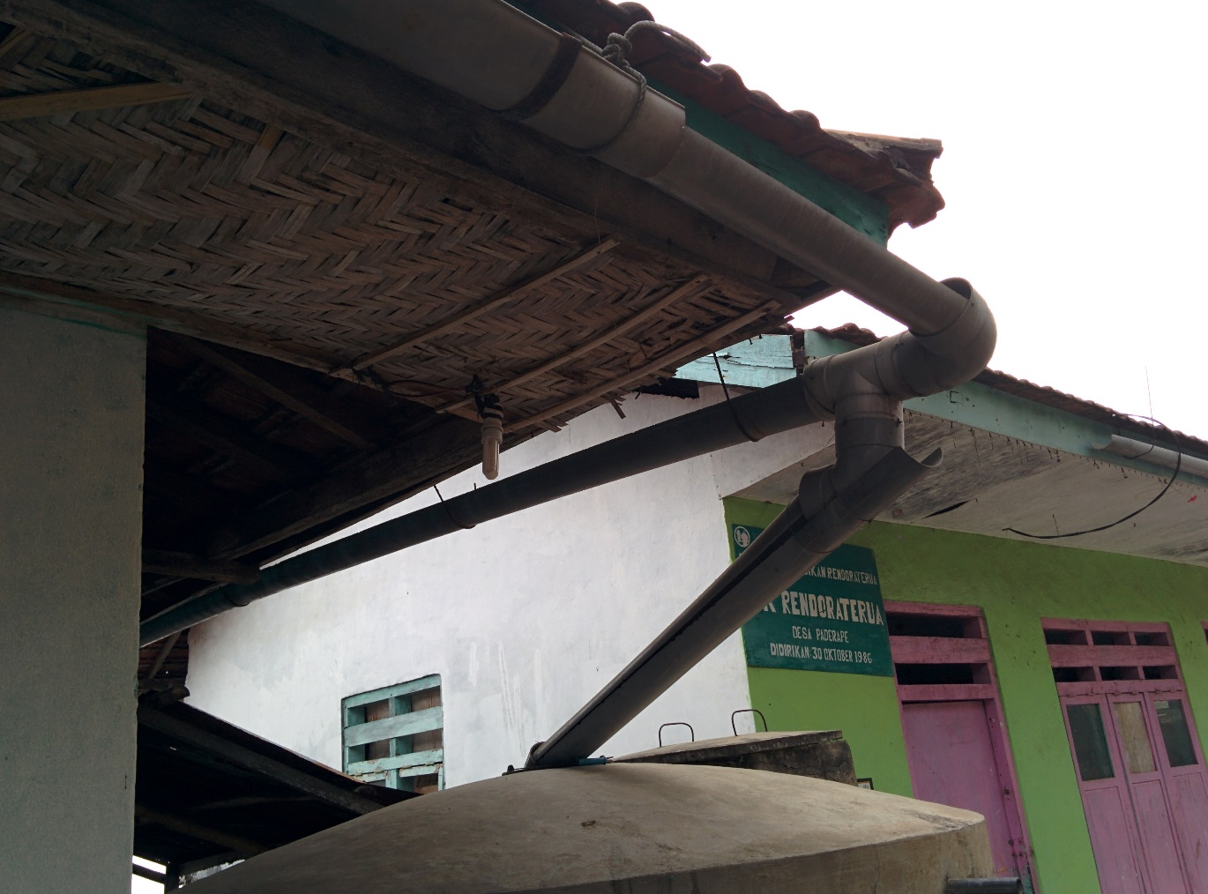
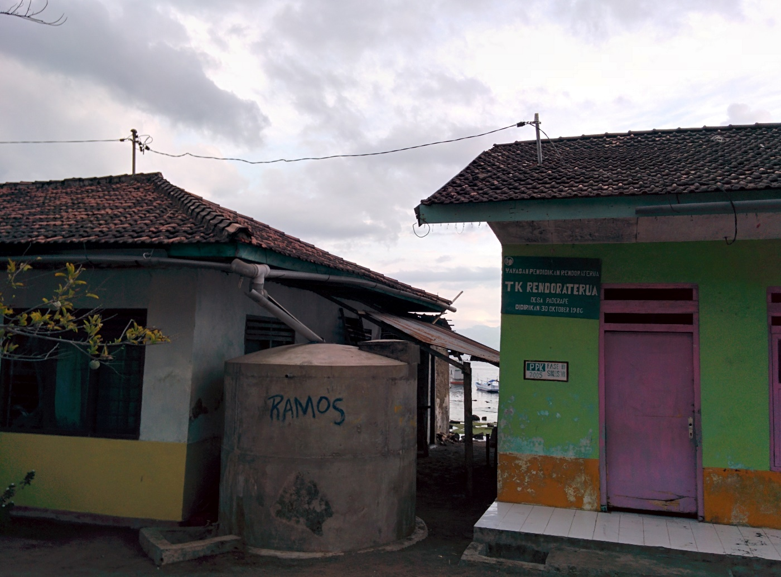
Pulau Ende

Slide 17
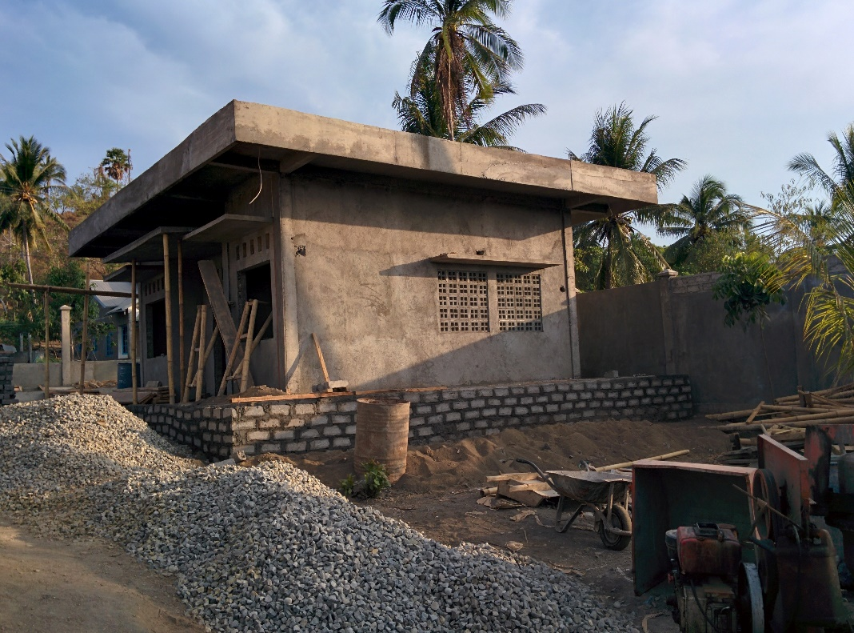
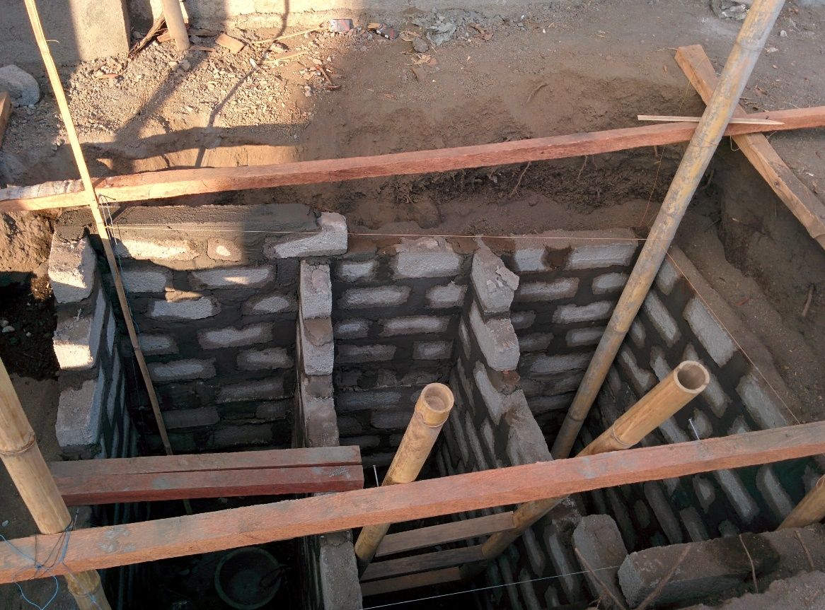
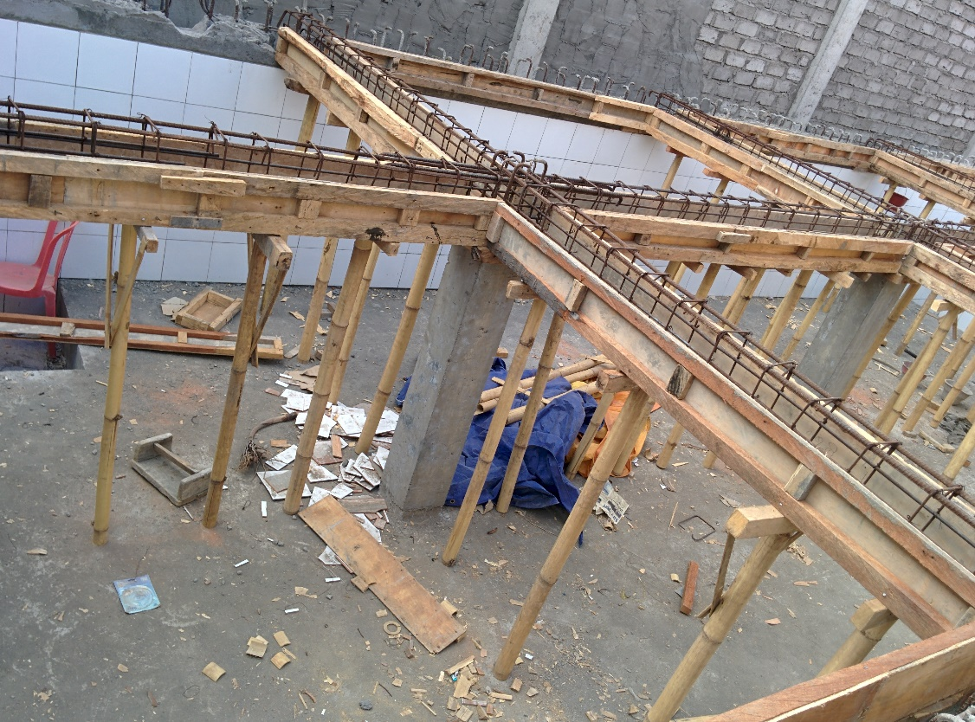
Pulau Ende

Slide 18
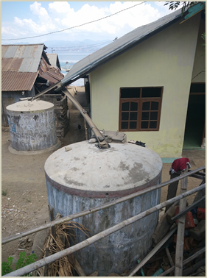
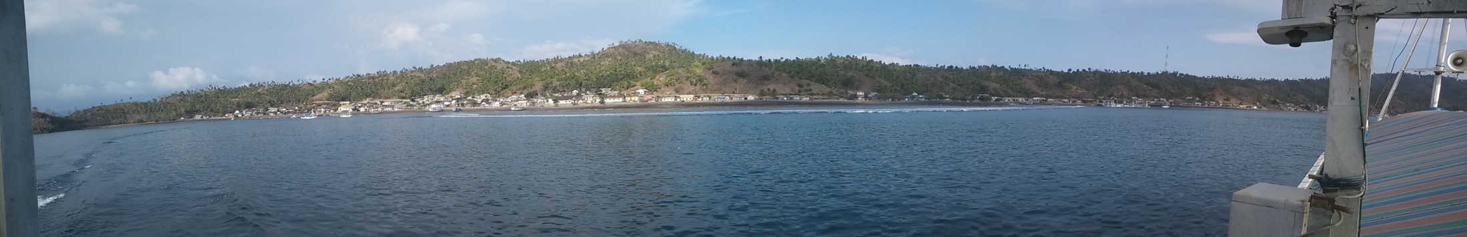
Findings at Pulau Ende
Rainwater cisterns cannot accommodate the needs during long droughts
Rusty roofs turns rainwater into reddish, several village communities no loner used rainwater for drinking.
10 wells in two villages have been contaminated with e-coli
Households waste are being channelled to the beach
The number of latrines have decreased (due to abration) and there is a tendency of increase in ODF behaviour

Slide 19
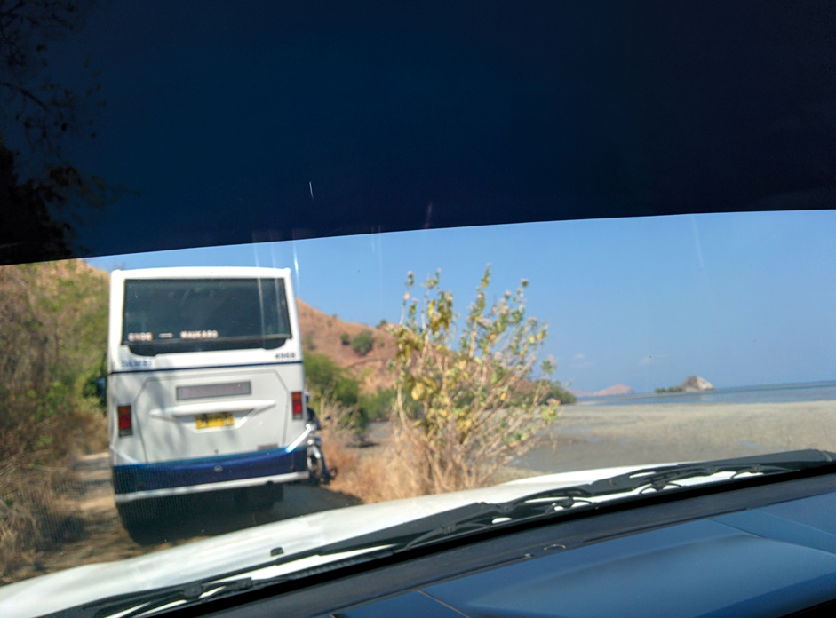
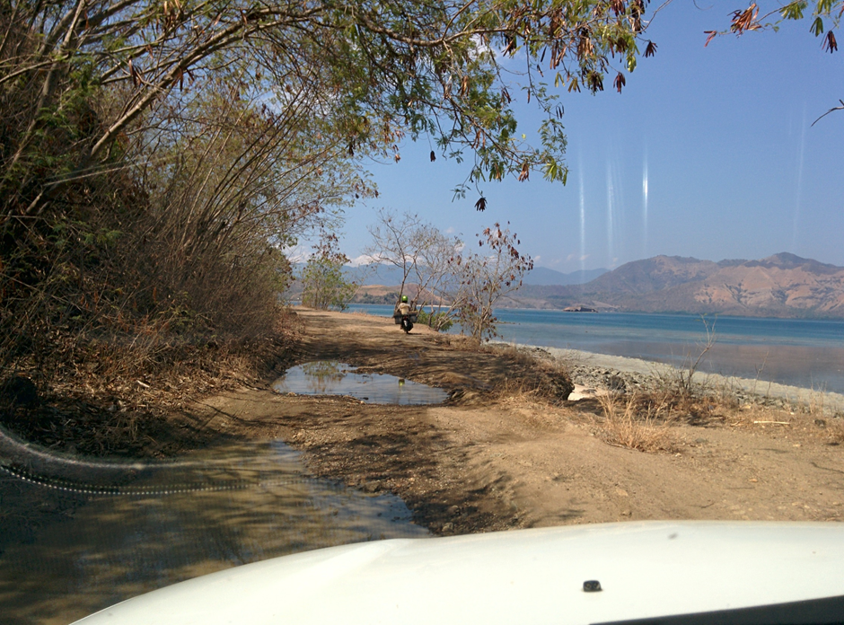
Maukaro

Slide 20
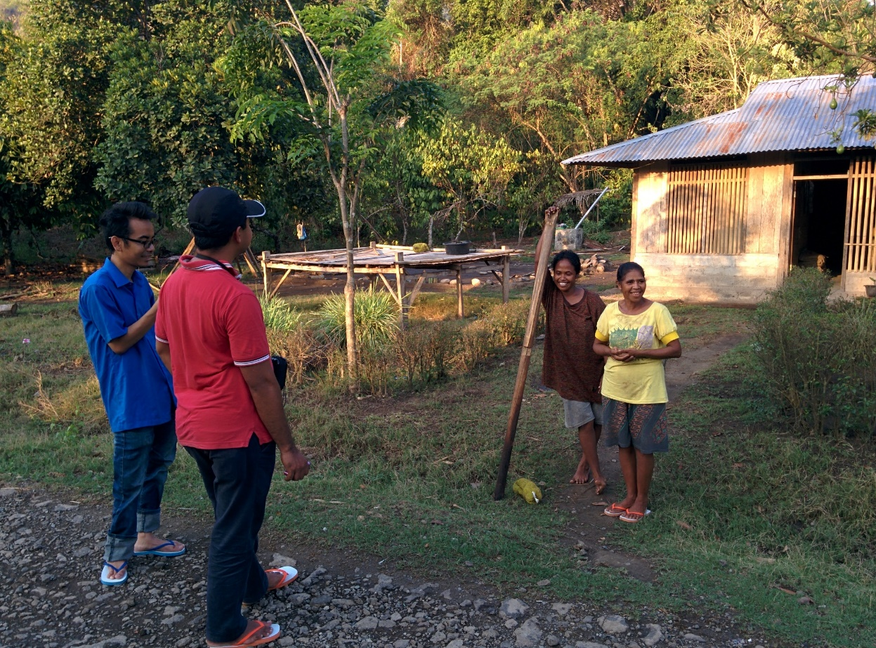
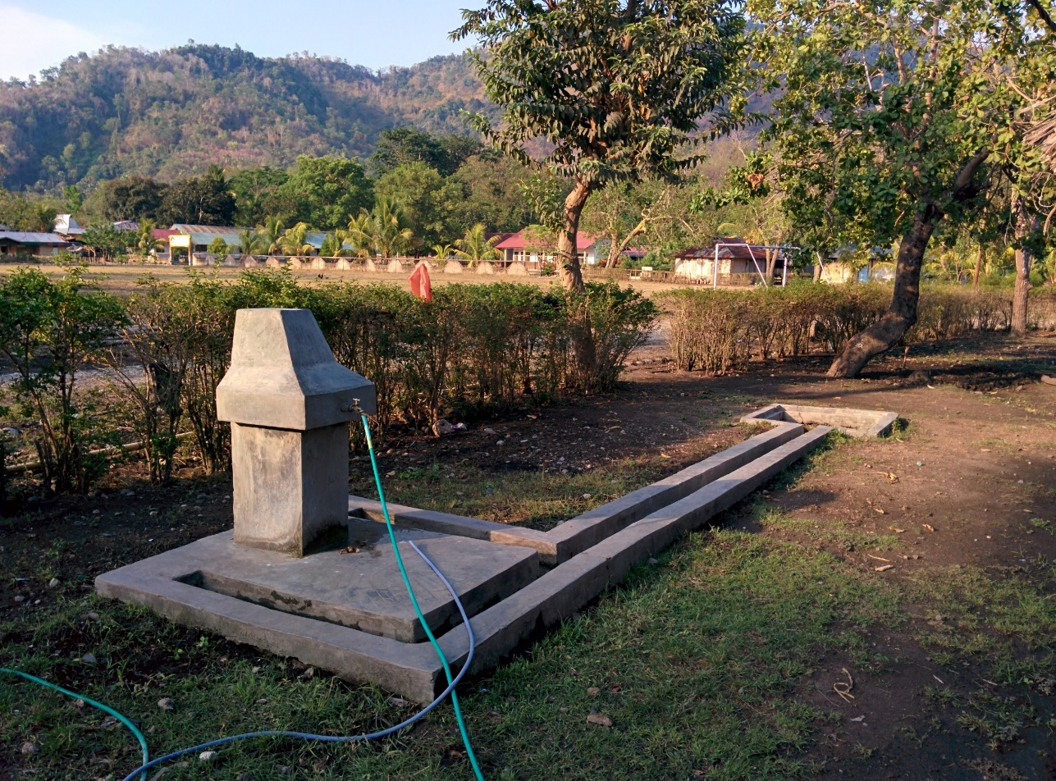
Maukaro

Slide 21
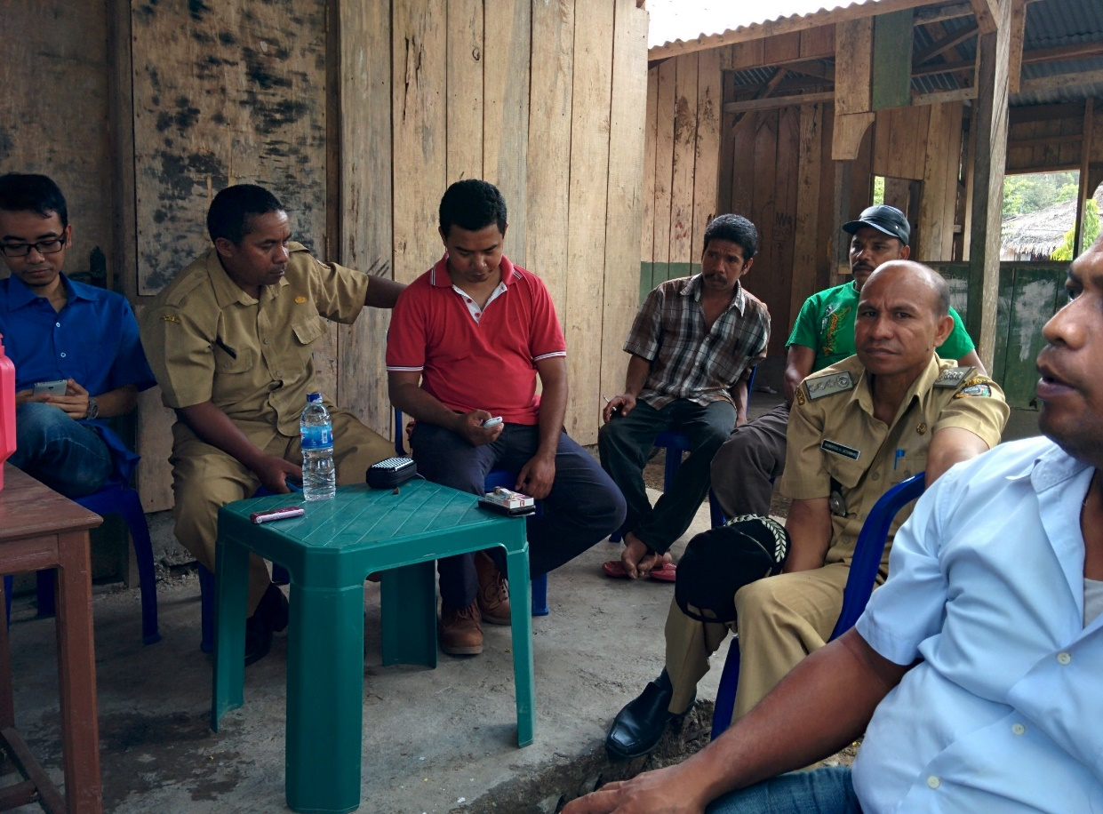
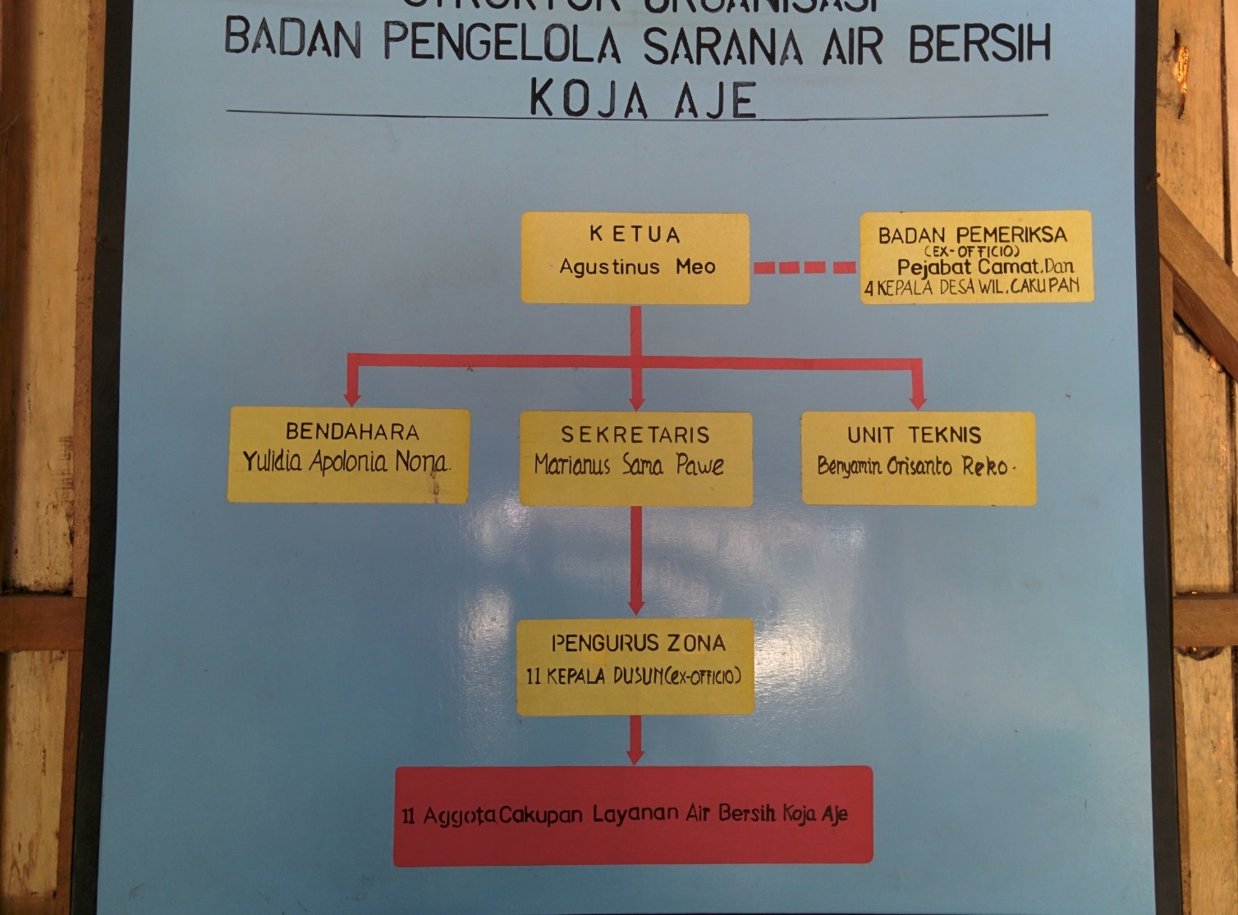
Maukaro

Slide 22
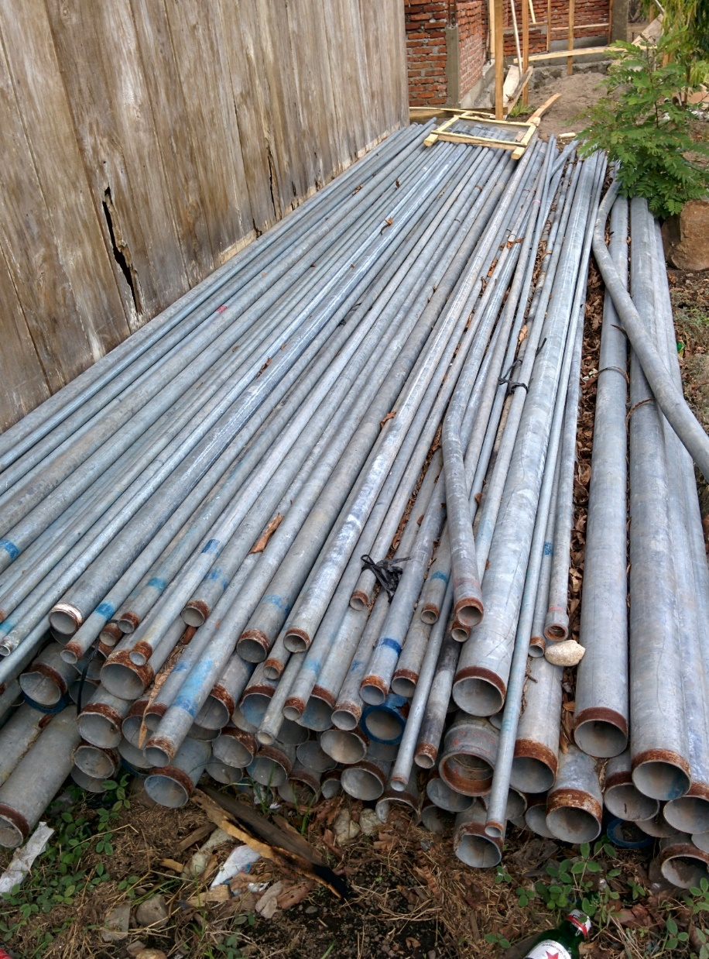
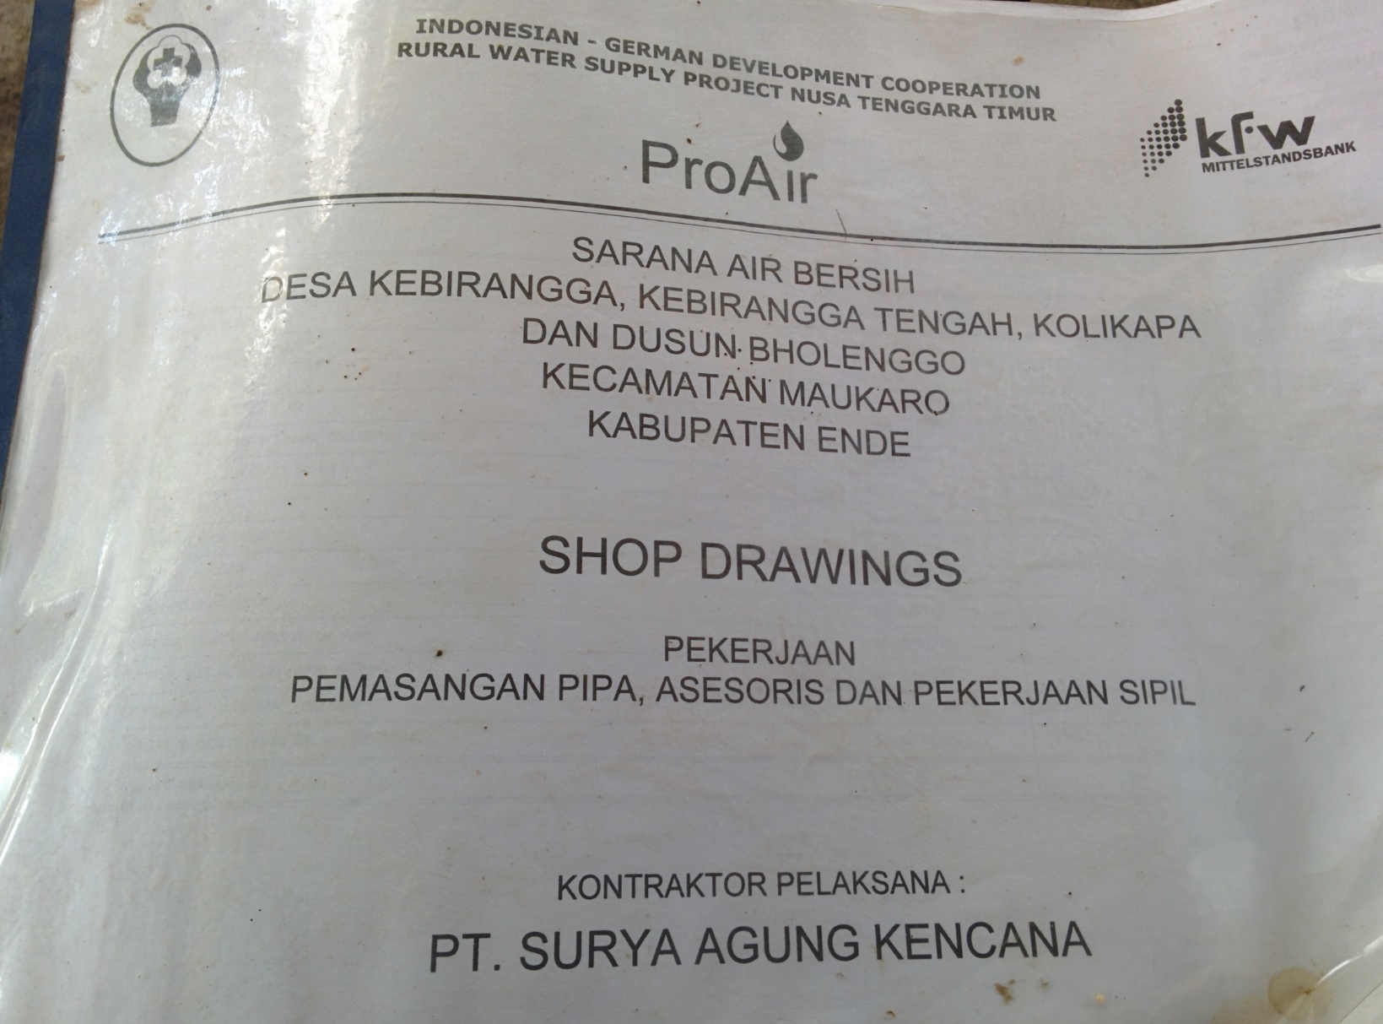
Maukaro

Slide 23
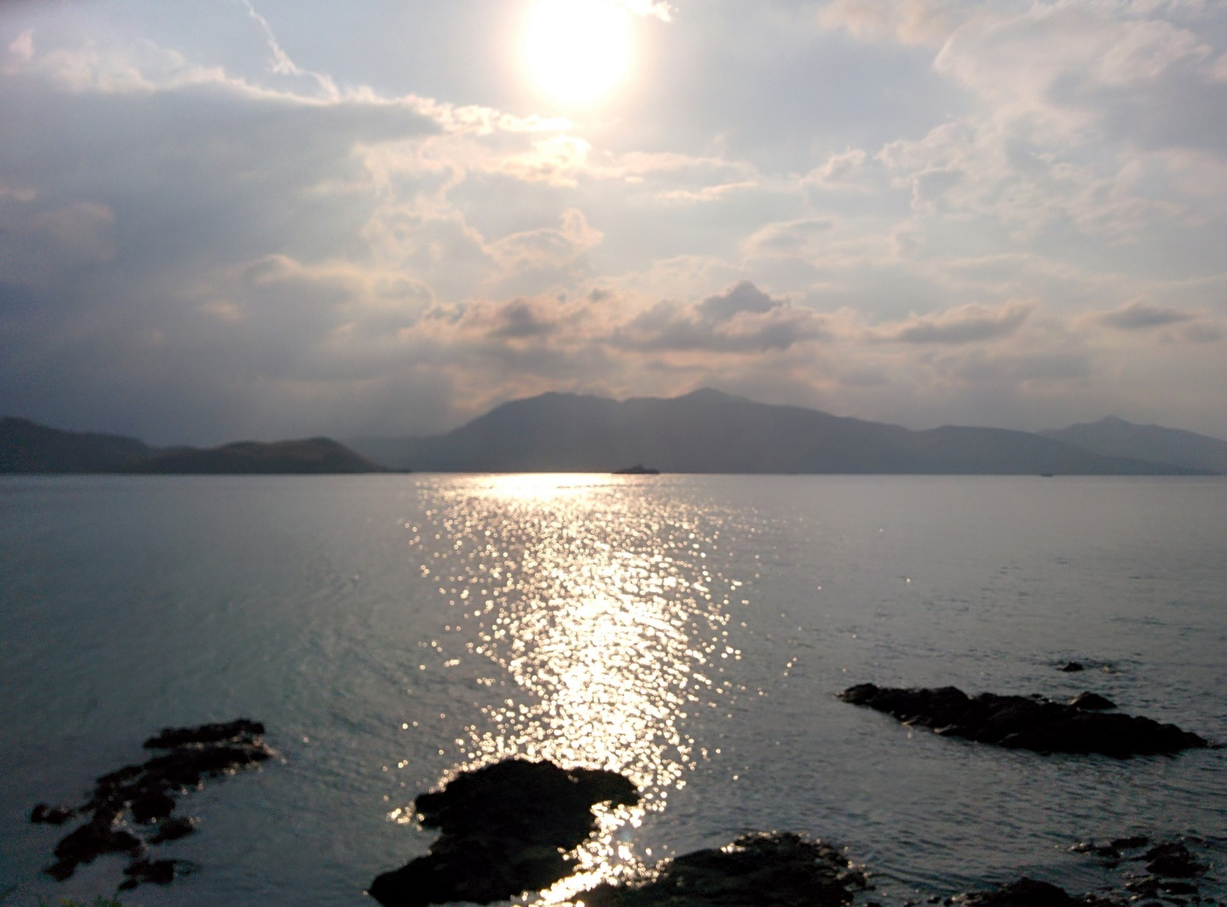
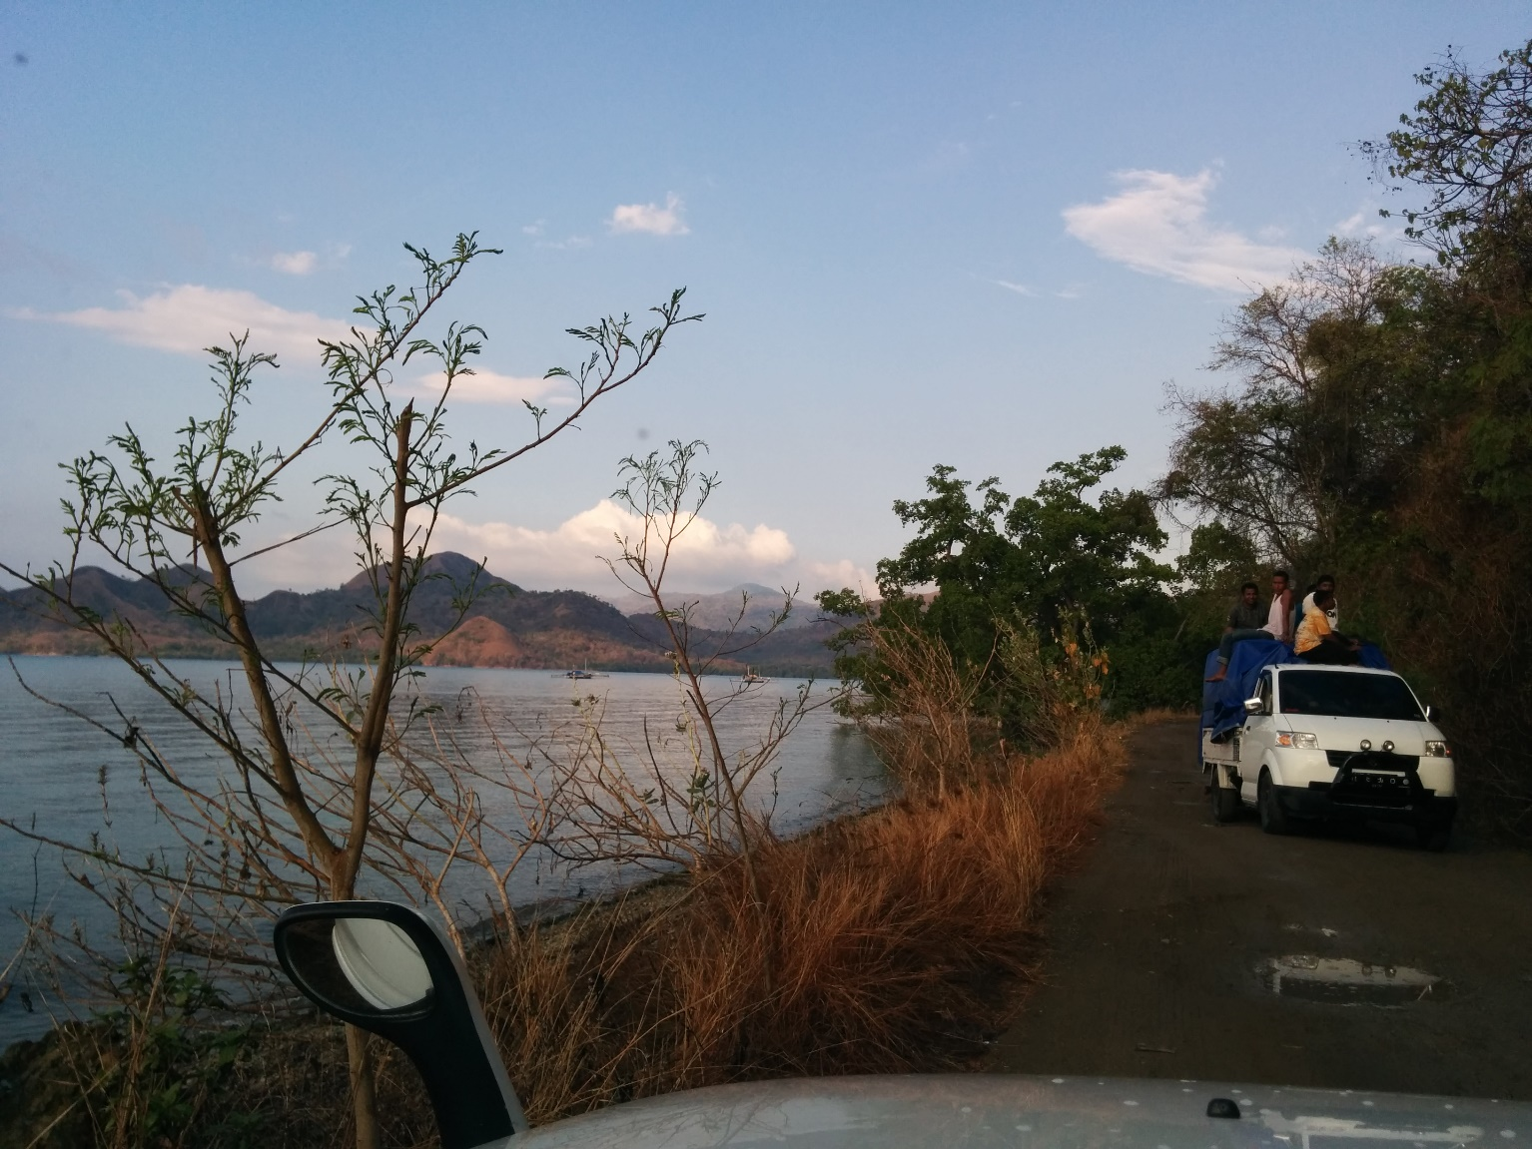
Maukaro

Slide 24
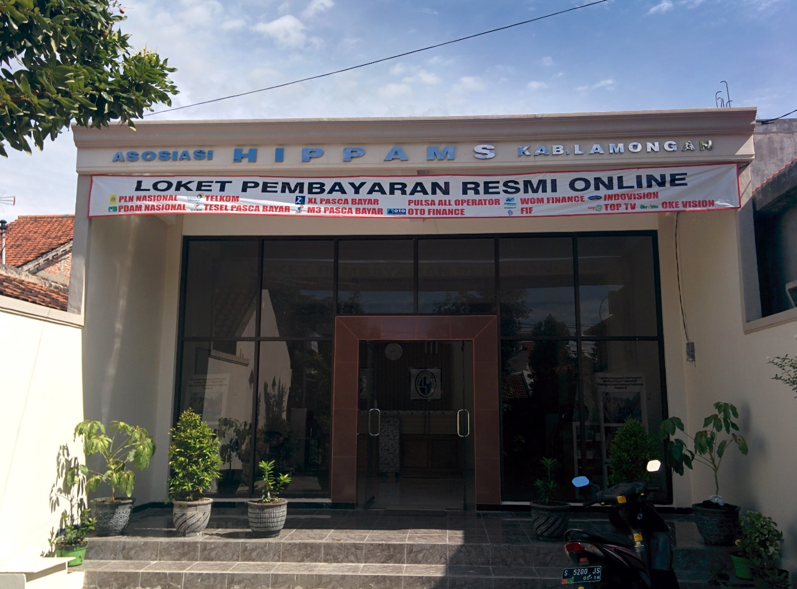
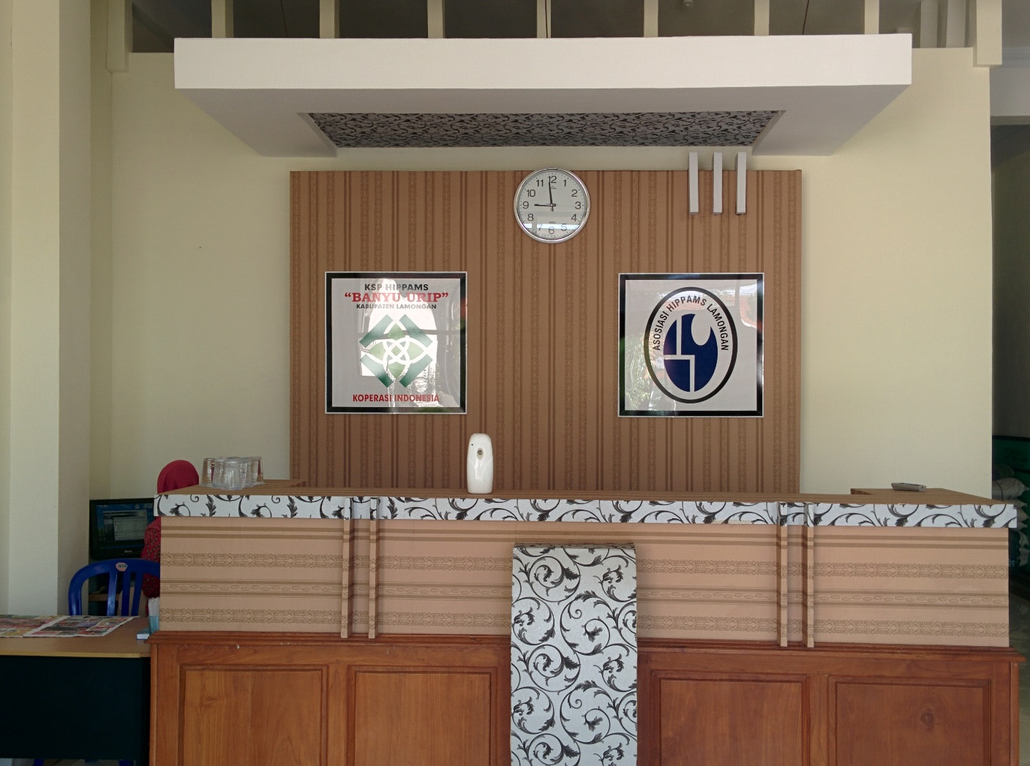
Lamongan

Slide 25
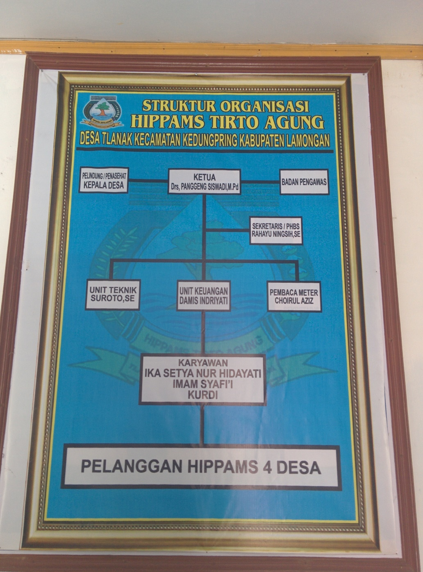
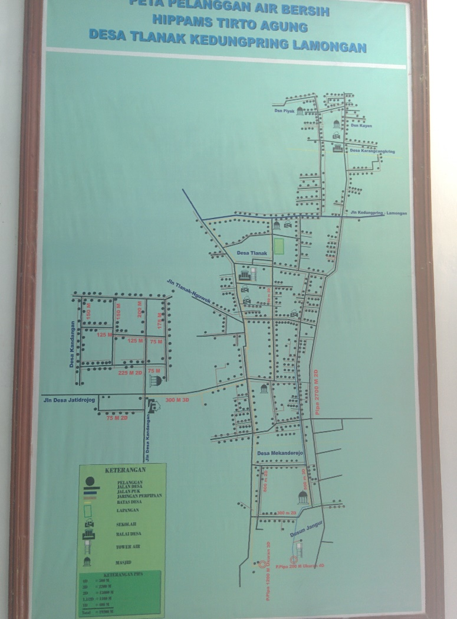
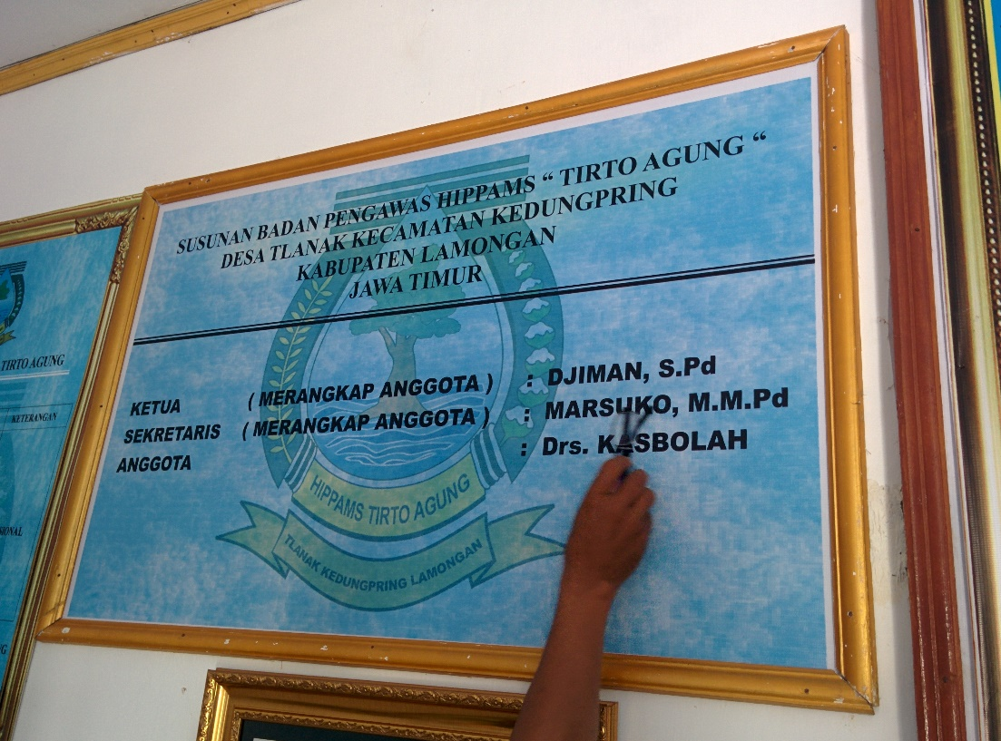
Lamongan

Slide 26
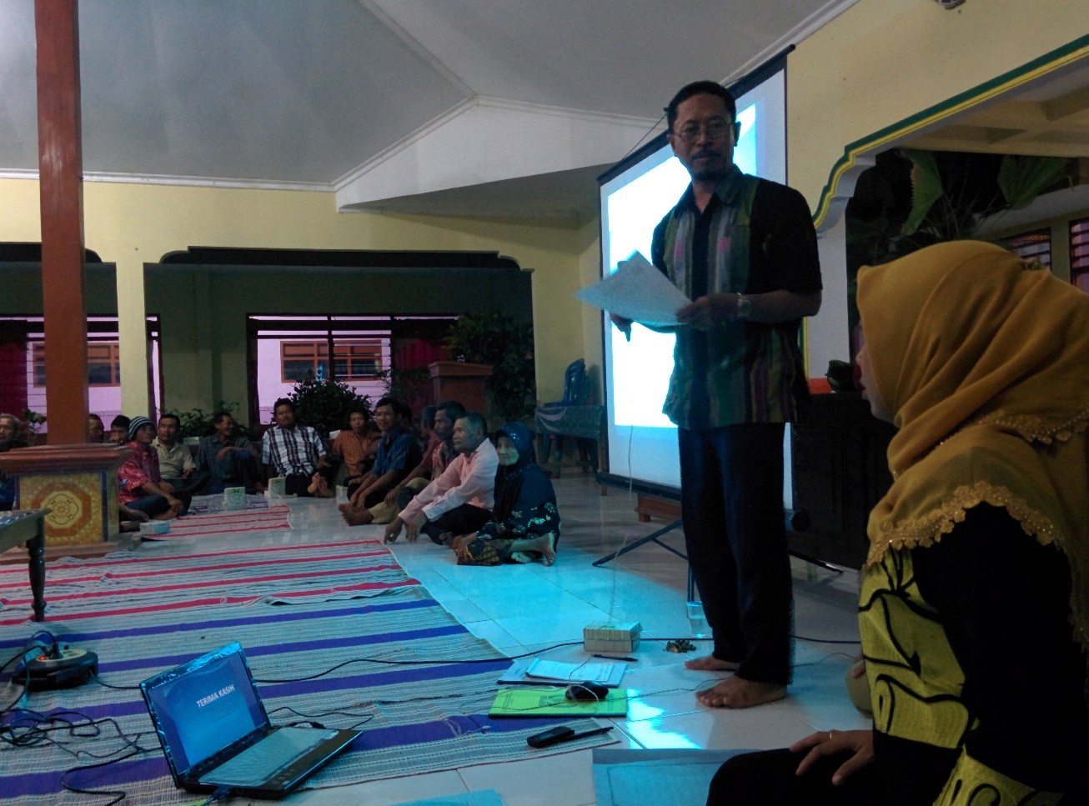
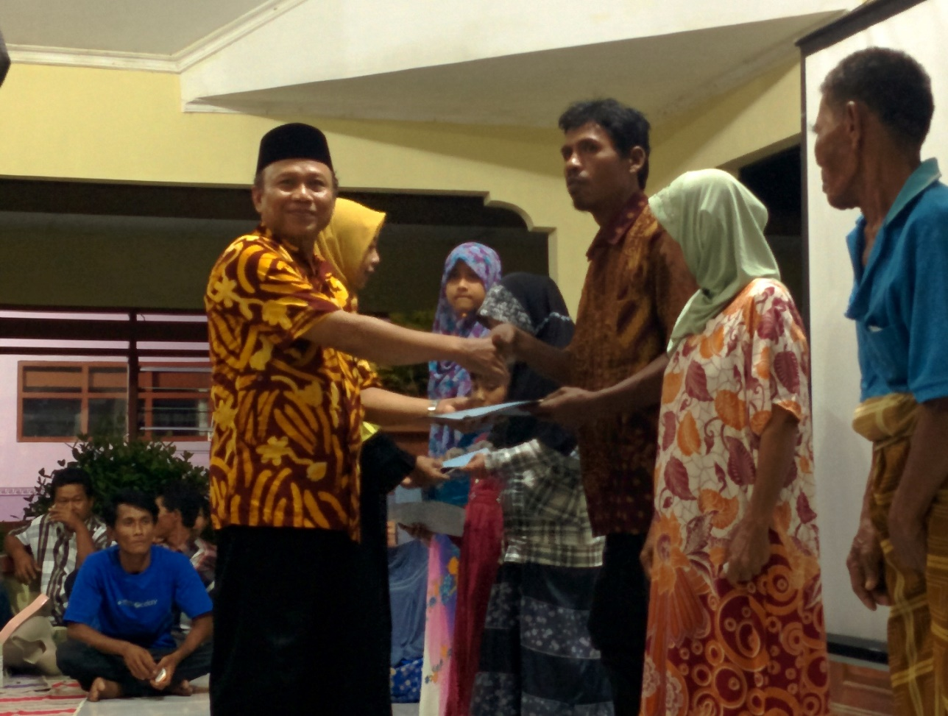
Lamongan

Slide 27
Findings at Maukaro
From 4 (four) CBO, only one is still operational (organisationally) (namely BPSAB Koja Aje)
Out of 4 CBOs, 3 CBOs are no longer operational on the second year after the program ends
At, BPSAB Ae Puu out of 26 stand pipes, 10 are no longer functional
At BPSAB Koja Kumi, out of 27 stand pipes, 19 was broken, although water is still running
Reduction of debit due to long drought
At BPSAB Koja Kumi, the appreciation towards CBO officers are weak and to some extent this demotivates them
Lack of incentives for technical persons
There are some (minor) dependencies on external skills and technologies

Slide 28
Conclusions
Conceptual: need clarifications on the “sustainability” approach. Sustainability for WS in general or only for CB-Watsan?
Limitation/Scope: fieldwork are too focused on rural water supply. Data on rural sanitation are also being gathered but not in the same quantity as rural water supply. However, some of the legal analysis on rural water supply are also applicable to urban watsan. (Should this be identified thoroughly and emphasized?)

