Slide 1
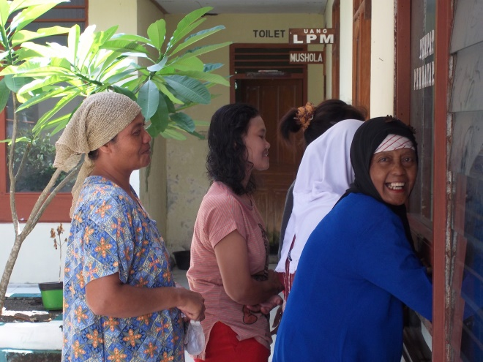
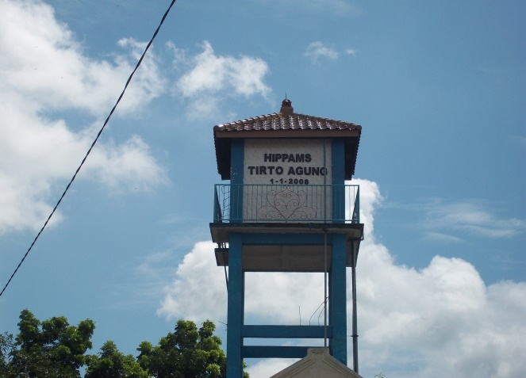

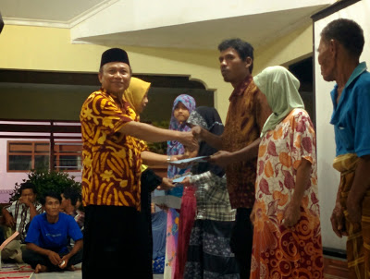
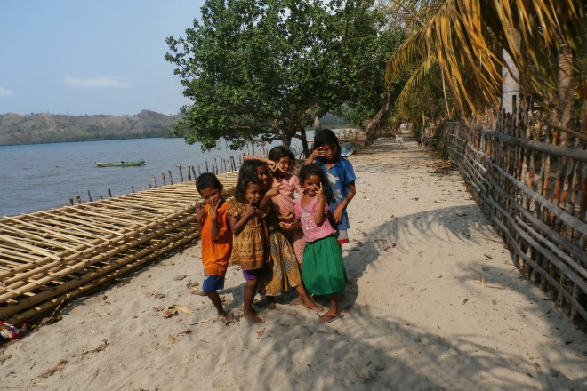
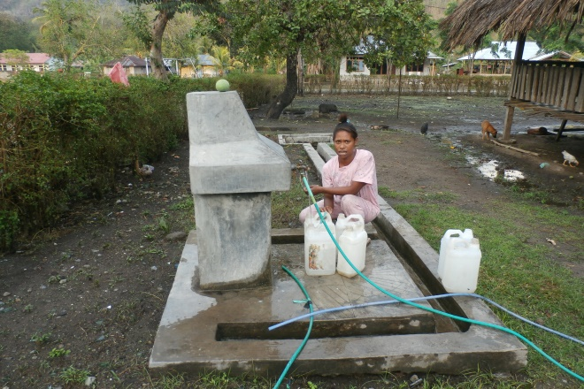
MANAGING ORGANIZATIONAL CULTURE ON
COMMUNITY BASED WATER SERVICE IN INDONESIA: A
COMPARATIVE FIELD STUDY ON EAST JAVA AND
EAST NUSA TENGGARA
AIIRA Project, Center for Regulation, Policy and Governance (CRPG)
Jibriel Avessina
Email: Avessina@gmail.com

Slide 2
Historical Context
The community based water service concept has been formaly recognized in Indonesia on 2003. The purpose behind implementation of the concept are that the community have an improved water acessibility.
Since 2003, international aid agency conducted rural water supply projects and programmes to provide water services infrastructure.
The aid agency also set up Community based Organisation (CBO) to maintain sustainability of community based-water services.
The CBO have the purpose to:
CBO ensure community participation to have a major role in its development,
The Community own the water system or facility,
The Community have total self-responsibility for its operation and
maintenance .

Slide 3
Historical Context
In reality, the sustainability of community based service face serious constrain while some CBO is no longer functional, inactive between 2-5 years period post construction. Some CBOs are able to maintain its existence, growth and provide water services to the community.
Culturally, there are two explanation as an explanation to understand it.
Firstly the constrain may not have been in existence at the time CBOs were formed. But as CBO move forward, a “organizational pattern ” could be major influence, on demand, affordability and ownership issue .
Secondly, The CBO have to adopt behaviour of how everything are done based on the people action that are in place.

Slide 4
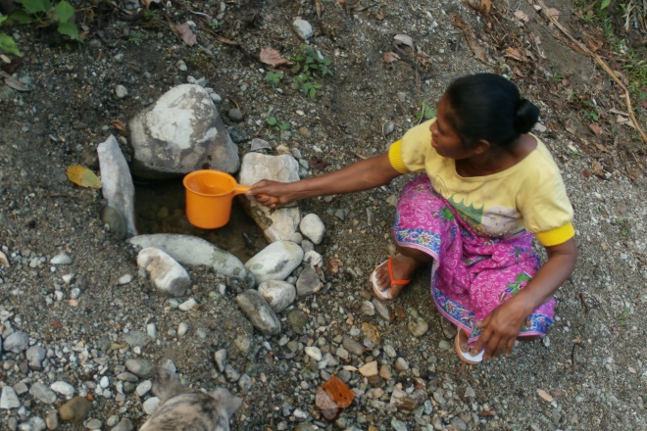
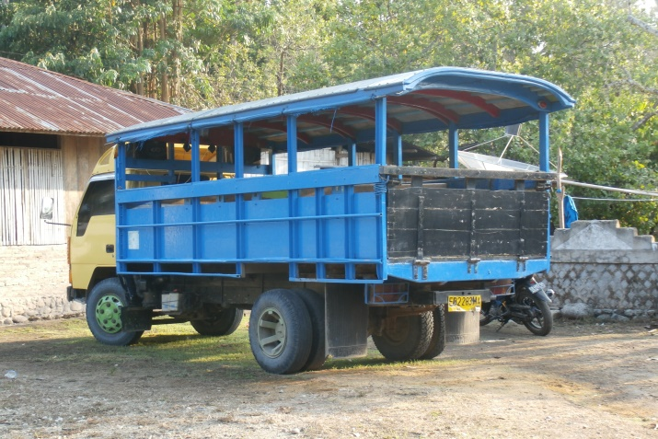
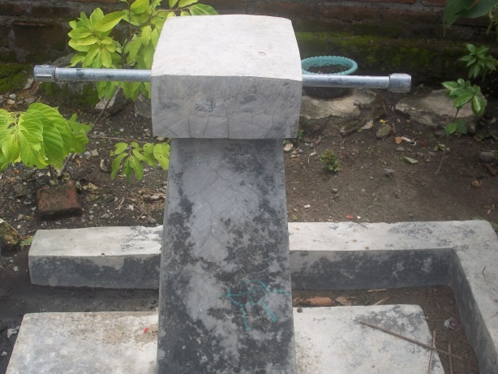
As a part of our research we conduct field study using multisite ethnography, at two locus, to understand cultural role and function of CBO among local society.
Ende, East Nusa Tenggara as a representation of underdeveloped region in Eastern Indonesia (Outside Java)
Lamongan, East Java as a representation of Community Based Organisation in Java

Slide 5
The Existing CBO Condition at Maukaro District
Parameter | CBO Koja Aje | CBO Koja Kumi | CBO Ae Pu`u
Annual Meeting | Once a Year | Once | Once
Coverage area | 4 Village (Multisystem) | 3 Village (Multisystem) | 3 Village (Multisystem)
Operational Maintanance | Technical resources Dependency | Technical Resources Dependency | Technical Resources Dependency
Regeneration | no | no | no
Willingness to Pay | Yes, almost 80 percent | Not Known | Not Known
Social sanction/Punishment | Yes | No | No
Authority | Weak, Limited | Not functional | Not functional
Local-level Decision Making | Collective | Not functional | Not Functional

Slide 6
The Existing CBO Condition at Maukaro District
Parameter | CBO Koja Aje | CBO Koja Kumi | CBO Ae Pu`u
Tariff | Flat Rate | Flat Rate | Flat Rate
Cultural context | Traditionalist,Hierarchal | Traditionalist,Hierarchal | Traditionalist,Hierarchal
CBO`s power position | Not Significant | Not Significant | Not Significant
Post-Construction Assistance | Limited by local Government | Not known | Not Known
Leadership Pattern | Charismatic | Not Known | Not Known
Professionalisation | No | No | No
Organisational type | association | association | association

Slide 7
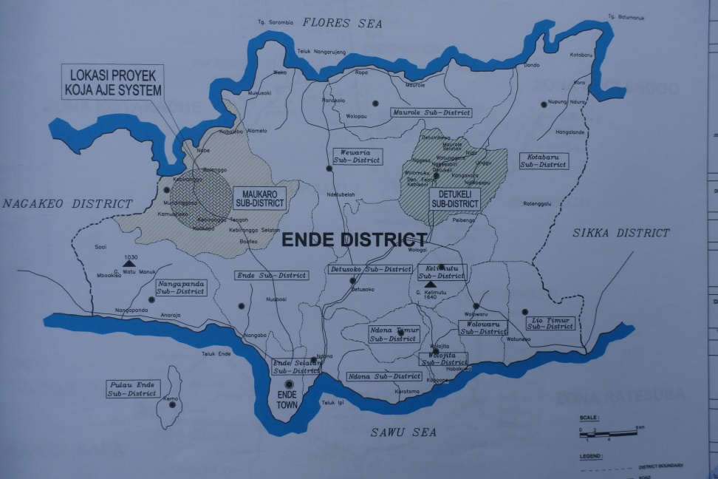
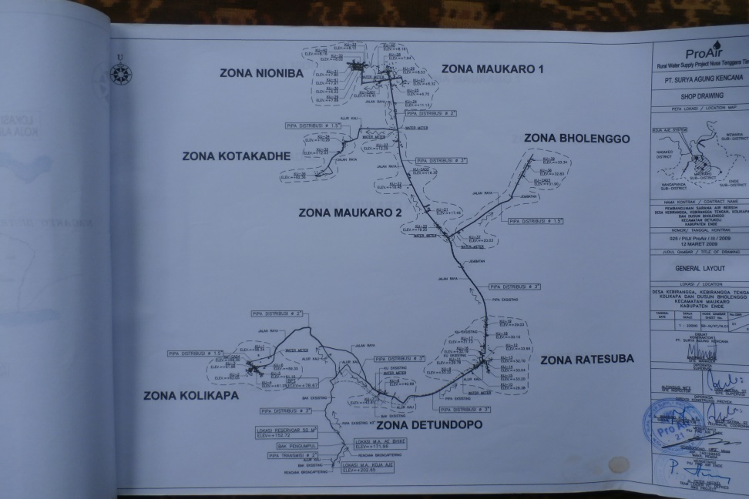
Field Context
A. CBO Koja Aje succesfully provide 3 Villages. Water infrastructure was built on 2006 by Pro-AIR.
B. Maukaro Village
Kolikapa Village
Ratesuba Village
Kabhirangga Village
C. Organisational pattern:
CBO Chairman
Secretary
Treasury
Technical Officer
Zone Coordinator
D.Post Construction
Limited supervision by local Government

Slide 8
Finding: The role of Adat leader and Power relation within CBO
Seven Type of Mosalaki:
1. mosa kaba laki wéa
a mosa laki who is rich in livestock and gold (chains)
2. mosa tana laki watu OR mosa watu laki tana
a mosa laki who owns a large plot of land
3. mosa nua laki bo’a
a mosa laki within the village (not the greatest of mosa laki; a ‘local hero’)
4. mosa wiwi laki lema
a mosa laki with exceptional oratorical skills
5. mosa toa laki wela
a mosa laki who frequently practices ritual killing of water buffaloes and
pigs
6. mosa pedu laki rona OR mosa péu laki rona OR
mosa wiu laki pi’u OR mosa pedu laki pada
a mosa laki who always gives good advice to others
7. mosa po laki péra/pu`u
a mosa laki able to instruct others

Slide 9
Findings
Two Structure : One Loyalty
Traditional Structure : The Mosalaki`s hierarchal system
Formal Structure : Formal Bereaucracy
People would follow the traditional structure, except for “charismatic” state official.
Potential Conflict among The Mosalaki system and formal bureaucracy

Slide 10
Findings
The Mosalaki` is a hierarchal traditional elite at Ende, East Nusa Tenggara, they “culturally own” all land, forest at Maukaro, Ende.
The people must obey a cultural ownership system of Mosalaki.
The Mosalaki have a power to maintain social order; punishment or social sanction is given by Mosalaki`s. People would follow all Mosalaki`s edict.
The Mosalaki voluntary giving his right for small amount of soil for water services infrastructure.
Mosalaki is given priviledge having personal standpipe
Mosalaki is given priviledge by CBO to not pay monthly incentive as a compensation for water services

Slide 11
Finding
The “Mosalaki system” is excluded on daily CBO organisational system
The Universality and Inclussiveness
Cultural Structure in Maukaro, Ende :
1. Mosalaki/Noblemen
2. Commoner
3. Former Slave
Practically, The Mosalaki have unequal culturally position with Commoner and Former Slave so that an “equal degree” on community participation.
Social punishment would not be effective, since the mosalaki are not involved in social punishment conduct by CBO. Mosalaki makes decision on behalf of the community, various agreements and resolution-conflict under Mosalaki`s Supervision.

Slide 12
Stakeholder Context
Post Construction Role:
Role of Central Government (No Action)
Role of Local Government (Limited role)
Role of Donor Agency (Limited role)
Role of CBO Official (Major role)

Slide 13
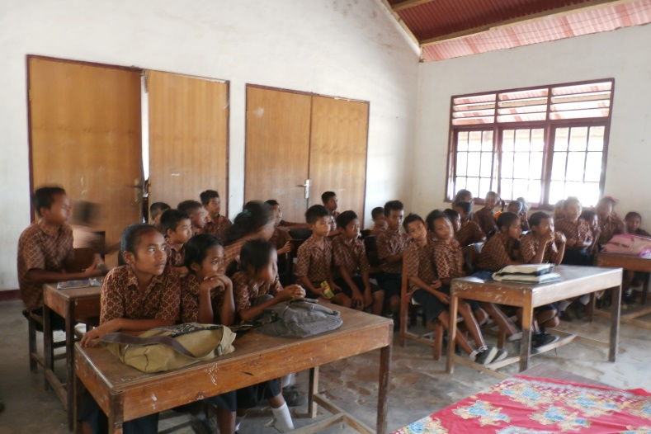
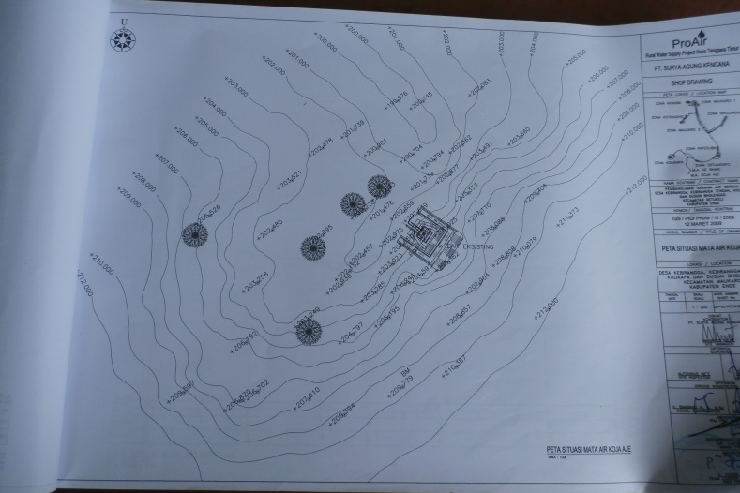
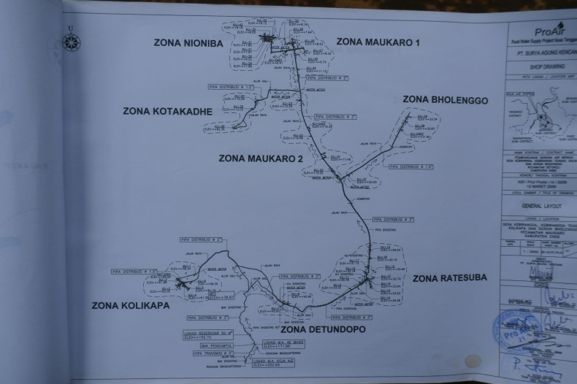
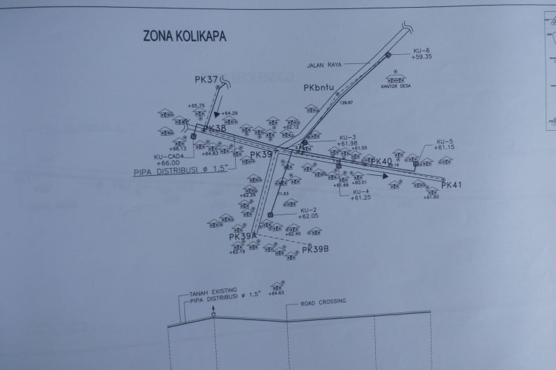
Finding

Slide 14
Field Context on Lamongan
Four Category of cultural boundaries at Lamongan.
The Traditional-agrarian
The Traditional-religious
(Predominantly on South Lamongan)
The Modernist-religious
(Predominantly on Western Lamongan)
The Traditional-Industrial
(Predominantly on North Lamongan)

Slide 15
Findings
Configuration of Local Elite in Lamongan Rural area:
Local Cleric (Religious leader)
Local Landlord
Local Educator/Intelectual
Local Entreupreneur
Local “Youth Leader” (Local gang-leader)

Slide 16
The Existing CBO Condition at Tlanak Village and Kemlagilor Village,Lamongan Regency (Field finding)
Parameter | CBO Tlanak | CBO Kemlagilor
Annual Meeting | Always Once a Year | Always Once a Year
Coverage area | 4 Village (Multisystem) | 2 Village (Multisystem)
Operational Maintanance | Technical resources, relatively independent | Technical Resources Dependency
Regeneration | no | yes
Willingness to Pay | Yes,almost 97 percent | Yes,almost 80 percent
Social sanction/Punishment | Yes | No
Authority | association | association
Local-level Decision Making | Decision made by CBO official, Confirmation through Stakeholder meeting. | Decision made by CBO Official

Slide 17
The Existing CBO Condition at Tlanak Village,Lamongan
Parameter | CBO Tlanak | CBO Kemlagilor
Tariff | Progressive tariff, Monthly conrtibution 1500-2500/m3 | Flat Rates 1000/m3
Cultural context | Traditionalist religious | Traditionalist Industrial
CBO`s Power position | Strategic, economical and Politically Valuable | Strategic, Political
Post Construction | Yes | Yes
Leadership Pattern | Charismatic | Formal
Professionalisation | Yes | No
Organisational type | Association, Cooperation | Association, Cooperation

Slide 18
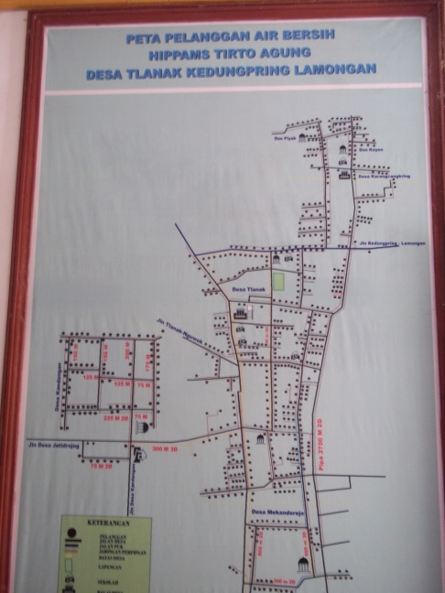
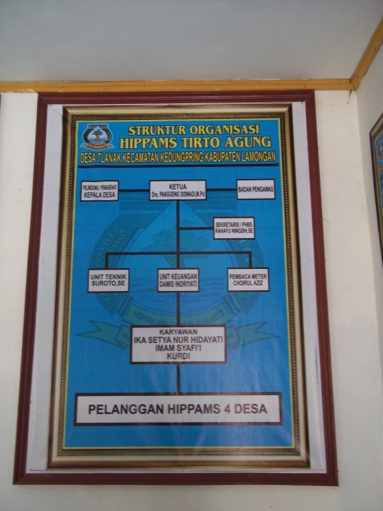
Tlanak
A. The CBO Tirto Agung (CBO Tlanak) succesfully provide water service for 4 Villages. The Water infrasturcture was build on 2008 by MSLIC-2 Program design by Worldbank and AUSAID. CBO Tirto Agung Distribute water into more than 6000 Consumer.
B. Coverage Area:
Tlanak Village
Janggur Village
Kandangrejo Village
Karangcangkring Village
C. The CBO Tirto Agung (Tlanak) applied both Association type and Cooperative type as an Organisational Model.

Slide 19
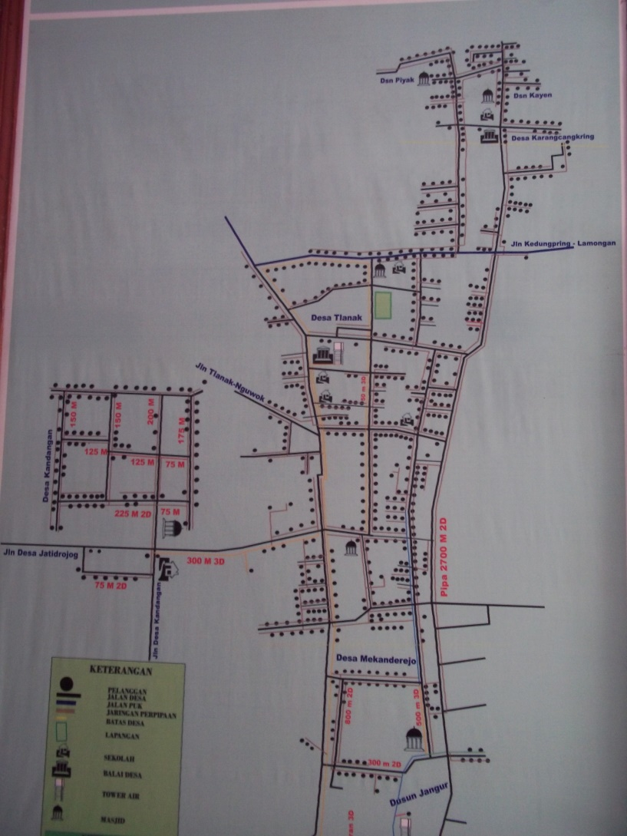
Tlanak
D. Organisational pattern:
CBO Chairman
Secretary
Treasury
Technical Officer
Technical Operator
Sales and Administrative
E..Post Construction
SGP (Second Generation Program) from INDII on 2011, They have regularly supervision by NGO and consultant

Slide 20
Tlanak: Professionalisation and Power relation within CBO
The `Hidden Power` structure in Tlanak Village: Power consolidates in CBO`s leader
The Chairman of CBO nearly absolutely control the CBO`s strategic decision making process.
Public stakeholder meeting only as a “Confirmation” about strategic decision made by The CBO leader
Different social degree mean different power bargain at public meeting
The CBO`s Official involved softly in village politics (The head village election)
The CBO official running the CBO the organisation adopt actor-oriented
There is no regeneration system provided by CBO,
Community Management versus Community Participation?.

Slide 21
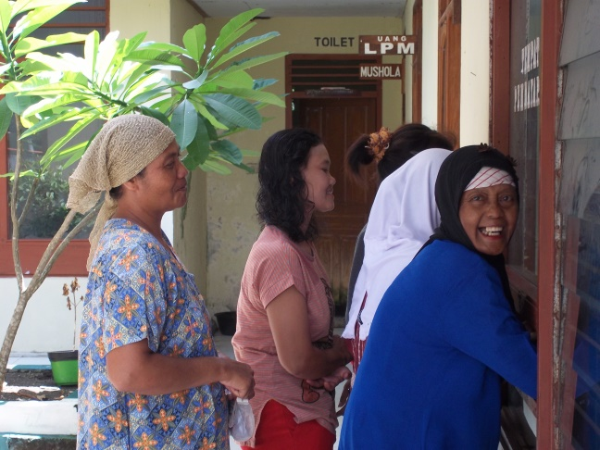
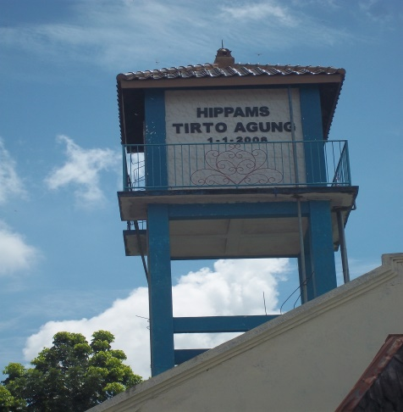
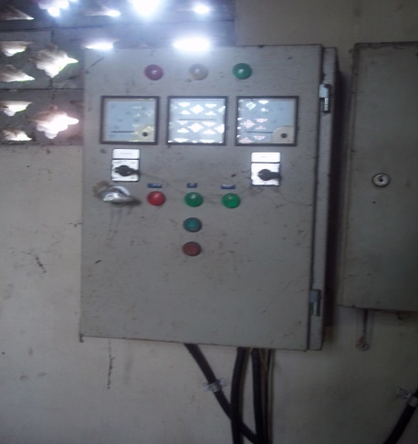
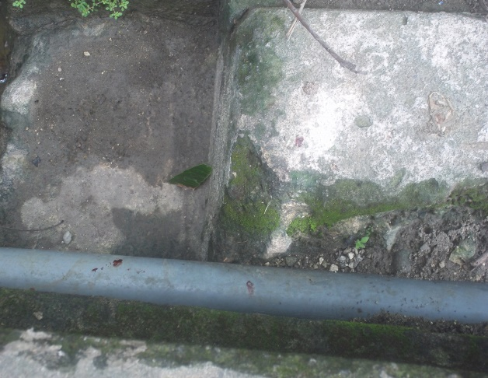
Tlanak
CBO official relatively have knowledge to maintain modern organisation
CBO official have access to technical expert to fix technical problem on daily O/M activity
Progressive tariff 1500-2500/m3
Independent from Local Government
Self sustainable
Profit: +- 6-7 Milllion/month

Slide 22
Tlanak
Community Management are relatively applied in CBO Tirto Agung
Water Committee Formation
Training and Capacity Building
Setting and Collecting water tariff
Management and implementation of operation and maintenance activity
Progressive tariff at 1500-2500/m3

Slide 23
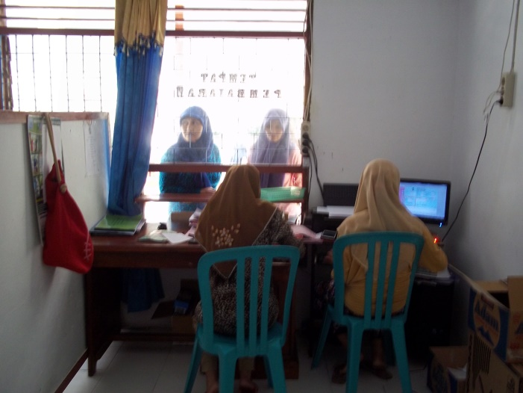
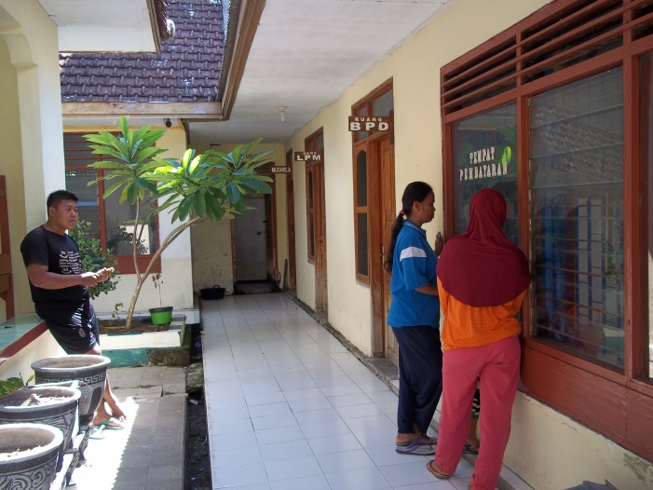
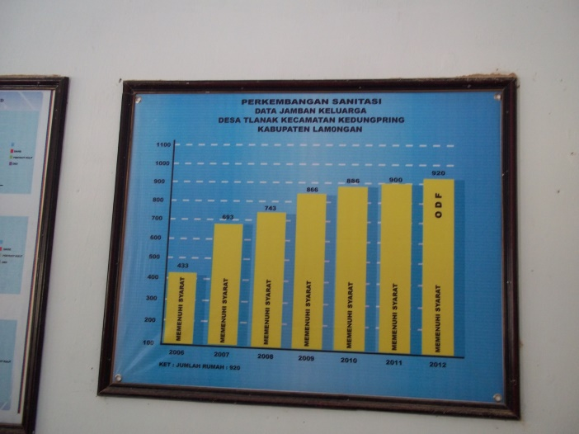
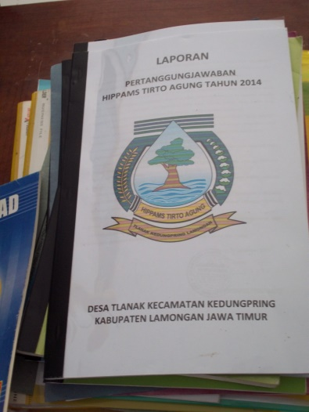
Tlanak

Slide 24
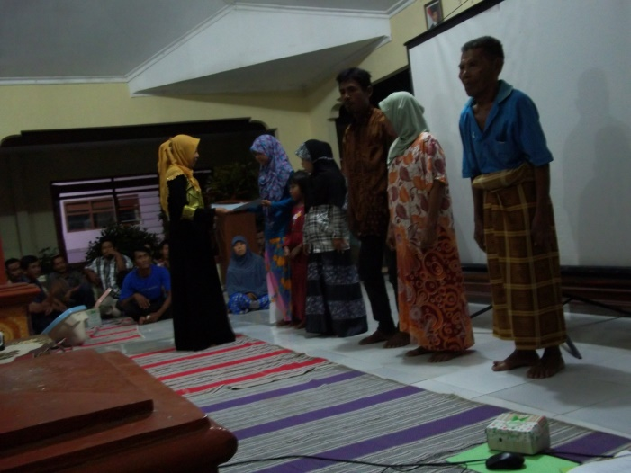
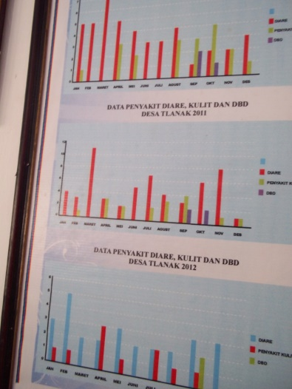
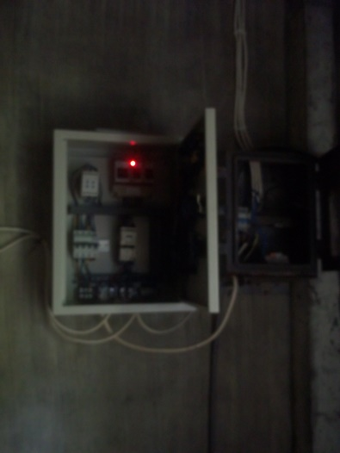
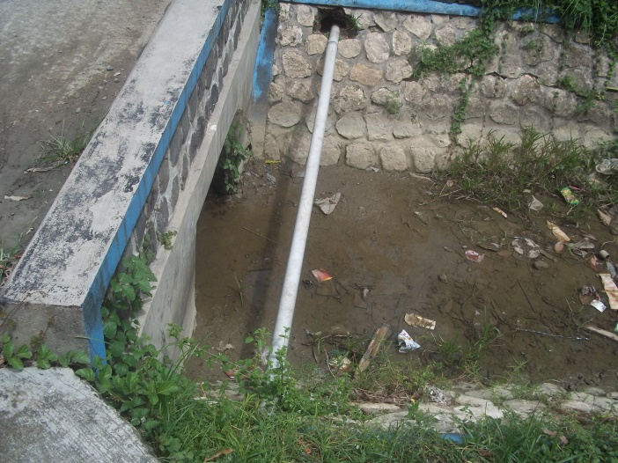
Tlanak

Slide 25
Kemlagilor Findings
The Kemlagilor Village adopt relatively traditional culture in a hierarchal traditional elite of the Jago that largely influence Socil sutructure at Kemlagilor, Turi District, Lamongan.
The people must have to follow a cultural system of Jago as a patron of underworld activity among the regions.
The Jago have a power to maintain social order, punishment or social sanction is given by Jago`s.
Jago often fight each other from different group to preserve their honor/respect/prestige.
Jago also involved in Village politics

Slide 26
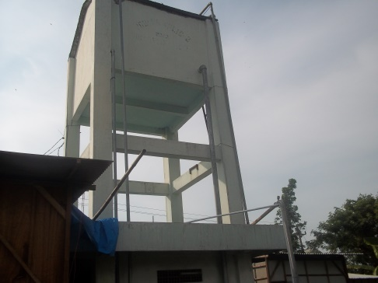
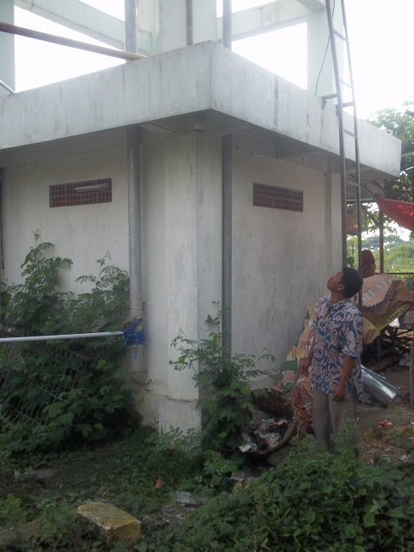
Kemlagilor
A. CBO Margo Tirto (CBO Kemlagilor) provide service for 2 Village. The water Water was build on 2008 by MSLIC-2 Program design by Worldbank and AUSAID. CBO Tirto Agung Distribute water into more than 2000 Consumer.
Services
B. Kemlagilor Village
Kemlagigede Village
C. Organisational pattern:
CBO Chairman
Secretary
Treasury
Technical Officer
Technical Operator
Zone Leader
Limited supervision by NGO

Slide 27
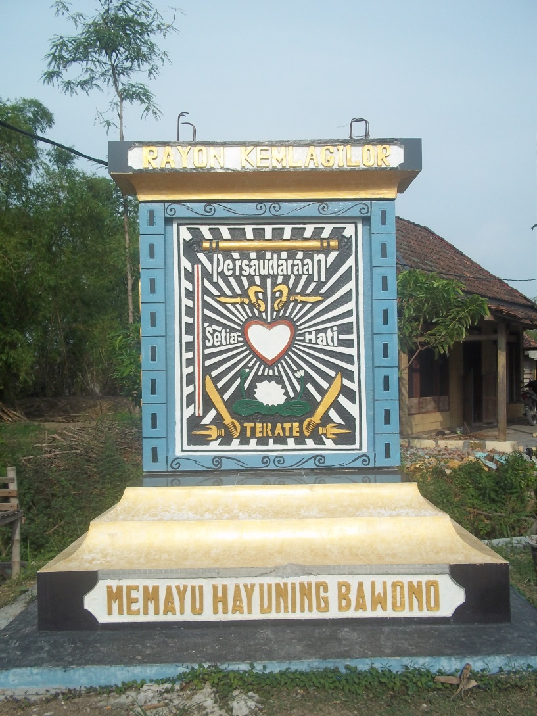
Kemlagilor
D. Post Construction
Second Generation Program provide by INDII
The CBO relatively hold strategics political value among society
The CBO official involved directly into local village politics.
There are 5 time replacement on CBO Official
E. Cultural Structure at Kemlagilor
Village:
Jago/Youth Leader/Gangleader
Local Village official
Clerics
Commoner
-

Slide 28
Findings Kemlagilor
Decision making determined by CBO official
Public participation only as formality as a confirmation of strategic decision that make by CBO Leader
Succession of CBO officials are the impact within internal conflict among community.
The CBO Official do not have sufficient knowledge to maintain CBO Operational activity
People willingness to pay approximately up to 80 percent
Political conflict influence operational and mantainance of CBO activity

