Slide 1
Regulation, Implementation and The Potential Role of Islamic Norms in River Restoration in Indonesia
وَجَعَلْنَا مِنَ ٱلْمَآءِ كُلَّ شَىْءٍ حَىٍّ ۖ
And We created from water every living thing (QS Al-Anbiya:30)
Mohamad Mova AlAfghani
Law Faculty, Universitas Ibn Khaldun Bogor
IICASS-2022

Slide 2
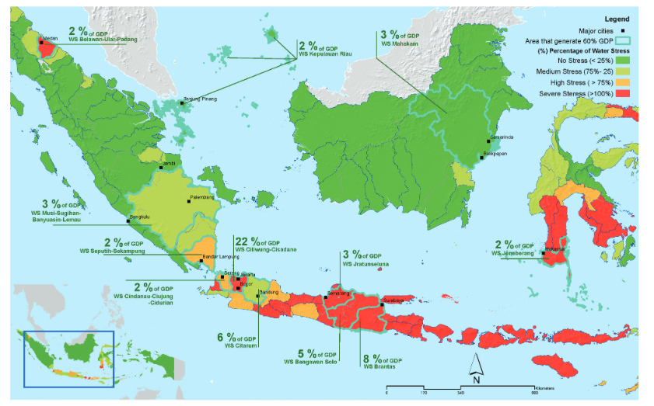
Dry Season Water Stress
“If nothing changes, by 2045 two-thirds (67 percent) of GDP is predicted to be generated in highly or severely stressed basins”
(World Bank, 2021)

Slide 3
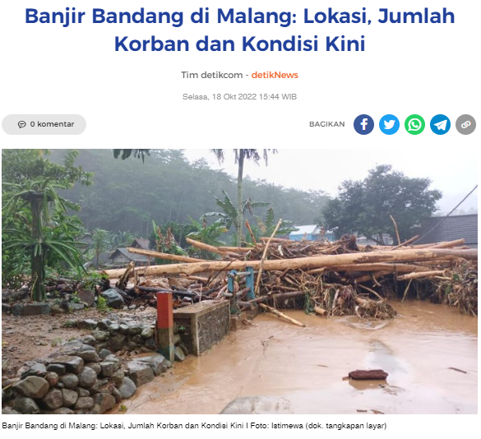
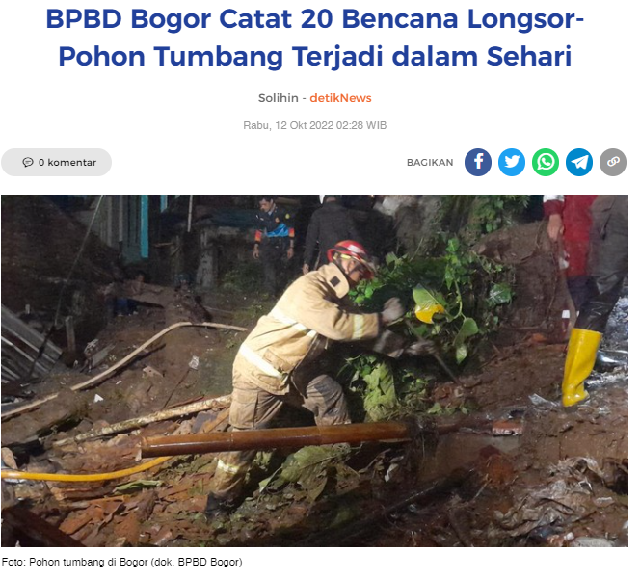
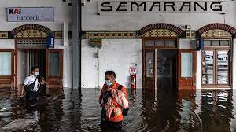
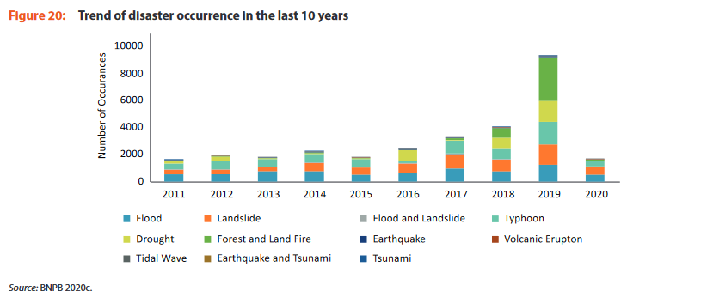
Climate Change & Flooding
Tempo, 2021
According to World Bank 2021, DIBI 2018:
More than 100 million Indonesians are exposed to flood risks
325 cities and districts are classified as high risk
From 2002 to 2015, Indonesia suffered an average reported damage of US$367 million annually due to flooding with a total cost of an estimated US$5.2 billion (discounting socioeconomic losses).
Analysis of 92 cities across Indonesia indicates that the number of reported floods in these cities almost tripled from 50 in 2006 to 146 in 2017
“More than three-quarters of Indonesia’s disasters are meteorological or hydrological” (World Bank, 2021)

Slide 4
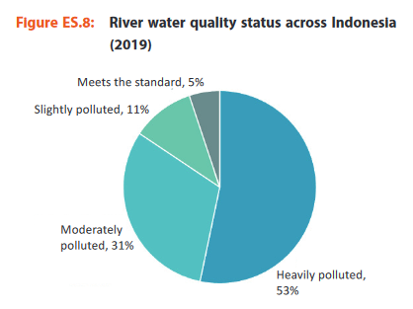
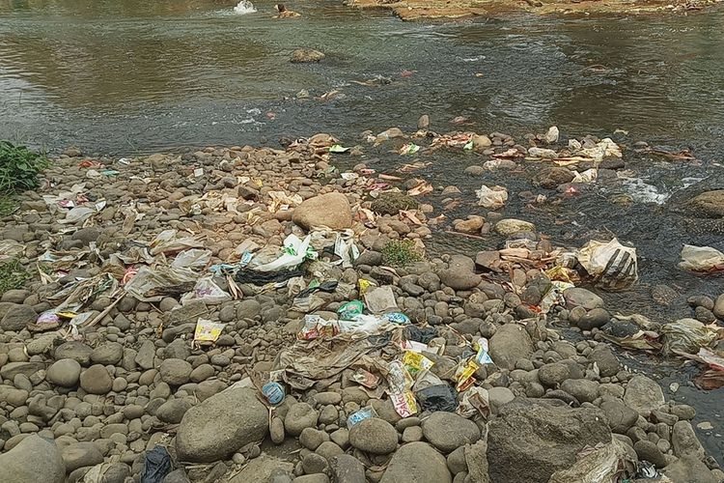
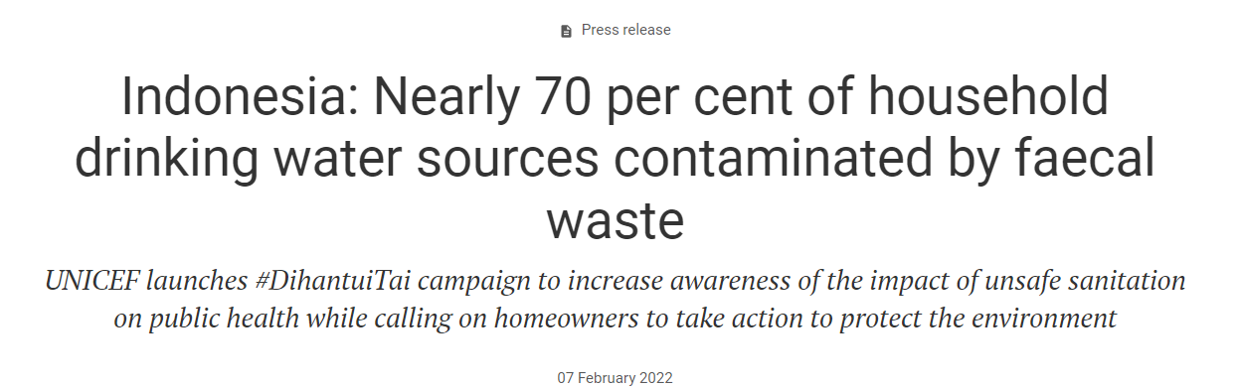
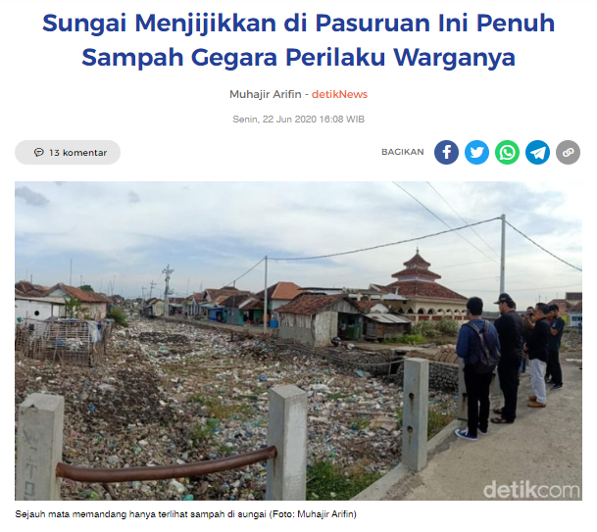
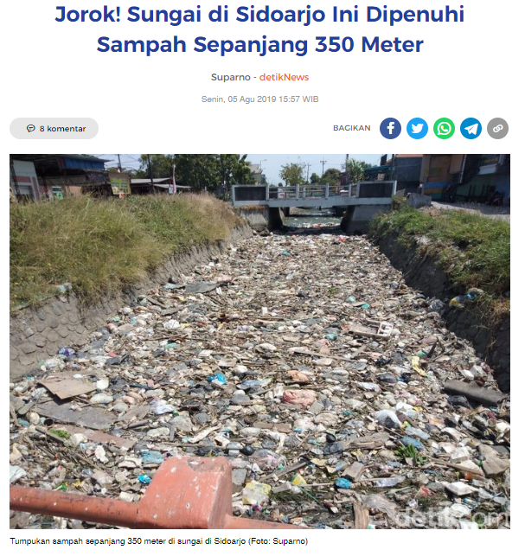
River Pollution and Water Quality Problems
Kompas, 2020
WB, 2021
Riset Buktikan, Sungai Ciliwung Termasuk Sungai Terkotor di Dunia, Kompas, 2020
53% of Indonesia’s River is Heavily Polluted

Slide 5
River Restoration: Conceptual Framework
“Ecological, physical, spatial and management measures and practices...aimed at restoring the natural state and functioning of the river system…” (ECRR)
Policy Driver in the EU:
“Good Water Quality” of the Water Framework Directive 2000/60/EC whose purpose is to “enhance the status of aquatic ecosystem, “maintaining and improving the aquatic environment”; “Good Ecological Status” (Annex V) by looking at for example the composition of aquatic flora, benthic invertebrate fauna (for rivers)
EU Groundwater Directive; EU Floods Directive, EU Bird and Habitat Directive
Hence, the purpose is not anthropocentric (for drinking water or using chemical parameters) but ecocentric -> natural ecosystem

Slide 6
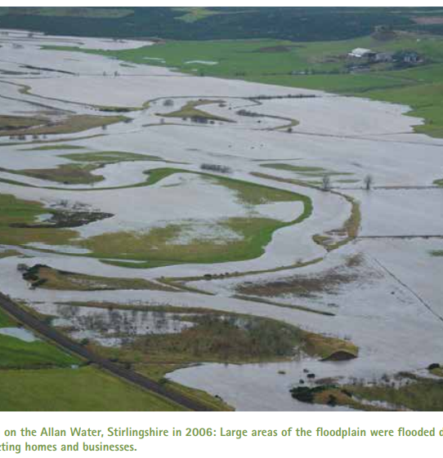
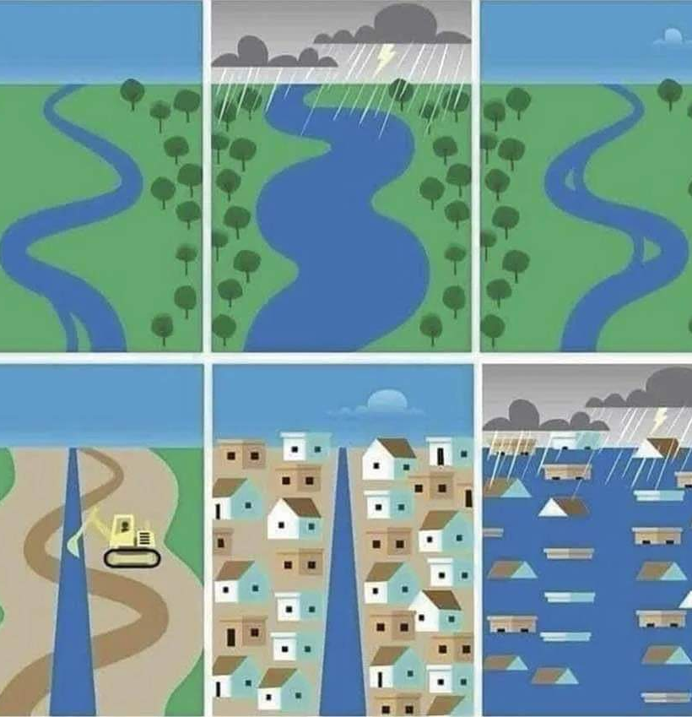
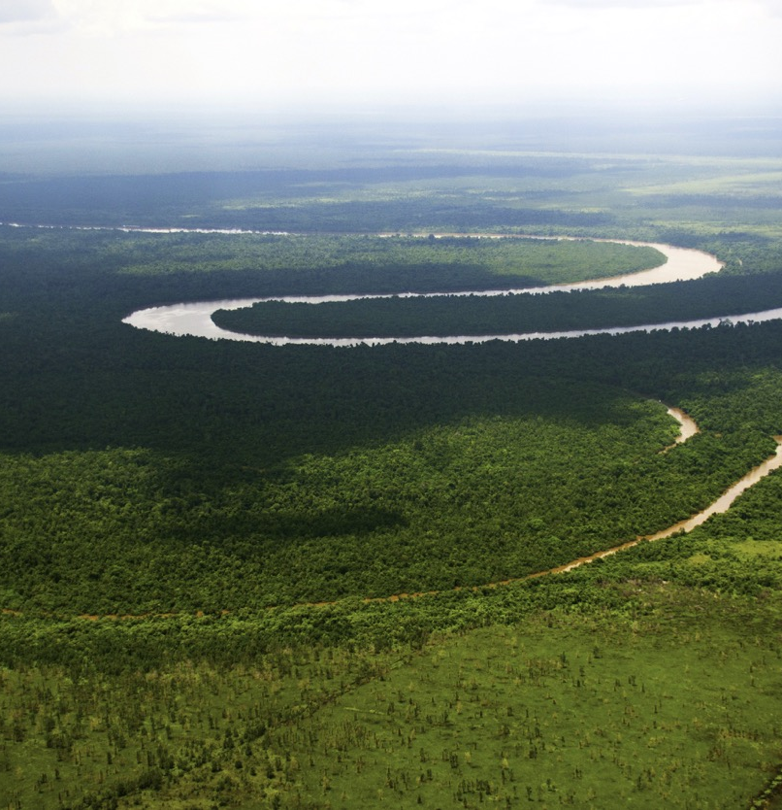
SEPA, 2015
Kahayan River, Kalimantan. Photo: Mongabay
River meander serves many functions, for example, it decreases water velocity. Re-meandering channelized river will improve biological quality, physico-chemical qualityreduce flood risk and protect habitat and many others (NWRM).
Re-meandering channelized rivers, preserving undisturbed meander

Slide 7
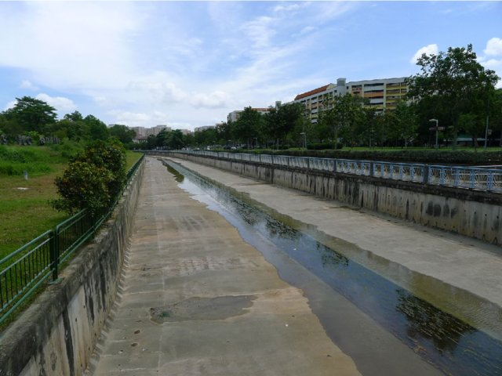
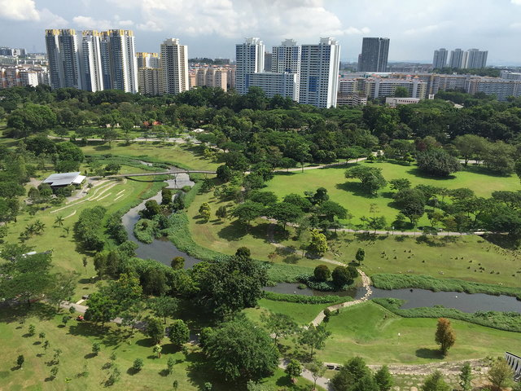
Singapore: From Embankment to Naturalisation
Picture Source: Kuei-Hsien, L; Socio-Ecological Practice Research, 2019
Left: Typical channelized river; Right: Bishan-Ang Mo Kio Park where Kallang River is Naturalized (Kuei-Hsien, 2019)

Slide 8
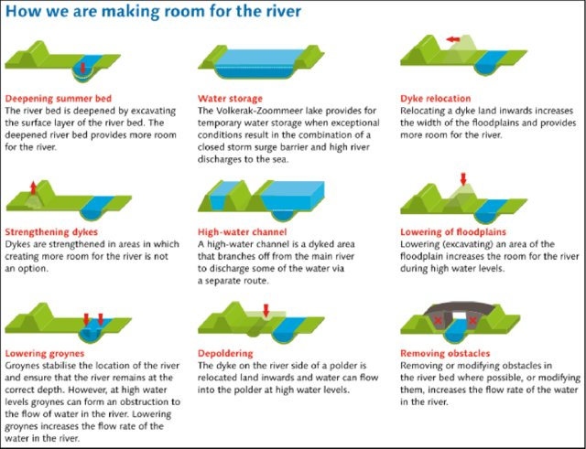
Dutch: Room for the River Projects
(Source: Ruimte voor de Rivier, 2016)

Slide 9
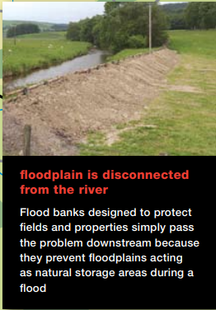
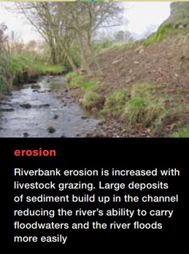
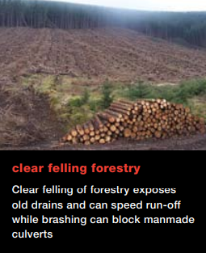
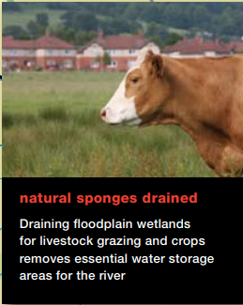
Scotland: Slowing the flow
Picture Source: WWF Scotland, 2016

Slide 10
Normative Framework for Indonesia
Constitutional: The 6 Basic Principles require water commercialization by the private sector to fulfill environmental needs (AlAfghani, ICCIS, 2022)
Water Law 17/2019: There are no explicit environmental flow regime but require allocation to calculate water for the maintenance of water sources and environment (Art 8 para 6); Conservation and Ecosystem must “be considered” (Art 22); Water resources is acknowledged as a part of ecosystem and the living space for flora and fauna (Elucidation of Art 21 (1)
Government Regulation 22/2021 on the Management and Protection of Environment: water pollution control is largely based on ambient and effluent standards (thus, not aquatic ecosystem)
To conclude: Unlike the EU, there are no legal obligation (both of conduct or of result) to restore river to its natural state under existing legal framework. The legal framework in Indonesia is anthropocentric, not ecocentric.

Slide 11
Naturalisation in Jakarta (Gov Reg 31/2019)
Definition: “….way of managing water resources through open green spaces by still paying attention to storage capacity, flood control functions and conservation…”;
The environmental ecology function conserves flora and fauna living in water resources through the provision of seeds in order to revitalize the ecosystem (Art 5 para 5)
Considerations to be made: (i) availability of land, (ii) optimum storage for flood control and (iii) the purpose is to return the ecosystem in water resources
Despite deficit in its legal formulation, this is closer to the EU’s approach of good ecological status and is a departure from the national legal framework.

Slide 12
Normalisasi (“Normalization”)
The term “normalisasi” is not a standard legal terminology and is usually found in policy documents. However, it is mentioned in Jakarta’s Regional By Law on Spatial Plan 1/2014, as a part of spatial plan but is not defined.
The term is usually used for river infrastructure maintenance through dredging, providing more space in the buffer zone or channelization. The approach is therefore is more in line with the grey infrastructure development and maintenance rather than nature-based solutions.

Slide 13
Islamic Norms (1): Basic Principles
According to Ahmad (1999):
Water (including river) is considered as Huquq Allah (rights of God) as opposed to huquq al’ibad (rights of humankind); the rights of Allah cannot be remitted, pardoned, relaxed, or compromised;
“The laws for maintaining water quality are not premised on property law or even on tort law. They are ecocentric, based solely on the character of water”;
“…the law requires that water be kept free from pollution so that it may continue to perform its social and religious functions, as well as serve as habitat for a great number of creatures”;
According to Caponera and Nanni (2007):
“…the gift of water entails a religious obligation deriving from the very nature of water, out of which ‘every living creature was created’” (This is referring to QS Al-Anbiya:30 “And We created from water every living thing)

Slide 14
Islamic Norms (2): Harim
The term “Harim” means inviolable. This could include sources of water such as seas and lakes, rivers, springs, wells, watercourses, which should have inviolable zones to preclude nuisances and hazards (IUCN, 1994).
“Harim is mainly associated with watercourses and rivers, but is also applicable to lands. It is the land that immediately adjoins all the corners of a well or the bank of a river. It is the buffer zone surrounding a water body within which human activities, apart from the lawful use of water, are prohibited. The cardinal rule of harims adjoining waters is that they must remain undeveloped” (Ahmad, 1999)

Slide 15

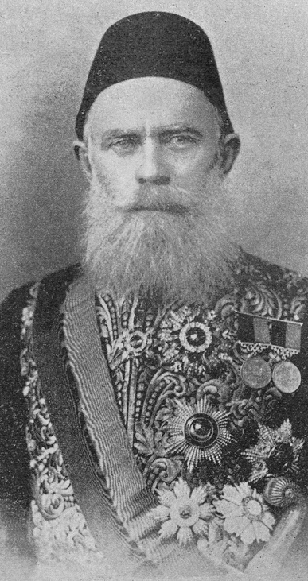
Islamic Norms (3): Harim in the Ottoman’s Mecelle
Mecelle is the Civil Code of the Ottoman Empire, based on the codification of the Sharia. Ahmed Cevdet Pasha (1822-1895) headed the Mecelle Commission.
Section VI. Ownership of Land Surrounding Wells Sunk, Water Brought and Trees Planted with Imperial Permission in Dead Land
1283. The land attaching to the two sides of a big river which does not require continually to be cleaned amounts to one half the breadth of the river. The amount of land attaching to both sides of the river is equal to the breadth of the whole river.
1284. The land attaching to small rivers which continually require to be cleaned, that is to say water courses, canals and underground channels, consists of an amount large enough for the stones and mud to be thrown upon when being cleaned.

Slide 16
Conclusions
In the EU, The Water Framework Directive requirement to attain good ecological status, as measured for example by flora and fauna, prompted the movement to “restore” rivers to its natural ecosystem;
This requirement is absent in Indonesia’s legal framework such as the Water Law and the Environmental Law which is anthropocentric in its approach (for example, looking at ambient water quality for drinking water purpose = class 1) and managing water quality solely based on parameters;
Under Islamic Law, Water is considered Huquq Allah (Rights of God) in which officials have little discretion; “The laws for maintaining water quality are not premised on property law or even on tort law. They are ecocentric, based solely on the character of water” (Ahmad, 1999);
The concept of Harim means that certain area (for example along the river) must remain undeveloped (Caponera and Nanni, 2007);
The requirements in the EU Water Framework Directive (2000) is concordant with Islamic Law approaches towards ecocentric water management; whereas the Indonesian legal framework is not;
Approaches to river restoration such as in Jakarta have tried to go beyond the national requirement but faces obstacles, especially related to land acquisition

Slide 17
Recommendations
In order to achieve SDG Target 6.6 (protect and “restore” water-related ecosystems, including mountains, forests, wetlands, rivers, aquifers and lakes) the regulatory and institutional framework must be in place;
This would require the Water Law and the Environmental Law to be reformed so that it contains an obligation of conduct to protect rivers and floodplains that are still in natural conditions and gradually restore developed floodplains to its ecological functions;
Islamic Water Law principles could have three potential roles: (i) to provide insight for water and environmental law reform, (ii) to motivate behavioral change and (iii) to increase demand-side for government responsiveness towards healthy and clean water

Slide 18

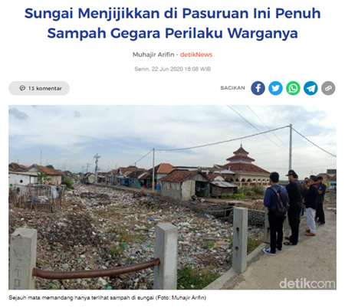
Something to ponder…. and further Research Question
We are the world’s largest Muslim population in a country;
We have been taught about najis since childhood;
Islamic injunctions regarding water conservation is very strong;
But why is our river dirty and our water sources contaminated with faeces?
Hypothesis: Aside from the governance and management of wastewater and solid waste, there are behavioral aspects: (i) lack of emphasis on public or environmental ethics at Da’wa, (ii) separation between private and public ethics at the individual level (e.g. wudhu using contaminated water); (iii) lack of contextualization of Islamic principles to contemporary challenges such as climate change and pollution

Slide 19
Thank You.
Wallahu a'lam bishawab

