Slide 1



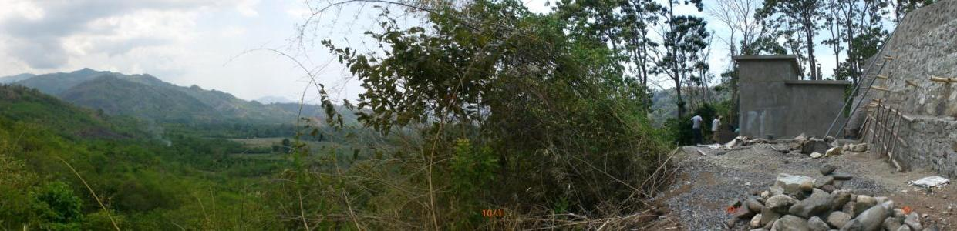
Rural Water Supply and Sanitation Project Nusa Tenggara Timur, Indonesia
KfW Project No.: 2001 65 134
Indonesian – German Development Cooperation
Rural Water Supply and Sanitation Program Nusa Tenggara Timur
ProAir
ProAir Alor-Ende
Ende District; 2007 - 2010
Presented for CRPG AIIRA Workshop; Novotel Bogor, 8 February 2015

Slide 2
Background
ProAir is a join program between The Government of Indonesia and The Government of Federal Republic of Germany in Rural Water Supply & Sanitation Project in East Nusa Tenggara
This program started in 2002 with coverage area:
  Sumba Barat & Sumba Barat Daya,
  Sumba Timur,
  Timor Tengah Selatan,
  Alor & Ende in 2006
Funding 90% Grants, 10% Local District
Applying WASPOLA Concept, the empowerment object of the project is the community itself to build a Water Supply System that meet current standards and sound management, while ProAir filling gaps in where they are currently incapable of.
Grants through KfW Entwicklungsbank,
  Technical Consultant Rodeco GmbH (GOPA),
  Social Consultant (Empowerment, Sanitation included) by GTZ (GIZ)

Slide 3
Working Area of ProAir Ende
ProAir Program in Alor and Ende Districts is using the remaining Allocated Grants
Both Technical & Social part of the project is executed solely by the Technical Consultant – Rodeco GmbH.
Therefore there was no Sanitation Work done in both Alor & Ende
Notes:
Pekerjaan dilaksanakan seluruhnya oleh Konsultan Teknis Rodeco

Slide 4
Challenges in Ende
Tantangan Kegiatan di Ende
Communities require longer time to understand the demand-driven approach of ProAir as there was a system already in use
Activities covered 22 villages and not the usual number of 6 to 8 villages per district according to available budget and time
Selection and training of facilitators and trainers had to start from scratch. Re-training was considered necessary
Various type of Proposed Water Sources
Difficult access of project sites
Masyarakat perlu waktu lama untuk memahami pola baru pendekatan pemberdayaan ProAir karena sudah ada sistem berbeda yang dipakai
Aktifitas serentak mencakup 22 desa, tidak bertahap dalam 6 – 8 desa per kabupaten disesuaikan ketersediaan dana dan waktu
Seleksi dan pelatihan terhadap fasilitator harus dilakukan dari dasar sekali. Pelatihan penyegaran sangat diperlukan
Jenis sumber air yang diusulkan bermacam-macam
Sulitnya akses ke daerah kerja

Slide 5
Challenges in Ende
Tantangan Kegiatan di Ende
Delays through preparation of basic data and granting of water rights
In-cash collection needed much more time as communities are generally poorer than in other districts
The rainy season and dense rain forest along transmission pipeline made topographical surveys time consuming
The unusual long rainy season caused blockage of roads through landslides. Access to project sites not possible for several weeks.
Hiring of qualified and experienced staff was time consuming
Management of social and technical staff on two separate islands (Alor & Ende) needed more time as originally scheduled
Hambatan dalam pengumpulan data dasar dan lamanya proses pengalihan hak pakai Mata Air
Pengumpulan Tabungan Pemeliharaan lebih lama karena secara umum masyarakat target lebih miskin dibandingkan di kabupaten lain
Musim hujan dan rapatnya hutan sepanjang jalur pipa transmisi membuat survey topografi lebih lama
Musim hujan yang tidak menentu menyebabkan longsor yang menghambat akses ke lokasi selama beberapa minggu
Sulitnya mendapatkan staf yang mampu dan berpengalaman
Pengelolaan staf sosial dan teknis di dua pulau terpisah (Alor & Ende) membutuhkan waktu lebih lama dari yang direncanakan

Slide 6
ProAir Principles
Community is the central object, therefore they have to be actively involved in all phase. There will be no ProAir Investment / Activity without.
Community’s Proposal will be evaluated individually from technical, social & economical aspects, including environmental impacts & follows local customs & traditions.
There is no guarantee the ProAir is automatically accept Community’s Proposal
Ready to support community needs only if the community itself is fully willing & ready to works according to ProAir principles.
Water is free but Water System is expensive, therefore ProAir is relying to standardized materials & accessories
Example of Technical Criteria
  Gravitational System with Galvanized Iron (GI) Pipes (No HDPE or PVC’s)
  Source of Water: Water Springs
  Standardized Goods, Equipments & Tools - SNI

Slide 7
ProAir’s Requirements
Quantity , with the given parameters:
  Minimum domestic requirement (Q_{dom} = 40 liter/day/capita)
  Non-domestic requirement (Q_{nd}= 10% x Q_{dom})
  Population Growth Estimates up to 10 years
  Potential Leakages (20%)
Spring Quality (Lab scale & Local Guidelines/Permenkes)
  Physical
  Chemical
  Biological
Elevation Difference (Water Spring(s) to Service Area)
Distance (Water Spring(s) to Service Area)
Other Potential Risks (Cost, Ownerships, Spring Usage, etc.)

Slide 8
ProAir Criteria
Local community should write their own handwritten proposal based upon a village meeting, signed by all interested households, consisting of 15 items:
  A proposal that originated from a village meeting in proposing the water system, signed by all interested households
  Letter of Agreement to collect In cash – circa 4% of investment cost, with a copy of a Bank Book.
  Letter of Agreement to collect In-kind portion in a form of building materials – stones, sands, woods, bamboos, etc.
  Letter of Agreement for Labor participation
  Letter of Water Spring’s - Free of Charge - Handing Over Rights
  Letter of Agreement for paying monthly contribution – iuran.
  Letter of Agreement for using private land for pipelines and other parts of the water system.
  Letter of Aggreement for Land-reforestation within the spring’s water catchment area
  History of the Village
  Letter of Cooperation for Multi-village system
  List of Households from Coverage Area
  Official Note - Berita acara – Selection of Committee Personnel
  Letter of Agreement for routine Springs monitoring
  Village Map
  List of Public Facility

Slide 9
Study On ProAir Requirements
NO | Village Name | Single System Requirements |  |  | Multi System Requirements
 |  | Technical | Economy | Social | Technical | Financial | Social
1 | Nabe | + | + | + | + | + | +
2 | Kobaleba | - | - | +
3 | Kebirangga Selatan | + | + | + | + | + | +
4 | Kamubheka | + | + | + | + | + | +
5 | Mundinggasa | - | - | +
6 | Kebirangga Tengah | - | - | + | + | + | +
7 | Bolenggo of Magekapa | - | - | +
8 | Kolikapa | + | - | +
9 | Kebirangga | + | - | +
10 | Watunggere | + | - | + | + | + | +
11 | Nida | + | + | +
12 | Unggu I | - | + | +
13 | Nggesa | + | + | + | + | + | +
14 | Wolomuku | + | + | + | + | + | +
15 | Detukeli | - | - | + | + | - | +
16 | Ndikosapu | - | - | + | + | - | +
17 | Kanganara | - | - | + | + | - | +
18 | Maurole Selatan | - | - | + | - | - | +
19 | Watunggere Marilonga | - | - | + | - | - | +
20 | Nggesa Biri | - | - | + | - | - | +
21 | Detumbewa | - | - | + | - | - | +
22 | Kebesani | - | - | + | + | - | +
+ | Passed
- | Failed

Slide 10
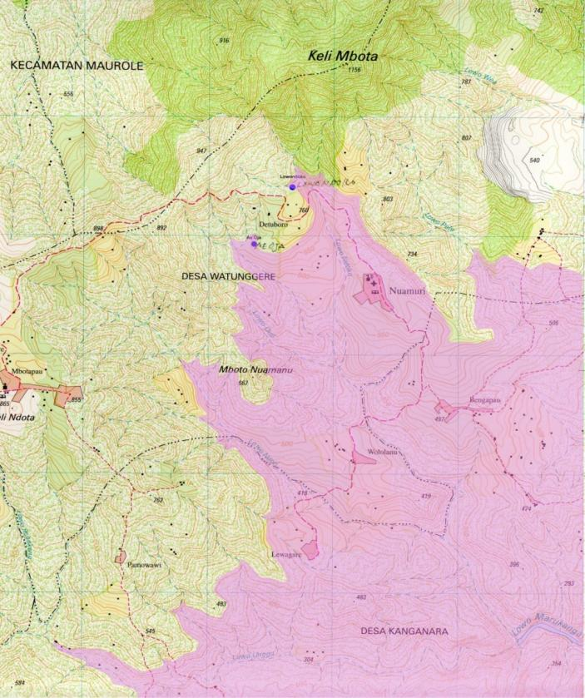
Sample on Field Study
Water Springs Ae Oja & Lowondoko
Feasible Service Area (calculated after field measurement using GPS and drawn on official map)
Desa Watunggere
Desa Nida
Dusun Bengepau (Unggu)
Dusun Lewagare (Unggu)
Map Source : Bakosurtanal RBI 1:50.000

Slide 11
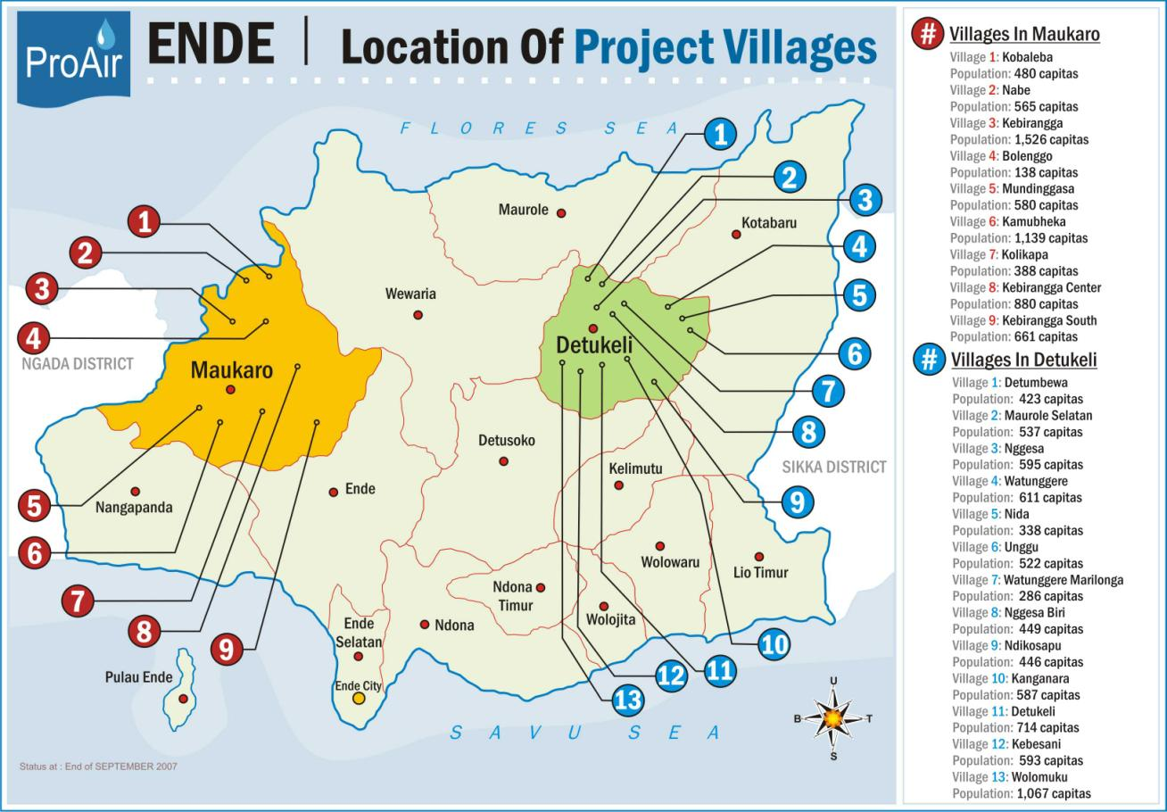
Location Of Project Villages

Slide 12
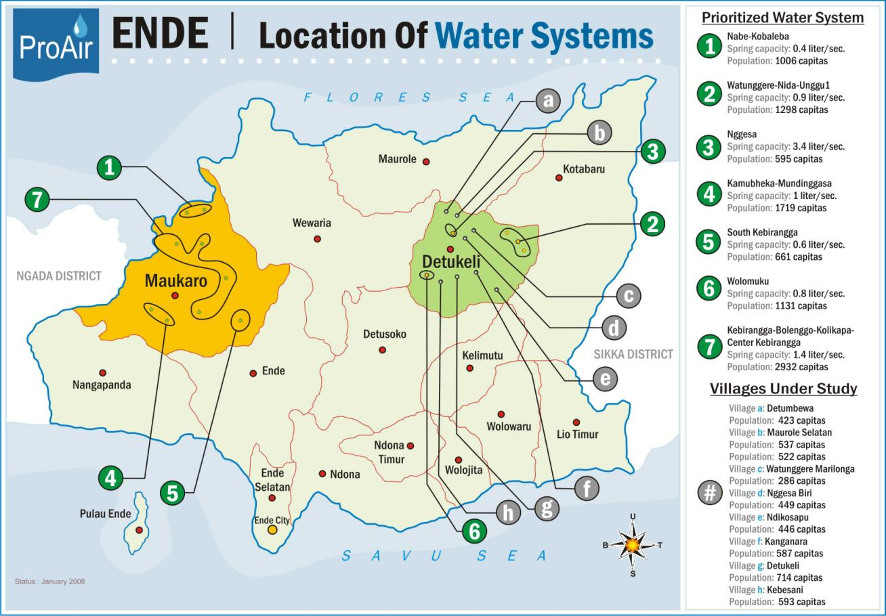
Location Of Water Systems

Slide 13
Work Phase
Information Campaign
Submission of Community’ Proposal & In-cash Amount in Bank Account under Water Committee name
Feasibility Study (Technical, Social, Economical Screening)
Persiapan Masyarakat /Detailed Design
  Pendataan baru wilayah cakupan (IDASI) (capita/HH)
  Legal Documents (General Coverage)
  Formation of Committee (BP-SAB)
  Campaign / Socialization
    Pre-Design
    Detail Engineering Design
    Ground Rules Discussion

Slide 14
Work Phase
Tendering Process/In-Kind Calculation/ Construction Execution
  In-cash 100%
  In-kind Portion are legalized
  Complete Legal Documents (Detail Coverage)
  Pre-Construction Meeting
  Construction Work
  Preliminary Handing Over (PHO – 6 months)
Post Construction Support
  Technical Training / Critical Points
  House Rules Discussion & Notary Act (Akte Notaris Kelompok)
  Retribution / Iuran & Bookkeeping
  Cash flows & Reporting
  O&M management training
  Water System Monitoring
Final Handing Over

Slide 15
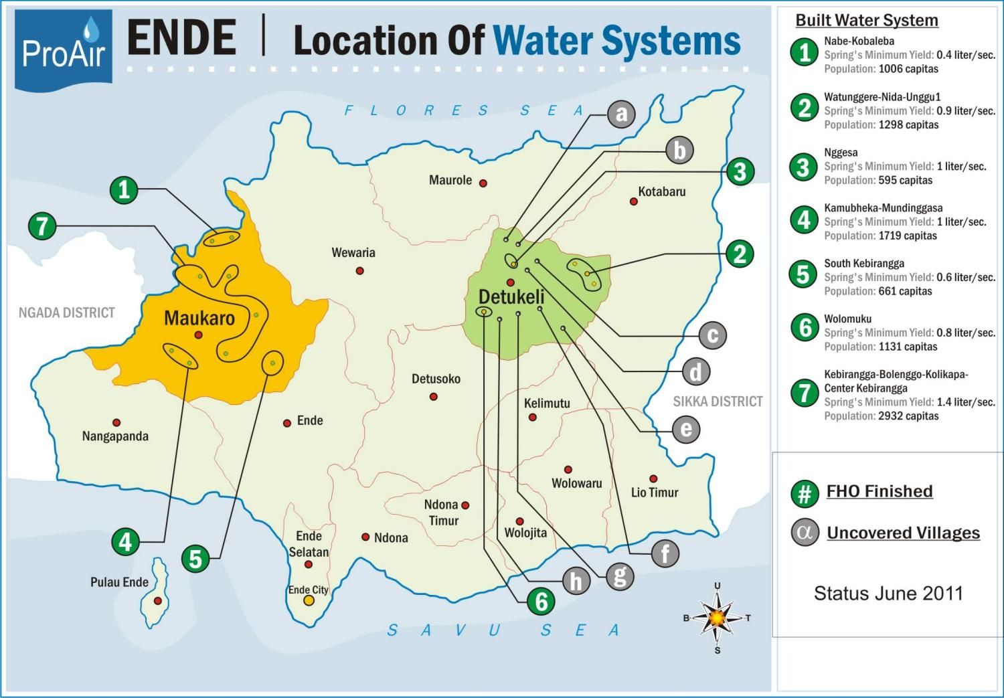
Lokasi Kerja

Slide 16
Service Coverage
No | Desa | Kecamatan | Populasi Desain (kapita) | Perkiraan Biaya Pembangunan (IDR) (July 2010)
1 | Nabe | Maukaro | 576 | 2,211,874,950
 | Kobaleba |  | 430
2 | Watunggere | Detukeli | 618 | 3,213,874,000
 | Nida
 |  |  | 470
 | Unggu 1
 |  |  | 210
3 | Nggesa | Detukeli | 595 | 1,429,746,476
4 | Kamubheka | Maukaro | 1,139 | 2,962,230,000
 | Mundinggasa |  | 580
5 | Kebirangga Selatan | Maukaro | 661 | 2,443,874,000
6 | Wolomuku | Detukeli | 1,131 | 1,986,055,583
7 | Kebirangga Tengah | Maukaro | 880 | 4,343,647,300
 | Kebirangga |  | 1,526
 | Bolenggo |  | 138
 | Kolikapa |  | 388
 | TOTAL |  | 9,342 | 18,591,302,309

Slide 17
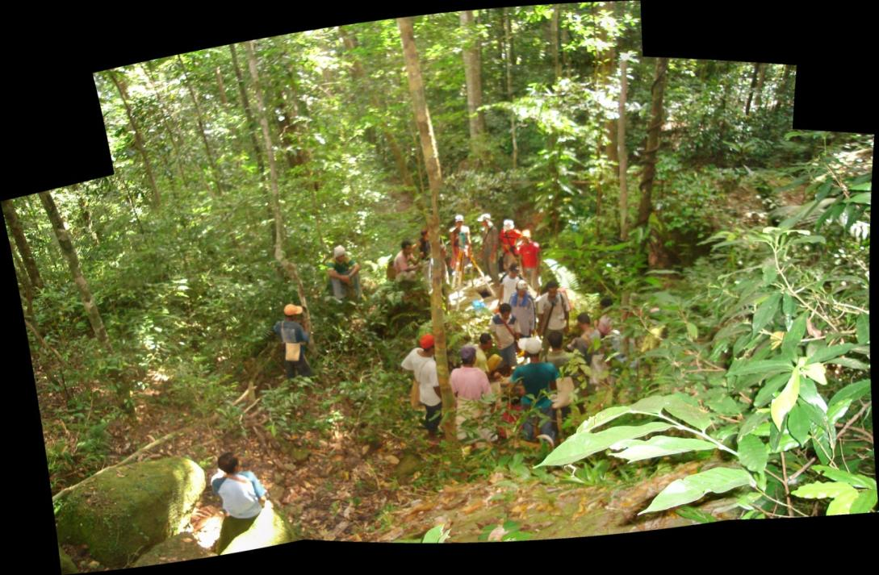
Photo Gallery
Terestrial Survey

Slide 18
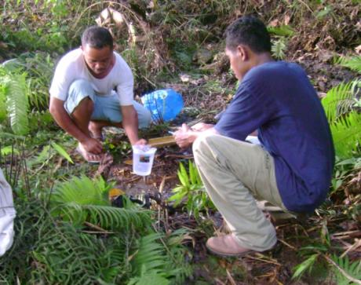
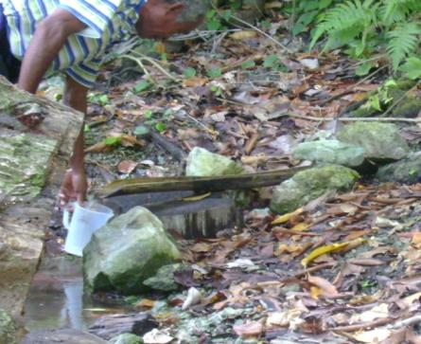
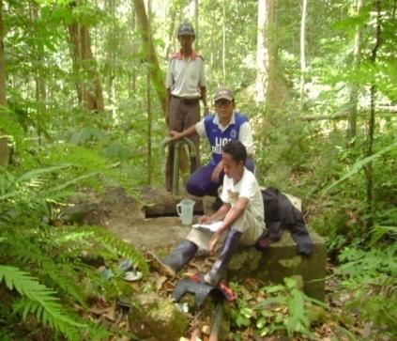
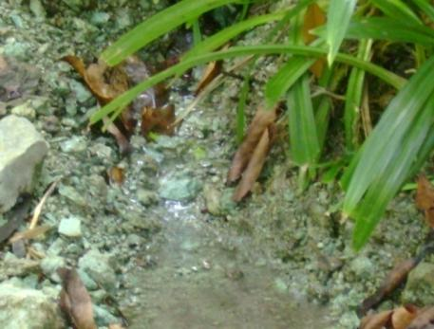
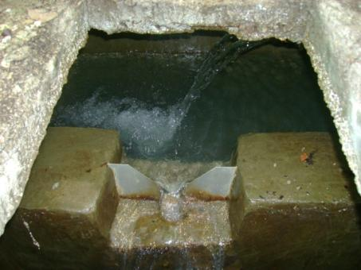
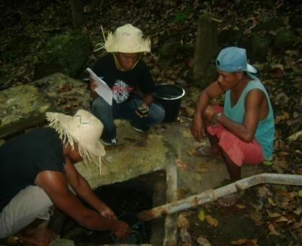
Photo Gallery
Spring Yield Measurement

Slide 19
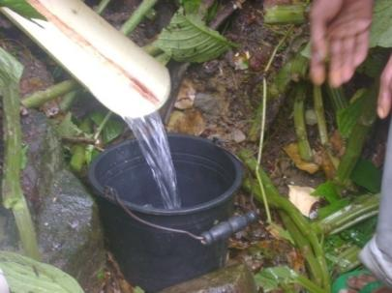
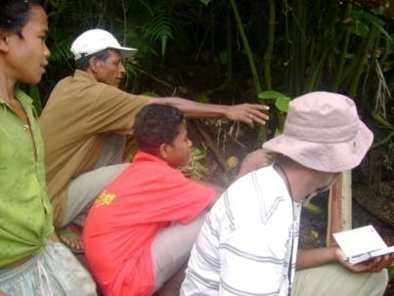
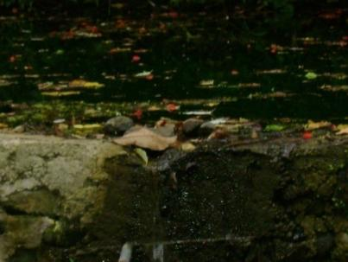
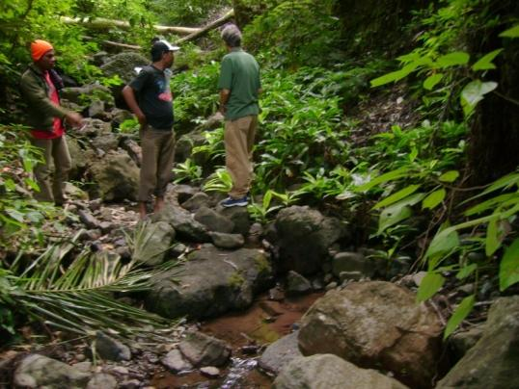
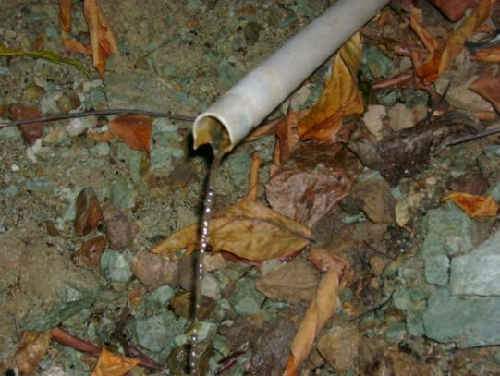
Photo Gallery
Spring Yield Measurement

Slide 20
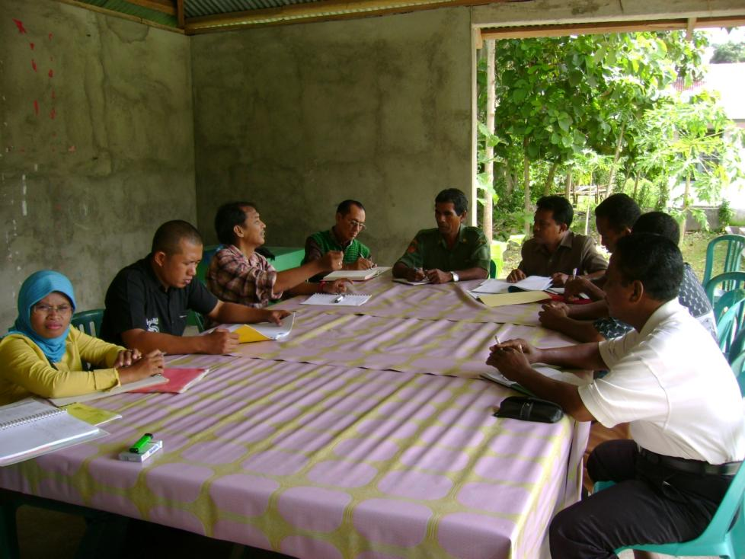
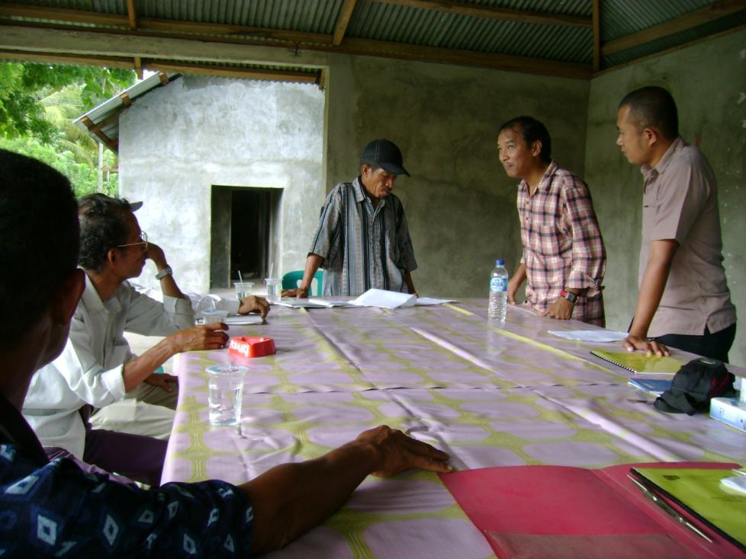
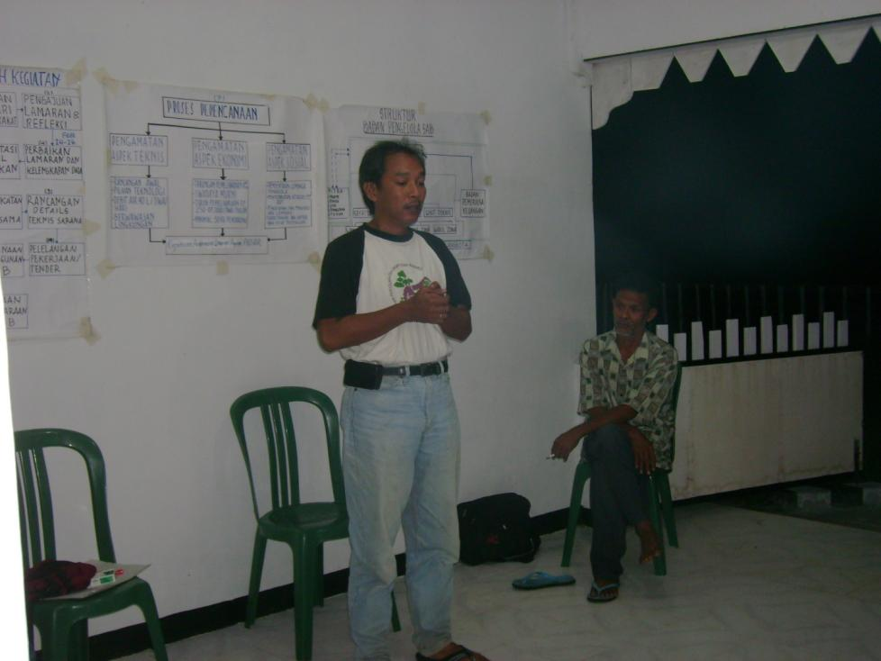
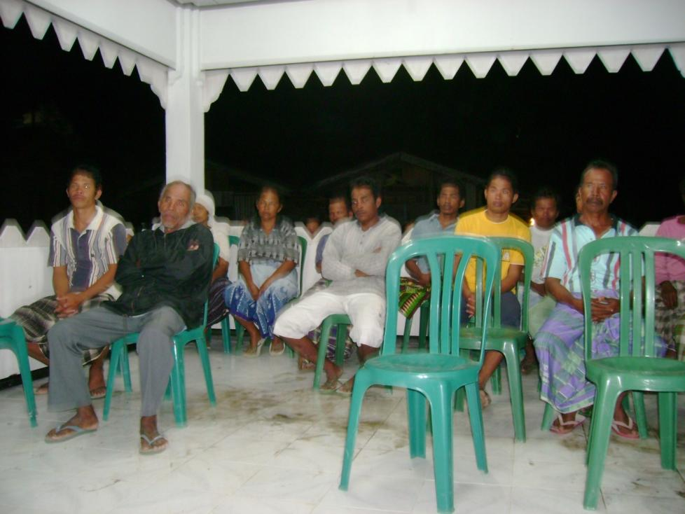
Photo Gallery
Socialization of ProAir Program

Slide 21
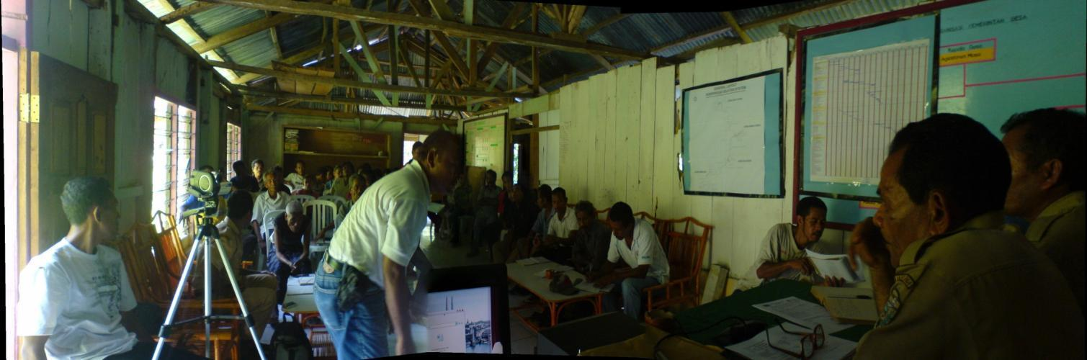
Photo Gallery
Pre Construction Meeting

Slide 22
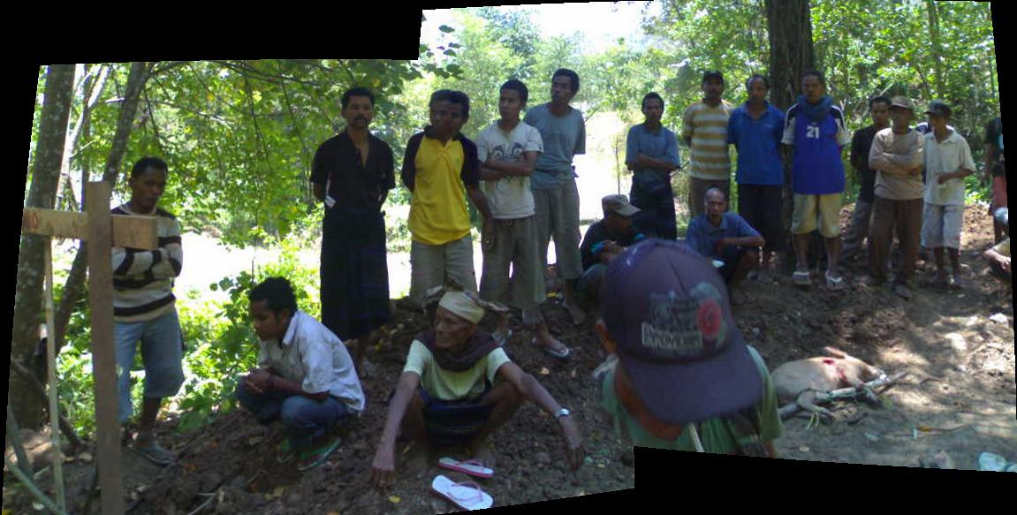
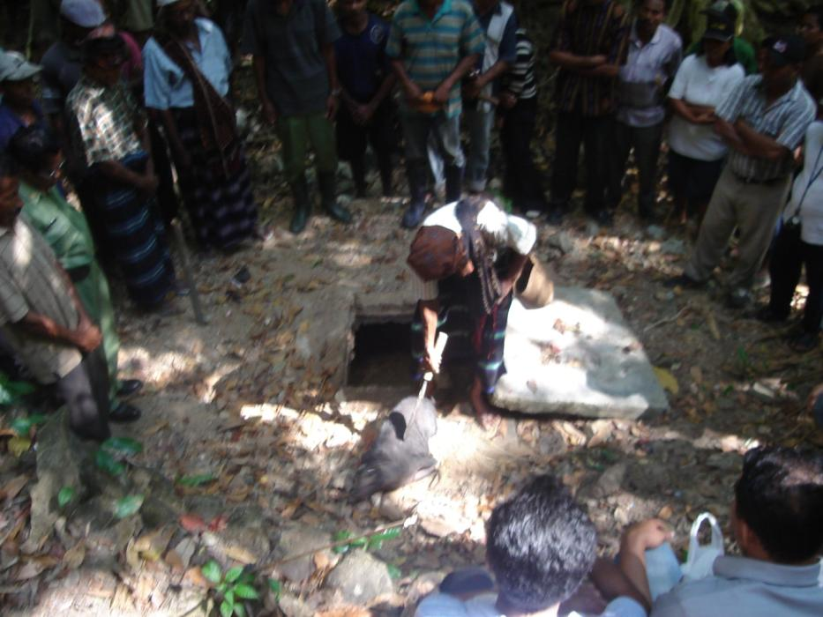
Photo Gallery
Tribal Ceremony / Nekatana

Slide 23
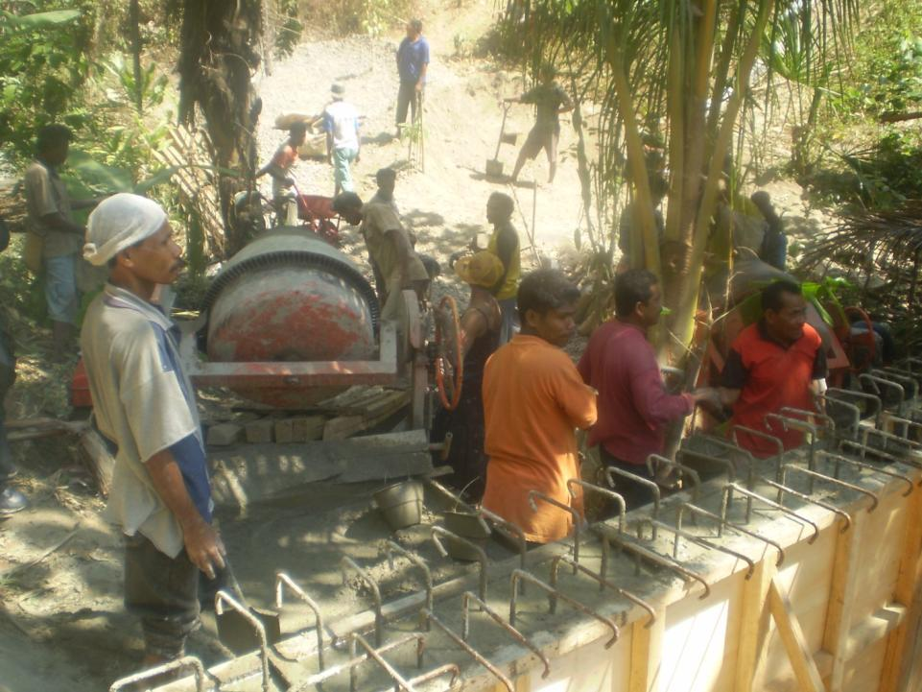
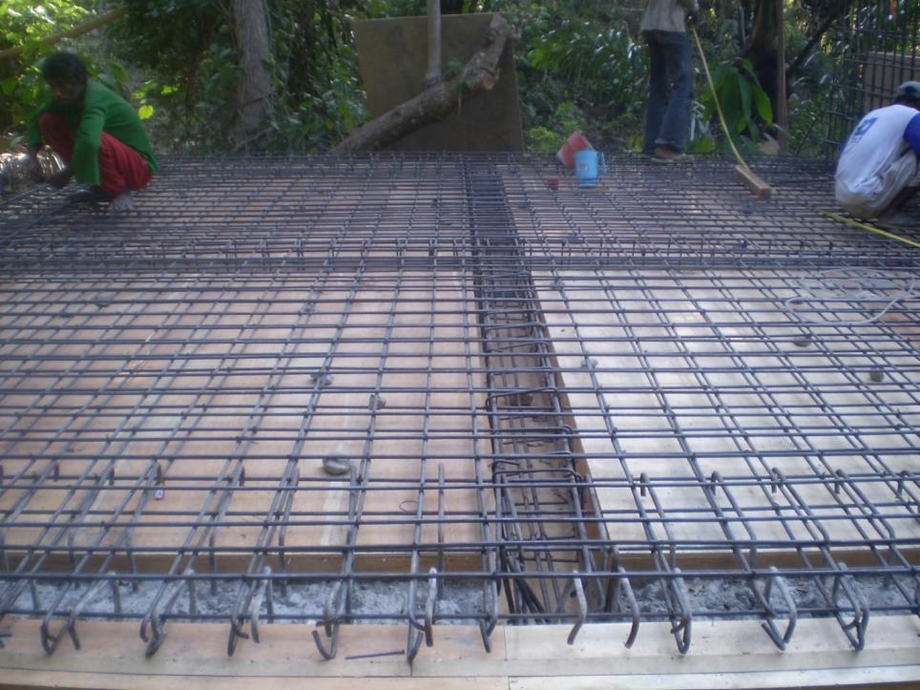
Photo Gallery
Beton Casting – In-kind Portion

Slide 24
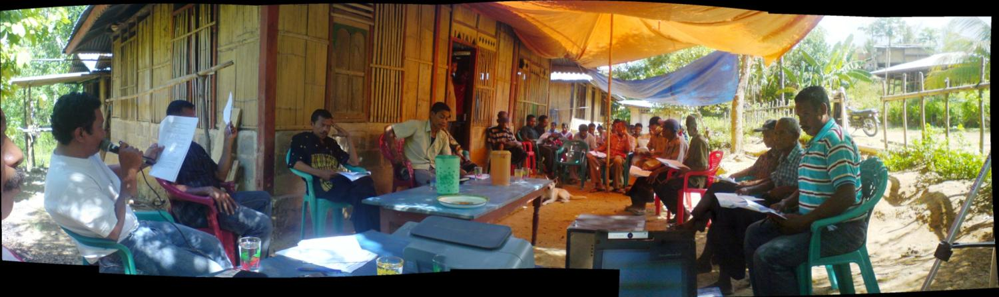
Photo Gallery
Community Discussion on “Ground Rule” – Anggaran Dasar

Slide 25
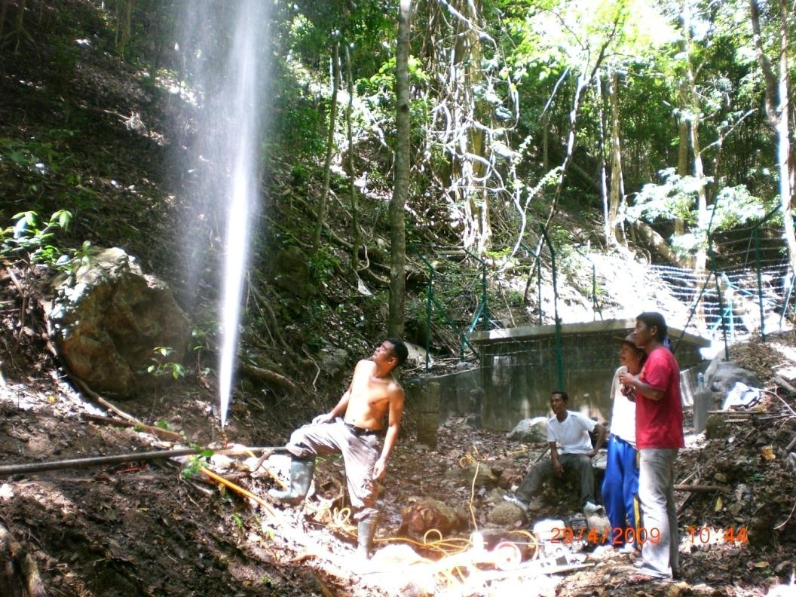
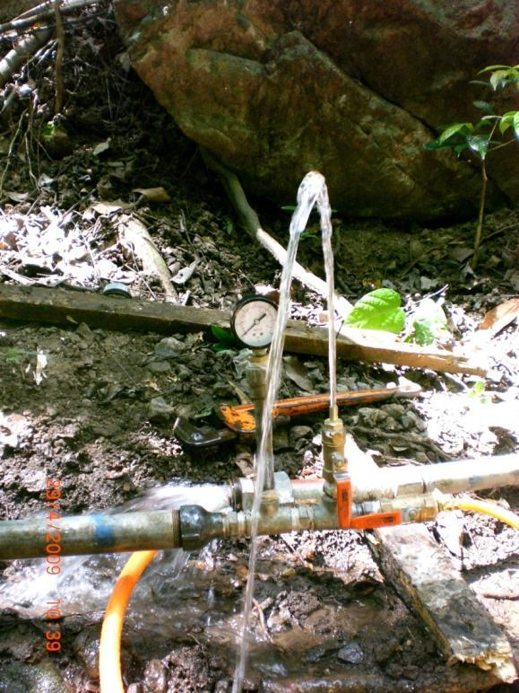
Photo Gallery
Leak Test

Slide 26
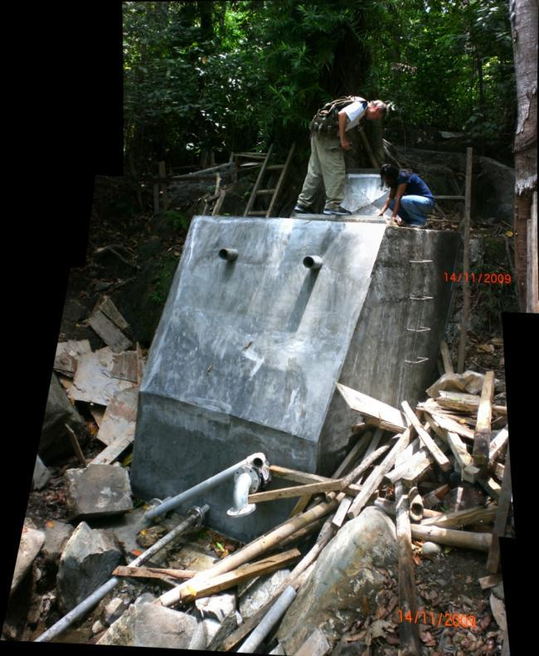
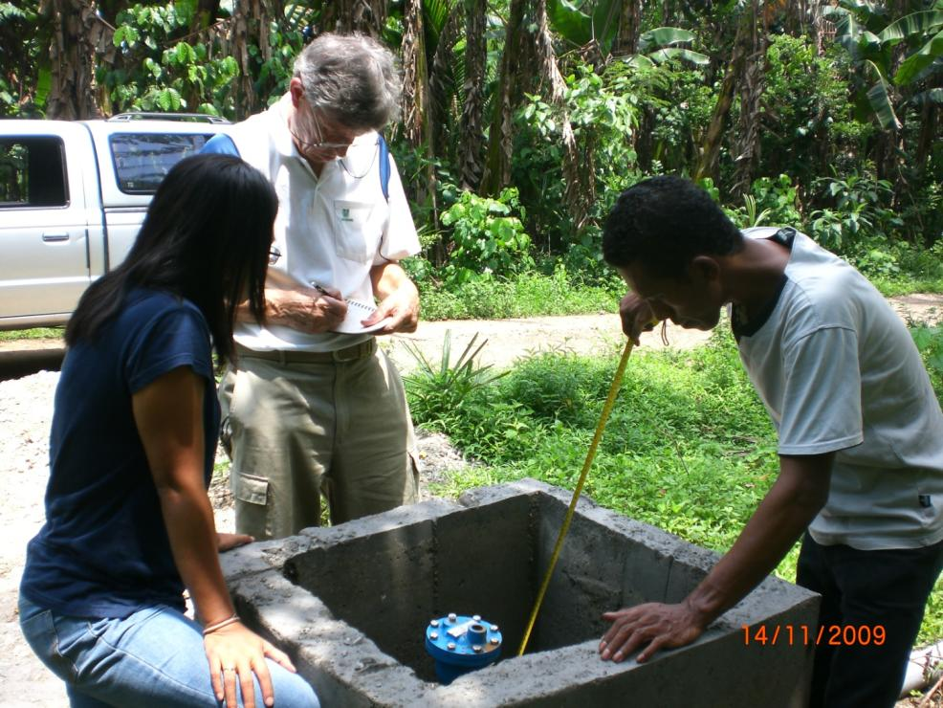
Photo Gallery
Quality Control

Slide 27
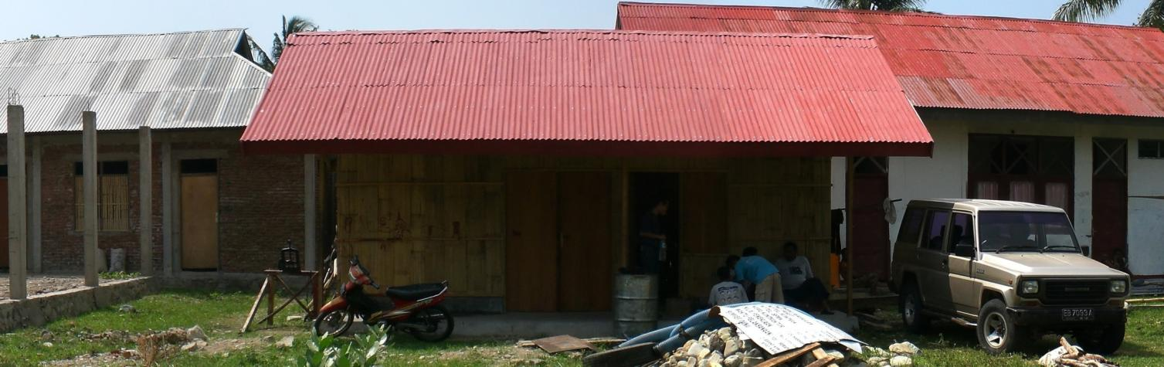
Photo Gallery
WUG (BP-SAB) Office ~ ex. Direksi Kit

Slide 28
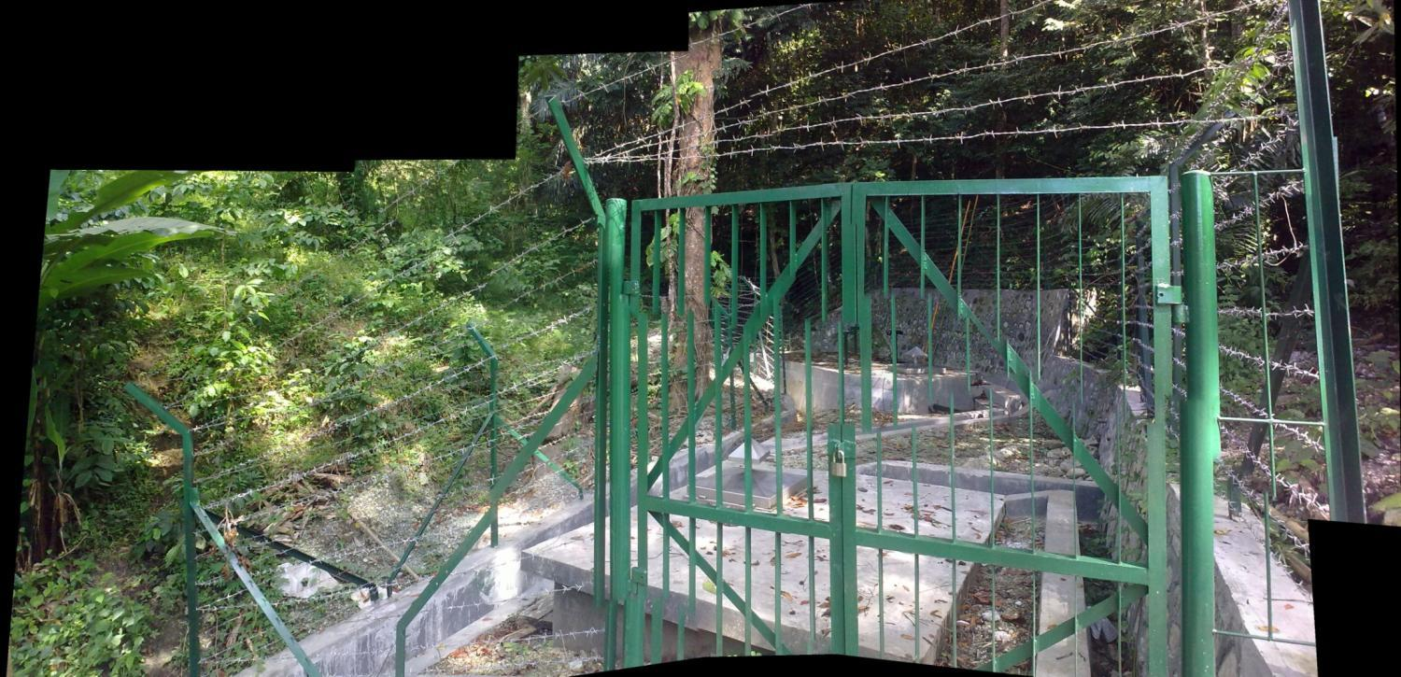
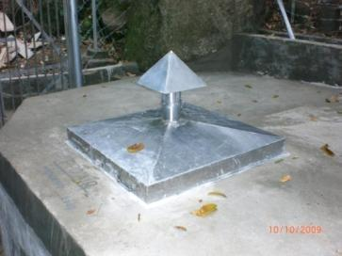
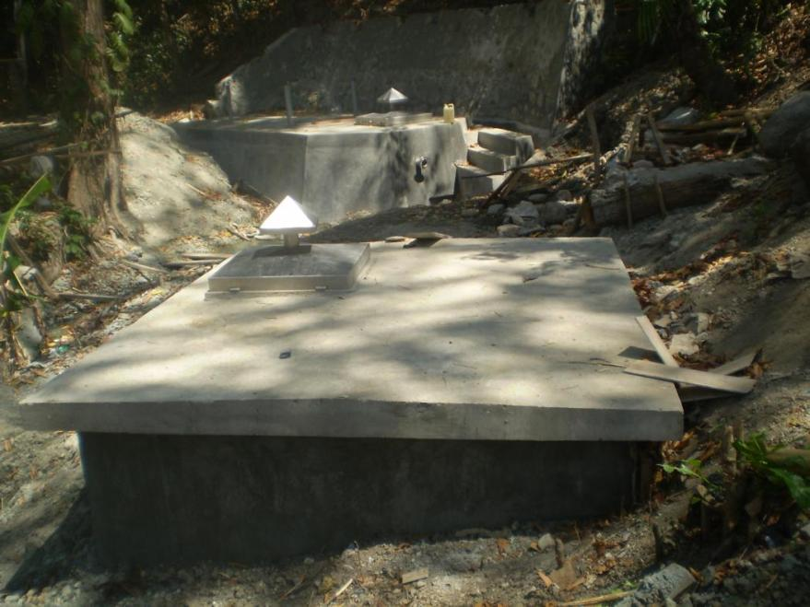
Photo Gallery
Bronkap

Slide 29
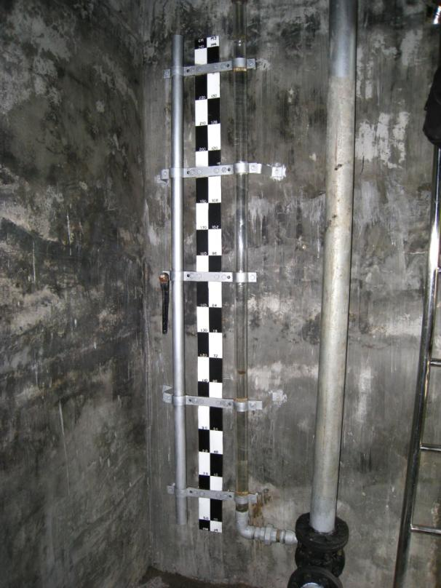
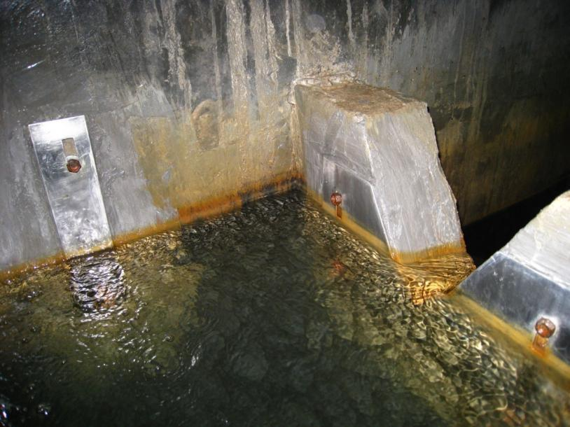
Photo Gallery
Bronkap

Slide 30
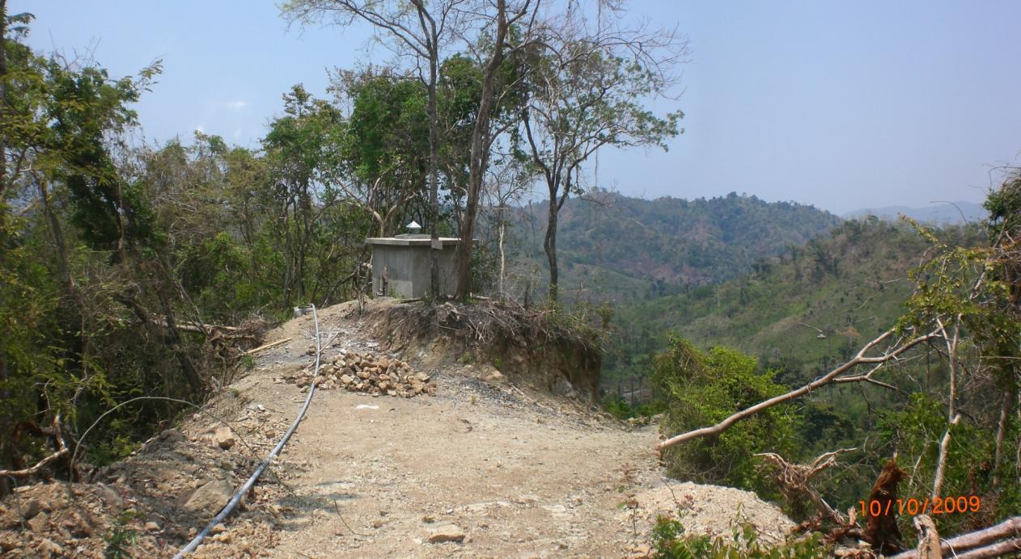
Photo Gallery
Reservoir & BPT

Slide 31
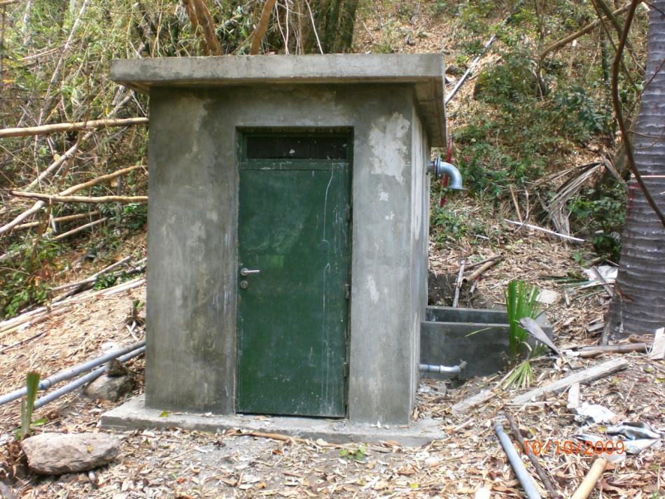
Photo Gallery
Reservoir & BPT

Slide 32
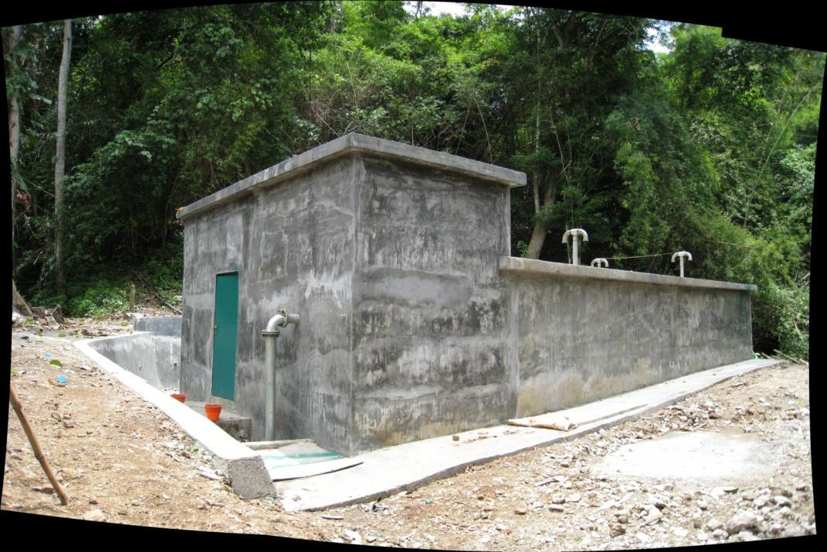
Photo Gallery
Reservoir & BPT

Slide 33
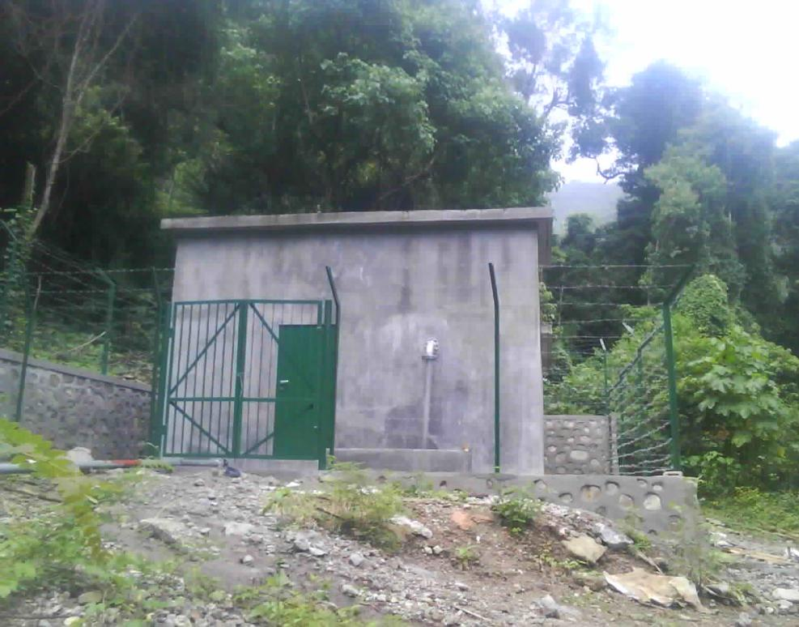
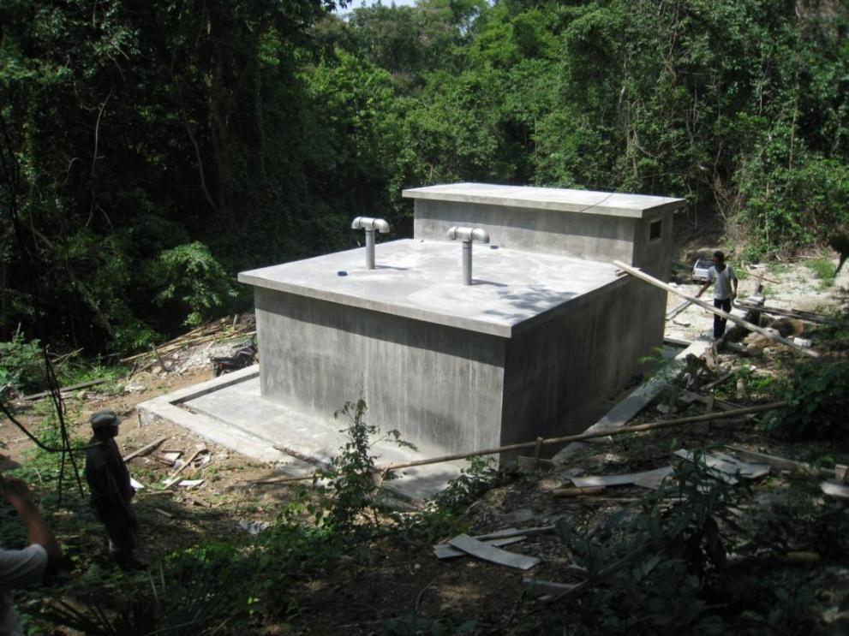
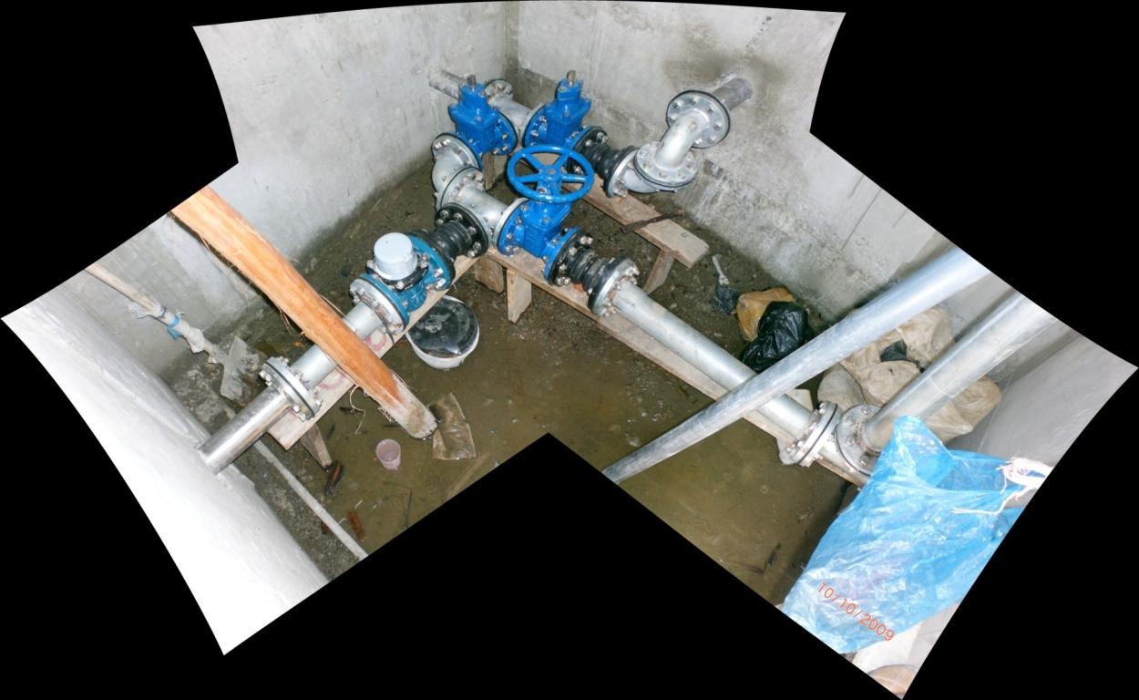
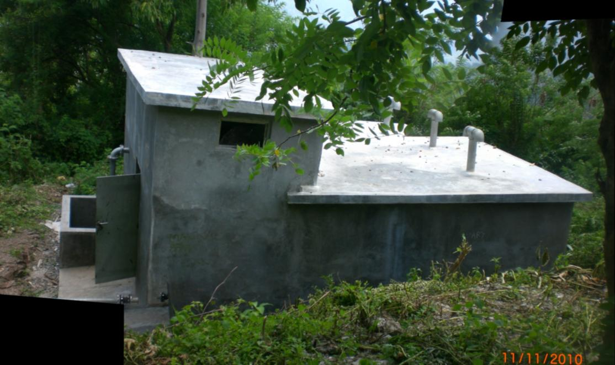
Photo Gallery
Reservoir & BPT

Slide 34
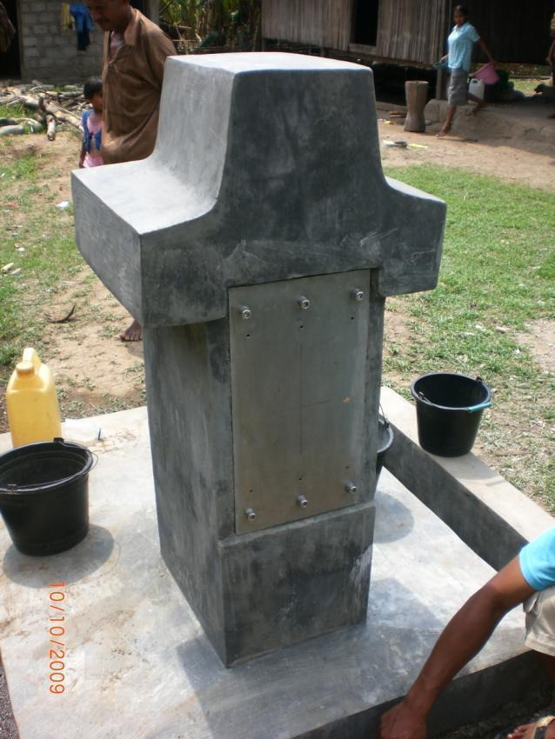
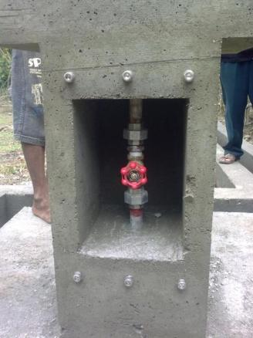
Photo Gallery
Water Tap

Slide 35
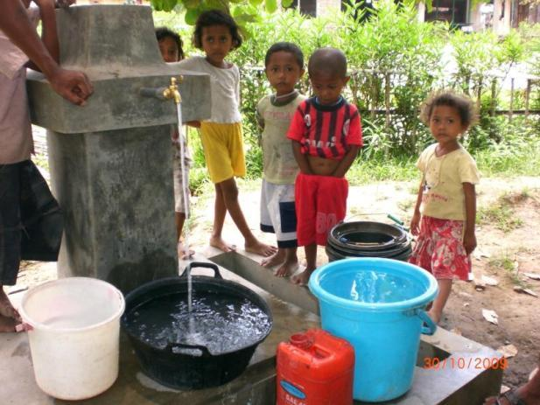
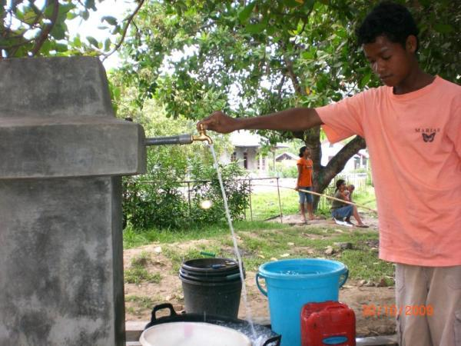
Photo Gallery
Water Tap

Slide 36
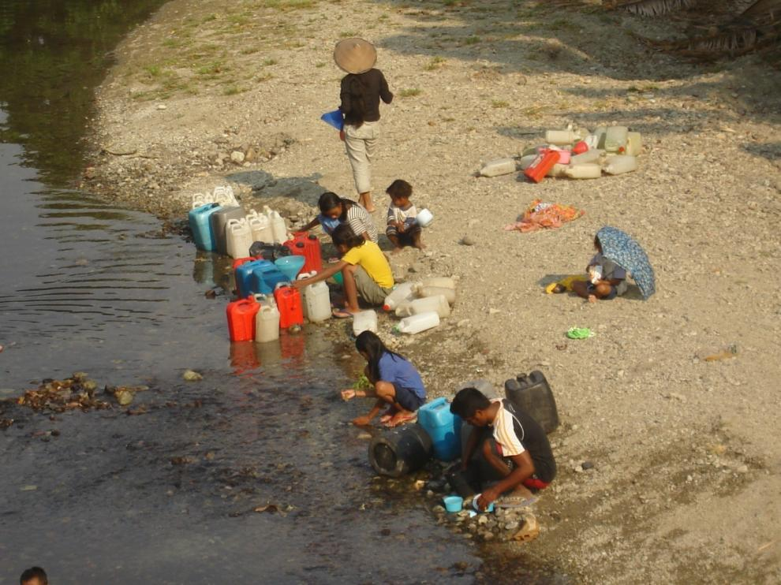
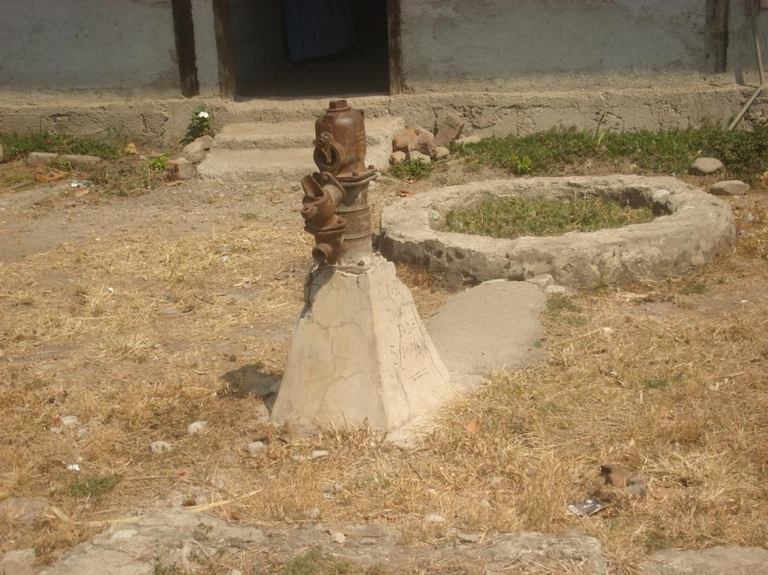

Behavior Change (before)

Slide 37





Behavior Change (after)

Slide 38
Current Status - 2014
All Water System still functioning 24/7
In Libhu System – The system with the smallest minimum springs yield:
  Expand services; 1 additional water tap in Nabe – for school & 1 additional water tap in Kobaleba village – for Puskesmas
In Koja Aje System – The Largest Multi-villages System (3 villages, 3000 capita) in Maukaro; :
  Managing 2 (two) system; ProAir & Nakertrans Water Service System
  Expanding services; several extra water taps for public uses
  Collections / Iuran still in order
  Became Good Governance example for Rural Water System Management in East Nusa Tenggara

Slide 39
Lesson Learned
Community DOES plays the most important role in building a Rural Water System
Access to water system first, only then sanitation activities can be implemented
Access to water system should be as cheap as possible, but the water system itself might be quite expensive to assure long-run low-maintenance
A water system without a good management body is a nonsense
Education background does have substantial influence during management body‘s personnel selection
Leave a Rural Water System “untouched” then it will serve a longer time
Without a sound O&M team, water system would breakdown faster
Village people is good enough to handle an O&M of a Rural Water System, it just takes a longer time for them to understand it
Education background plays important role in maintaining a sound water management body

Slide 40

Terima kasih

