Slide 1
Indrawan Prabaharyaka iprabaharyaka@gmail.com
National Water and Sanitation Working Group
Sustainability Indicators
for Community-Based Water Supply Organizations in Rural Area
Case Study: BPSPAM Demak & HIPPAM Lamongan
CRPG AIIRA Workshop, Novotel Bogor, February 8, 2015

Slide 2
Background
Kalimantan, Papua and Sumatra Islands have around 82% of the country’s total water reserves, while Java Island only holds 4% (PU, 2012). This raises the issue of water security.
Access to safe water supply in rural area (56%) is lower than rural area (79%) in which Java Island is experiencing the most rapid urbanization.
National Development Plan: universal access by virtue of piped water network.

Slide 3
Methodology
Quantitative: survey for 100 Community Based Organizations in Demak and Lamongan
Qualitative: in-depth interviews, Focus Group Discussions, participant observation, informal conversations.

Slide 4
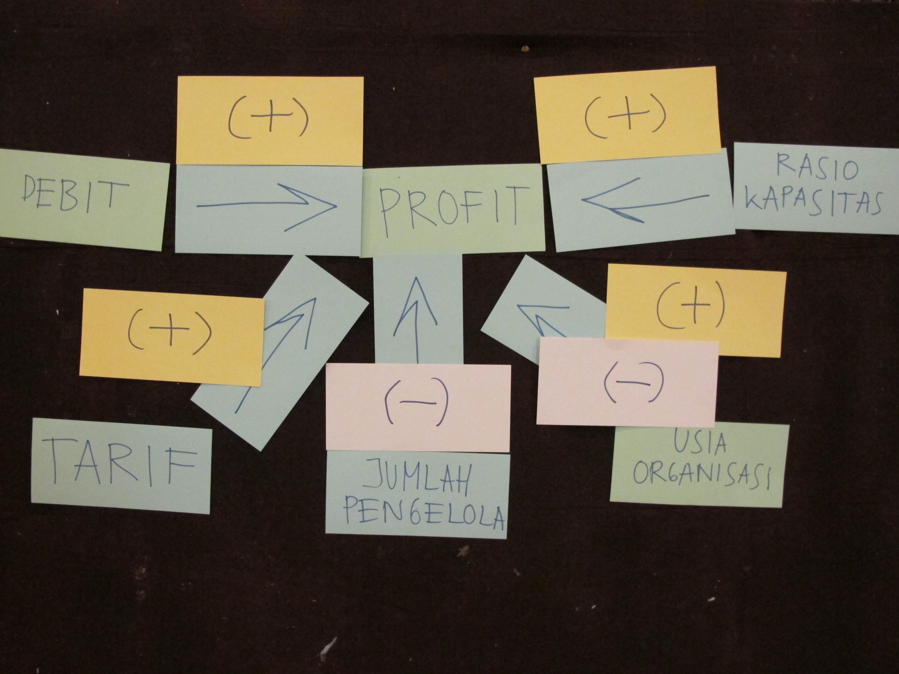

Slide 5
Reverse Onus
The institutions are dysfunctional because of two fundamental conditions: unreliable (or absence of) flow and insufficient capital

Slide 6
Reverse Onus
Unreliable (or absence of) flow forces the CBOs to adapt and mitigate:
water rationing
reduction of flow duration
renting water sources
even temporary (or permanent) total closure

Slide 7
Reverse Onus
“Renting” phenomena: HIPPAM rents surrounding wells—or pay for pumping from surface water (i.e. Bengawan Solo) to their pond or other water storages—to increase its flow during dry season (which may occur for months).

Slide 8
Reverse Onus
Insufficient capital triggers negative externality spill-over effects:
salary is sacrificed
O&M is minimized
even the personnel have to temporarily pay for O&M (nombok)
or the users have to pay more for O&M and they call it “swadaya masyarakat”
or looking for credit from third parties (village government, Association, cooperative, or private/informal money lender)

Slide 9
Flow Reliability
As time goes by, flow and or the ground water table has always been decreasing. Some reasons: increasing number of customers, aging infrastructures
Climate change highly influences flow reliability

Slide 10
Profit
BPSPAM in Demak Regency, is more profit oriented than HIPPAM in Lamongan Regency.
Some CBOs stipulate the percentage of overturn (i.e. 15%) from gross income, and the percentage for depreciation (i.e. 25%)
Meanwhile, other CBOs think that profit is enough as long as the final balance is positive—although they don’t properly calculate overturn and depreciation

Slide 11
Priority Scale: Demak
Tarif | 65
Kehandalan Debit | 64
Rasio Kapasitas | 45
Profit | 39
Usia Organisasi | 35
Jumlah Pengelola | 25
Priority Scale: Lamongan
Kehandalan Debit | 66
Tarif | 42
Rasio Kapasitas | 46
Jumlah Pengelola | 36
Usia Organisasi | 33
Profit | 29

Slide 12
Descriptive Statistics: DEMAK
 | N | Minimum | Maximum | Mean | Std. Deviation
PROFIT | 48 | -1500000.00 | 4700000.00 | 1278800 | 1.28564E6
Valid N (listwise) | 48
Descriptive Statistics: LAMONGAN
 | N | Range | Minimum | Maximum | Mean | Std. Deviation
PROFIT | 50 | 3500000.00 | .00 | 3500000.00 | 813558.0000 | 8.92810E5
Valid N (listwise) | 50

Slide 13
Capacity Ratio
Efficiency ratio as technical limitations: it is difficult to pass 90% because of competition with private wells and no additional water sources

Slide 14
Tariff
Main factor that directly influences water tariff: electricity tariff (the most sensitive element, also a cue to water-energy relationship)

Slide 15
Ratio of Personnels to Customers
Arguably 5 is enough: 1 Leader, 1 Secretary, 1 Treasure, 1 Technician, 1 Sanitarian—others are “outsourced”
There are more occasions of increasing personnel, rather than decreasing
HIPPAM with more personnel, pay less for their salary—and it is interesting to note that higher level personnel will get less salary than lower level personnel. Also, they don’t pay salary when their balance is negative.

Slide 16
Organizational Age
Liability of newness: The initial year (5 to 8 months) are critical period in organizational age. The risk of failure/mortality is the highest during this period.
Liability of adolescence: The risk of mortality will be low at first as the organization is buffered from failure due to support by external constituents and initial endowments. But when these initial resources become depleted, the mortality hazard shoots up and then declines following the liability of newness pattern.
Liability of aging: It is perceived that the organizations are more independent and able to maintain its performance.

Slide 17
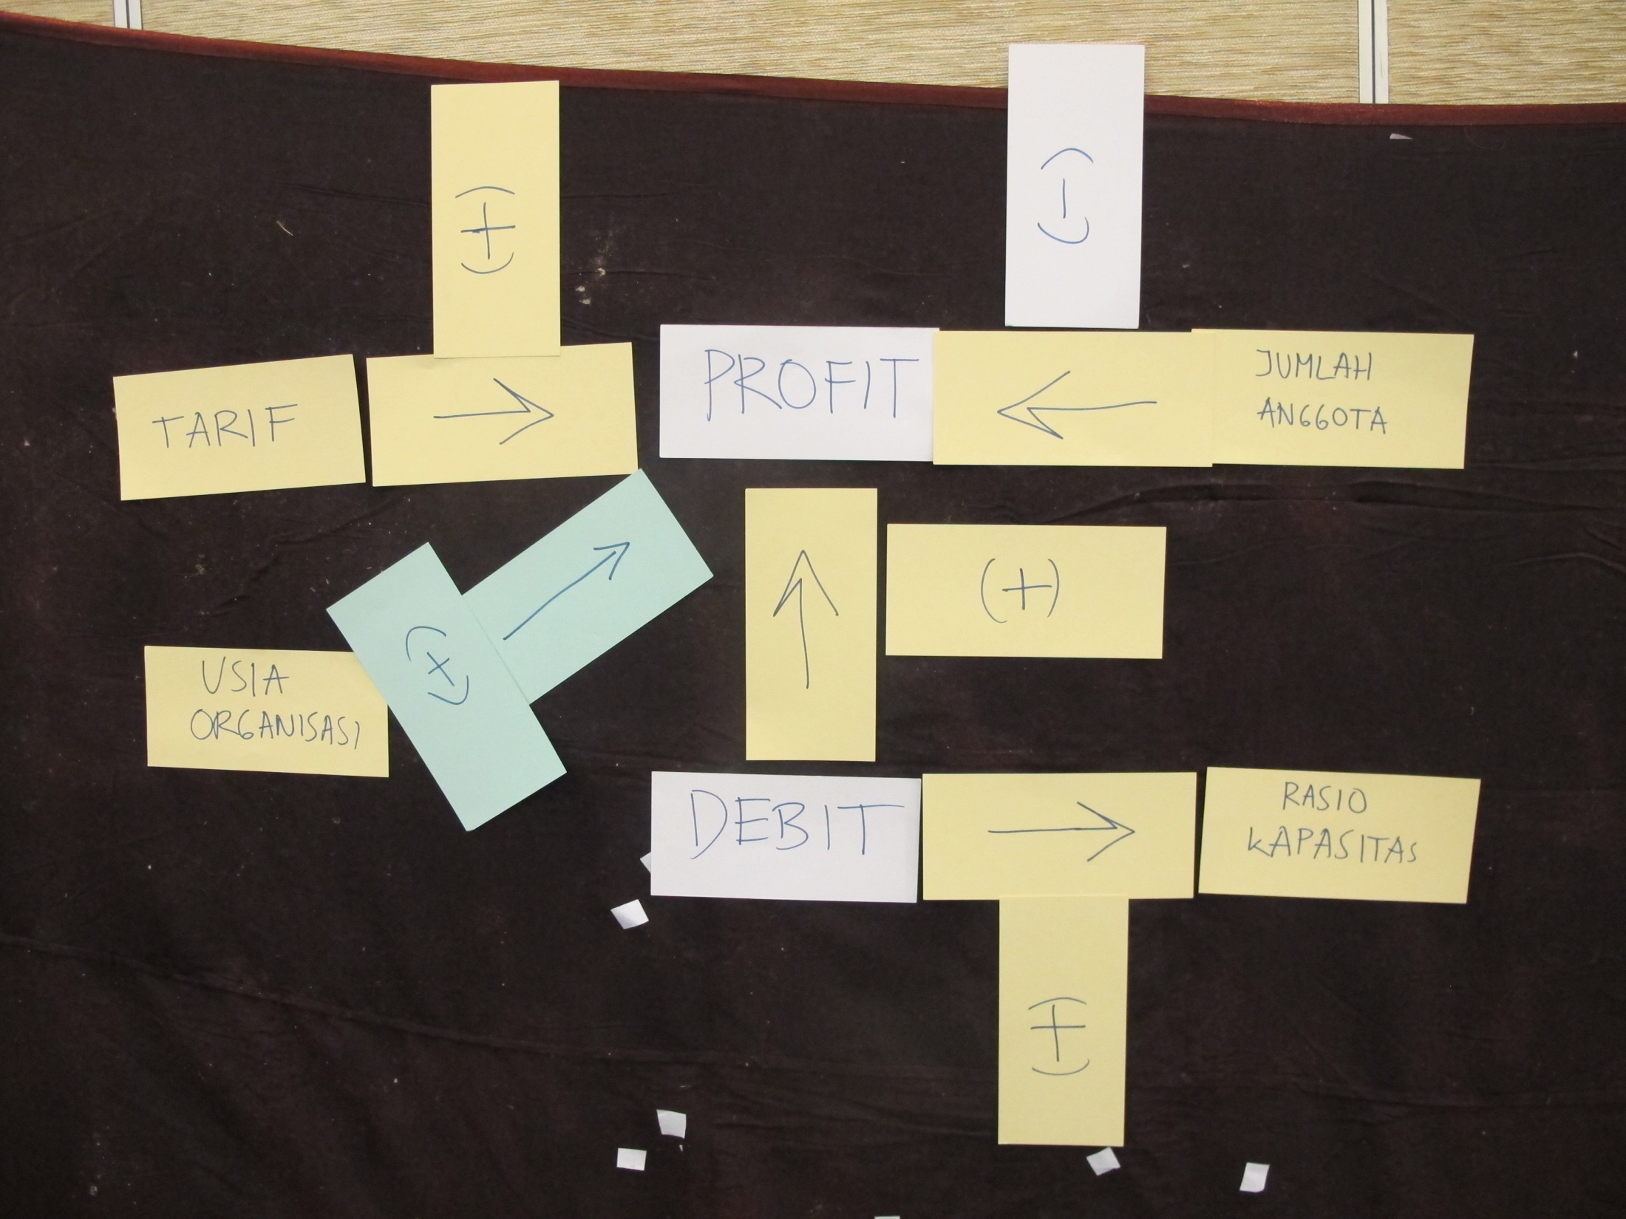
Model 1a: BPSPAM Demak
“Profit – Tariff – Flow” Triangle

Slide 18
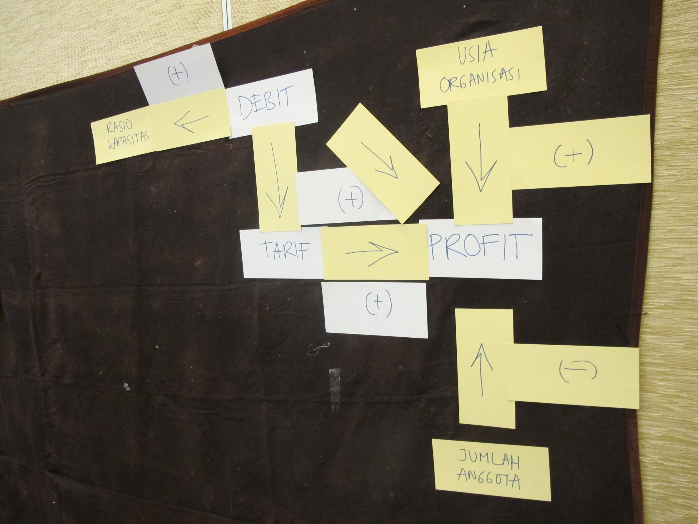
Model 1b: BPSPAM Demak
“Profit – Tariff – Flow” Triangle

Slide 19
Model 1Ia: HIPPAM Lamongan
Highly Profit Centered

Slide 20
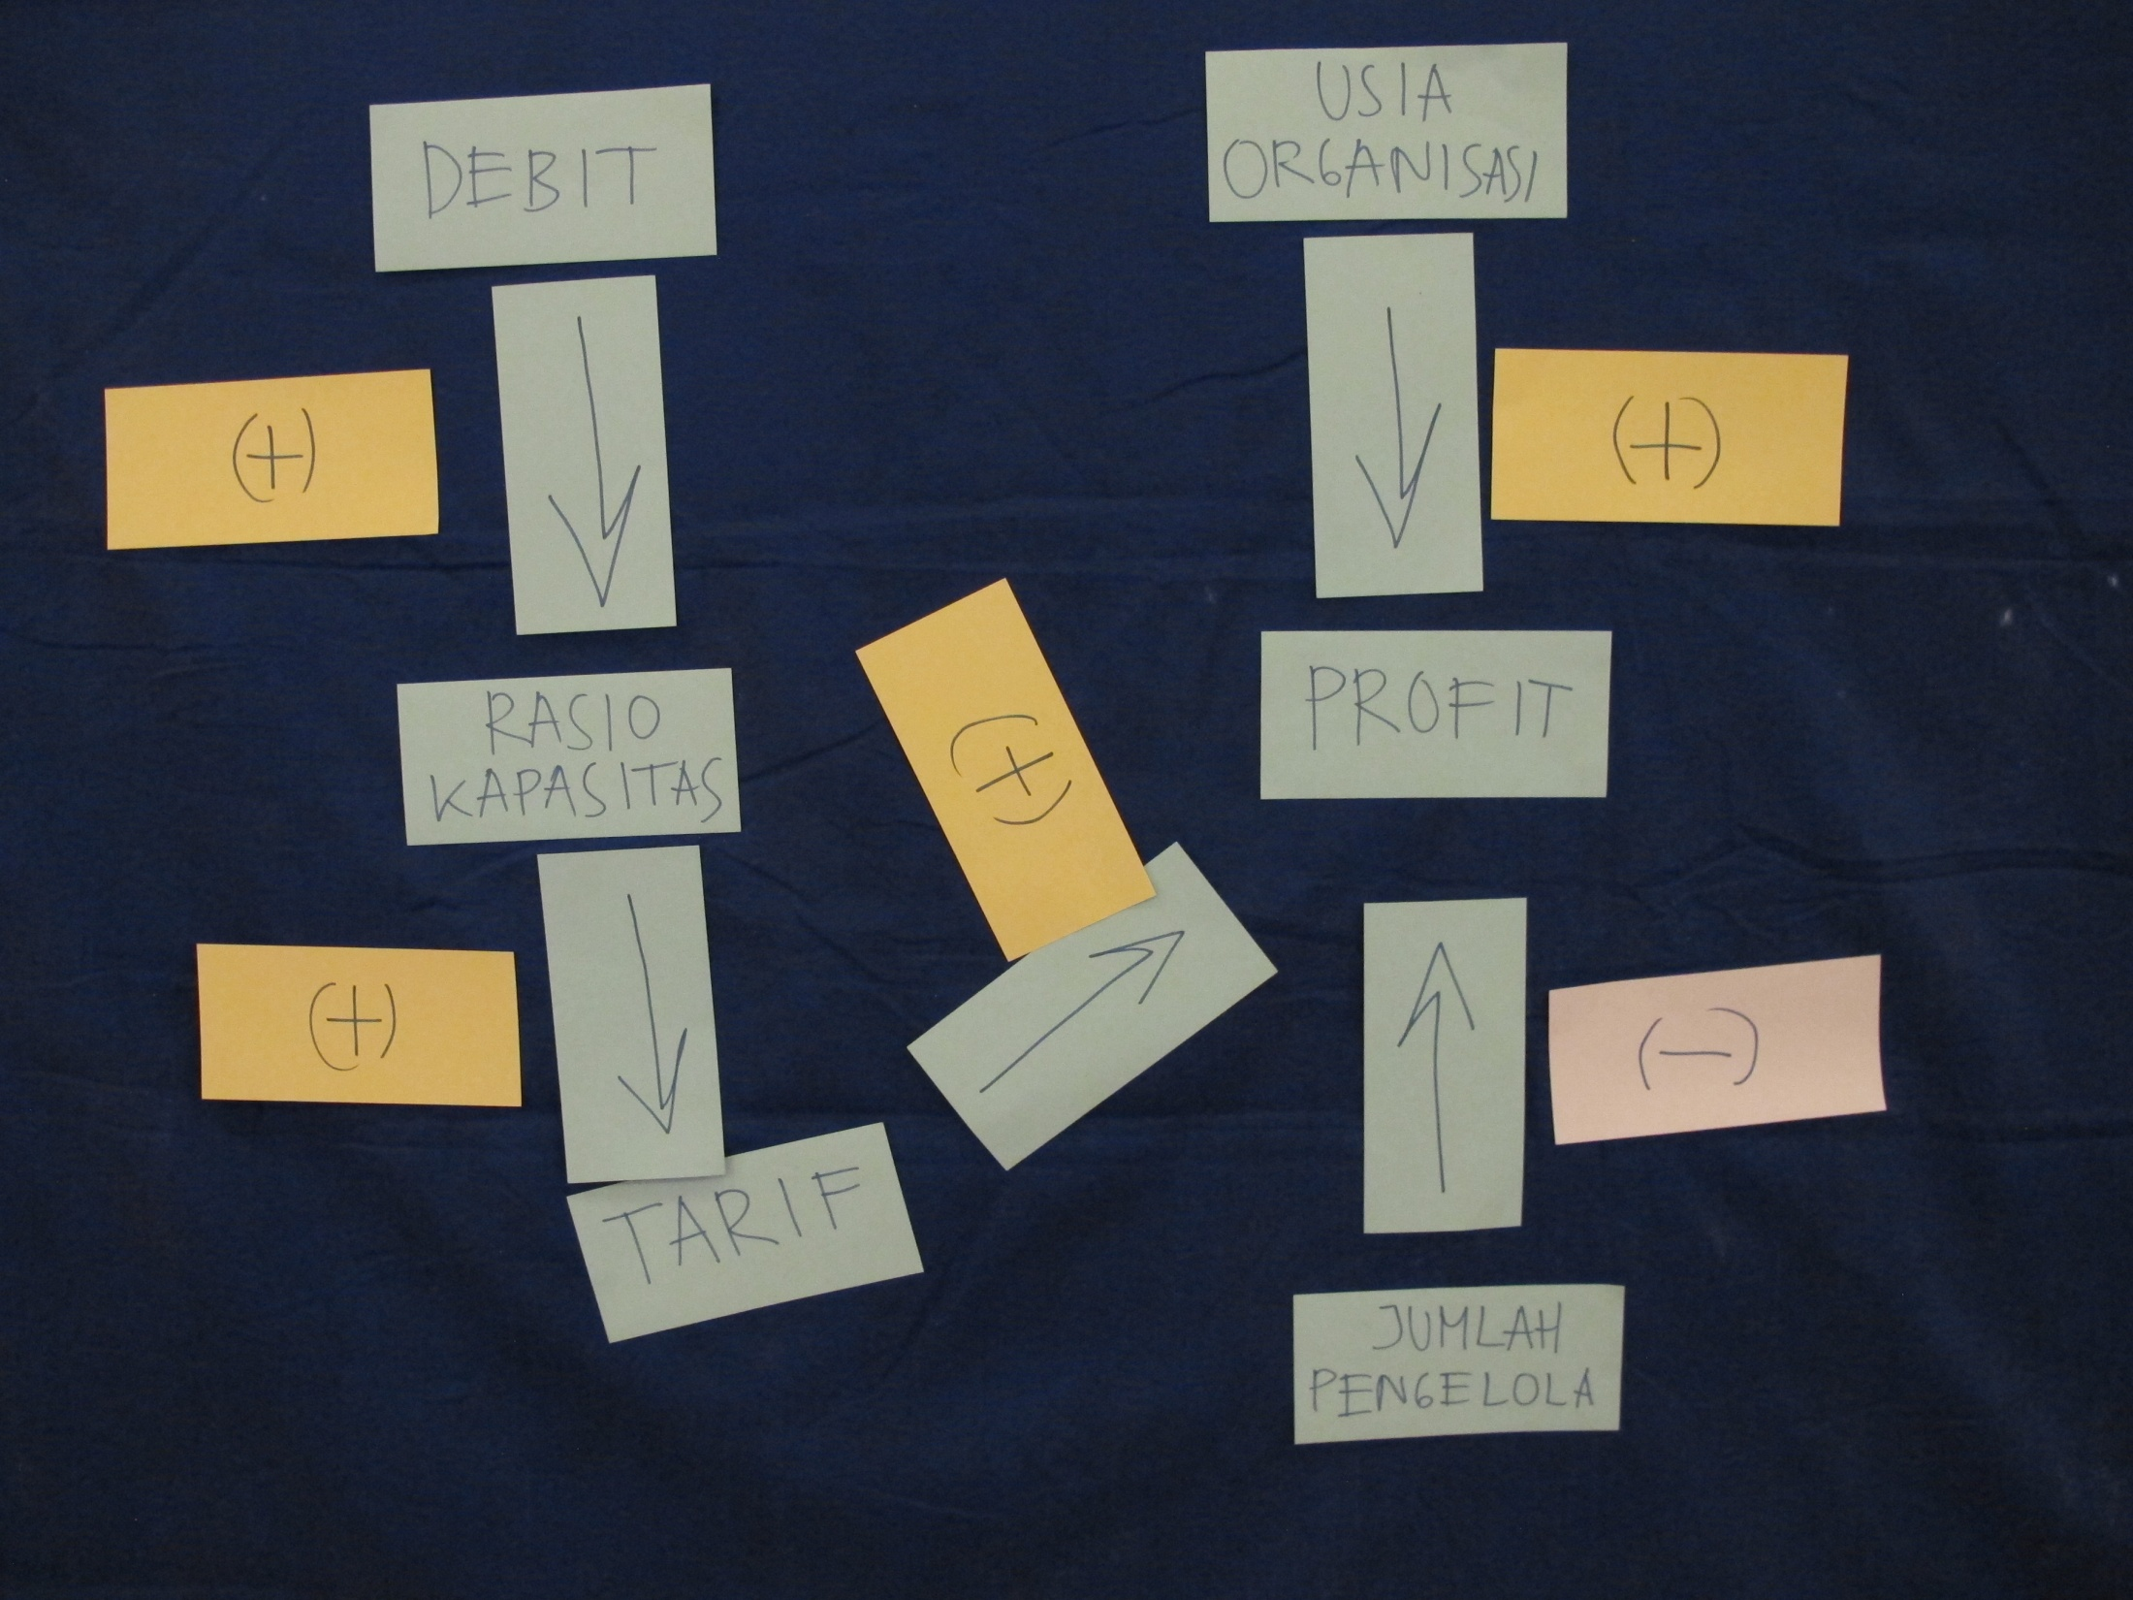
Model 1Ia: HIPPAM Lamongan
Less Profit Centered

Slide 21
Follow Up
(1) In line with the new program from the new government: construction of water reservoirs (waduk & embung) where 5% is allocated for water supply;
(2) Water harvesting as alternative water source;
(3) Integrated mapping from multiple watsan programs (PAMSIMAS, STBM, NAWASIS) to identify and register water potentials;
(4) Capacity building beyond PAMSIMAS through Association of Community-based Water Supply Organizations;
(5)Window of opportunity: watsan as one of the new government pri

